Slide 1

Navigating the Scientific Landscape: A Multi-Agent Approach to Research Synthesis
October 9th 2025
Christian Merrill

Slide 2
Agenda
Context and Foundation
Technical Foundation
Agent Systems
Content Generation
Advanced Analytics

Slide 3
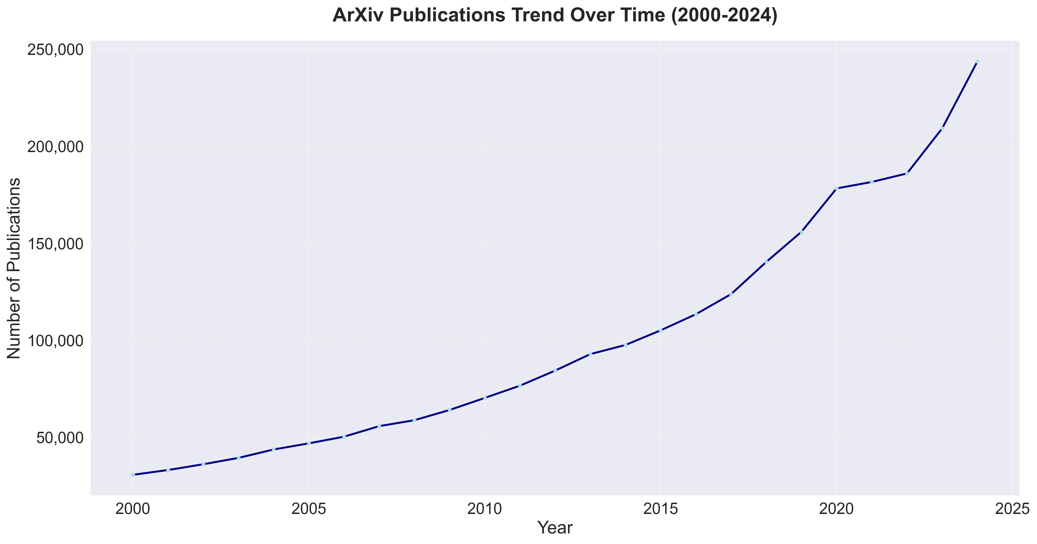
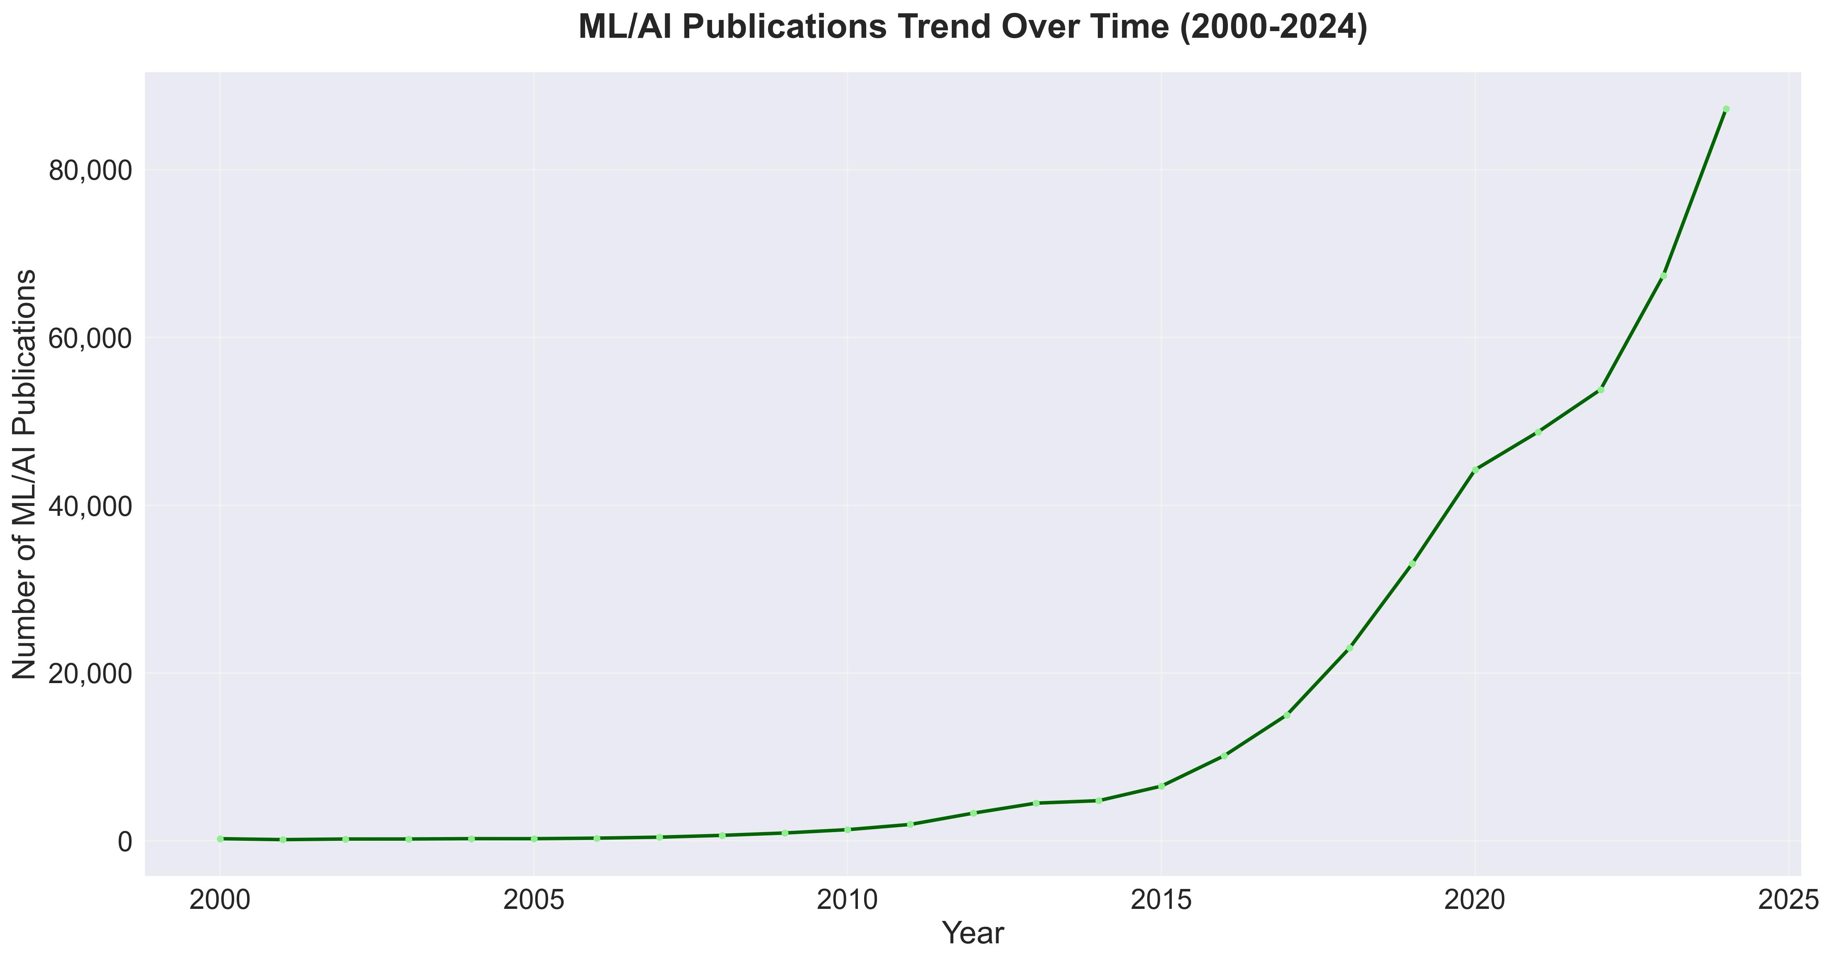
How this project started
Scientific literature is growing exponentially
2.5 million papers published annually
Doubling every 12-15 years
ArXiv alone: 80,000+ papers/year in ML/AI
Human processing capacity remains linear
Researchers can meaningfully review ~50-100 papers/month
Literature review consumes 40-60% of research time
Critical insights can be buried in information overload
Challenging to focus attention on highest value content
Project Started in 2023
Originally called PaperPal (now called Theseus Insight)
Used original LLaMA model trained on Alpaca dataset to do LLM as a judge to sort weekly papers from paperswithcode.com and send a rudimentary newsletter
Migrated to a more agentic tool in 2024-2025
Data from: https://www.kaggle.com/datasets/Cornell-University/arxiv

Slide 4
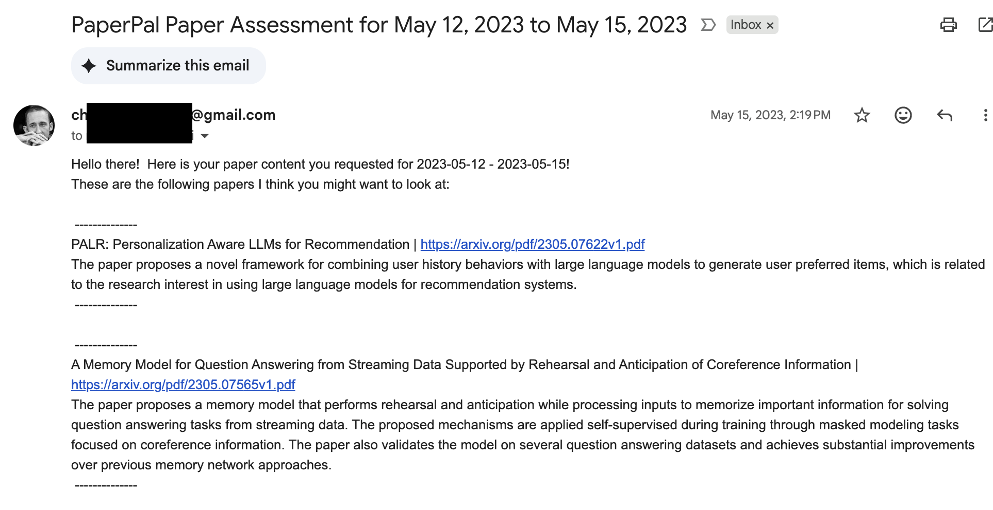
Example Rudimentary Newsletter

Slide 5
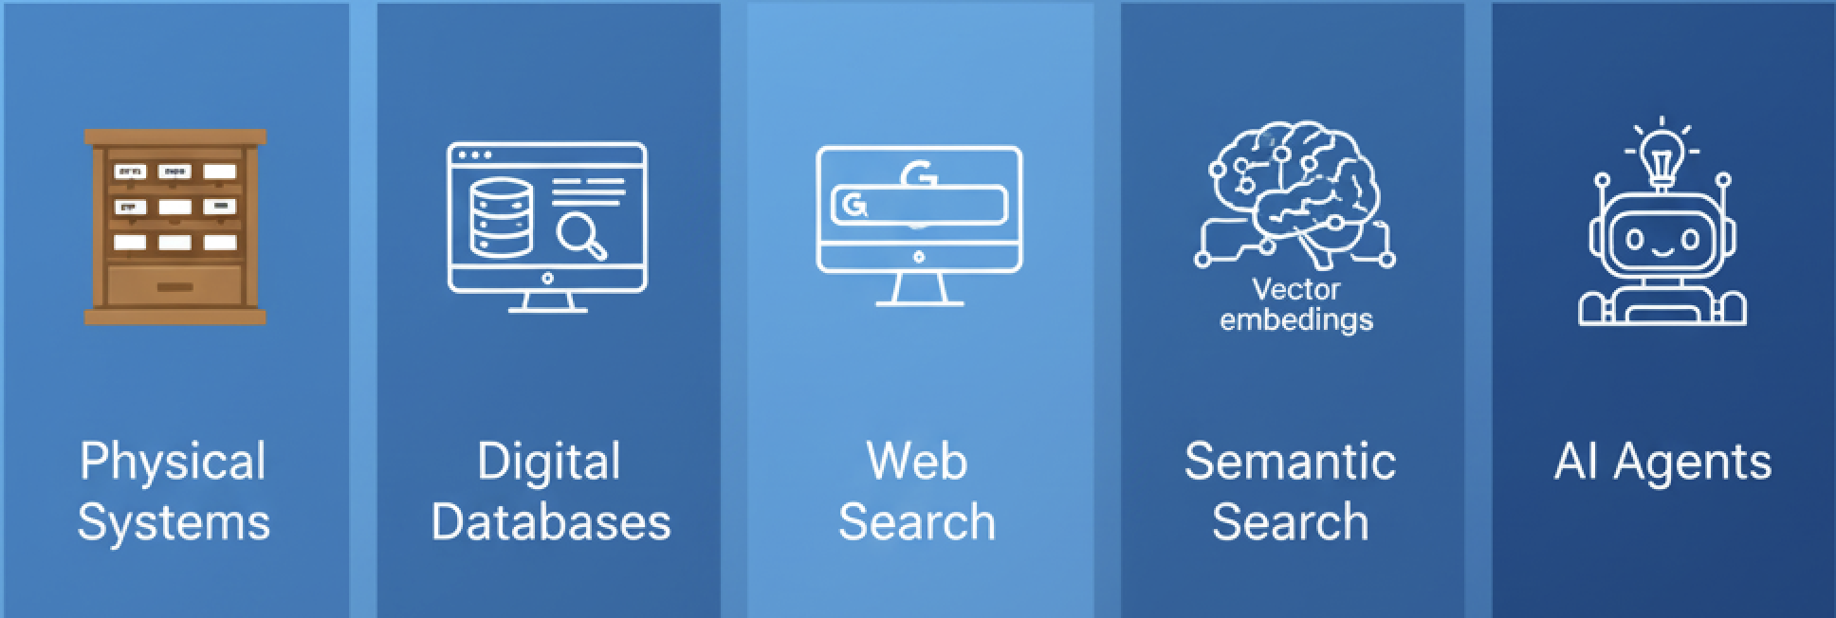
Evolution of Research Tools
Physical Systems (1900s-1980s)
Card catalogs, physical libraries
Manual indexing, limited cross-referencing
Digital Databases (1980s-2000s)
PubMed, Web of Science
Boolean search, keyword matching
Web Search (2000s-2010s)
Google Scholar, full-text search
Citation analysis, ranking algorithms
Semantic Search (2010s-2020s)
Vector embeddings, similarity matching
Still requires manual synthesis
AI Agents (Present/Emerging)
Deep Research
Autonomous analysis and synthesis
Proactive discovery and insights
Historical Evolution for Systems of Research Tools

Slide 6
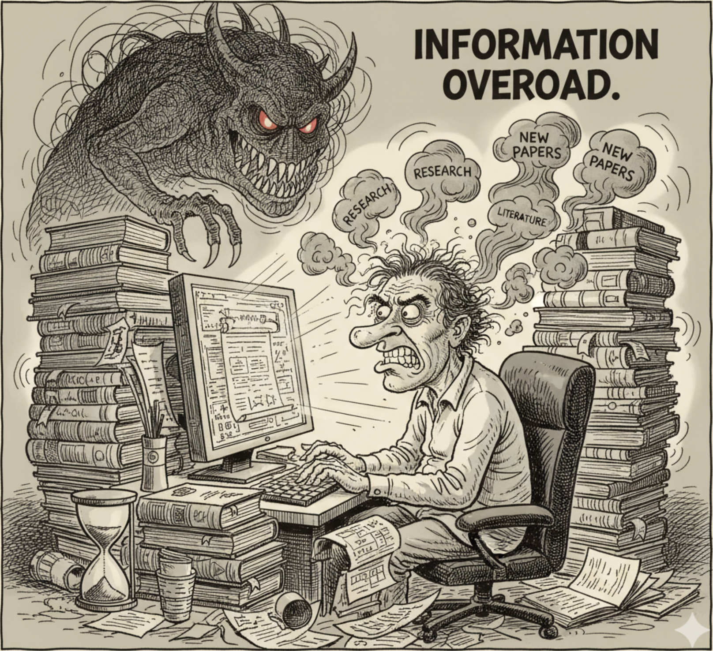
Problem Statement & Approach
The Professional Burden of Staying Current
Research literature grows faster than any individual can process
Each paper requires substantial time for thorough understanding
Citation networks create exponential reading demands
Working professionals have limited hours for literature review
The Fundamental Mismatch
Literature growth: Exponential expansion in published research
Human capacity: Linear, constrained by available time
Professional reality: Competing demands beyond research consumption
Result: Professionals inevitably fall behind current knowledge
Compounding Consequences
Miss breakthrough methods that could accelerate current projects
Duplicate existing solutions unknowingly
Unable to identify emerging opportunities early
Strategic decisions based on incomplete knowledge
Agent-Based Solution:
Automated Monitoring: Agents continuously scan and curate literature
Intelligent Synthesis: Multi-perspective analysis dramatically reduces review time
Proactive Discovery: Surface relevant connections before manual search
Strategic Intelligence: Identify emerging trends to inform research direction

Slide 7
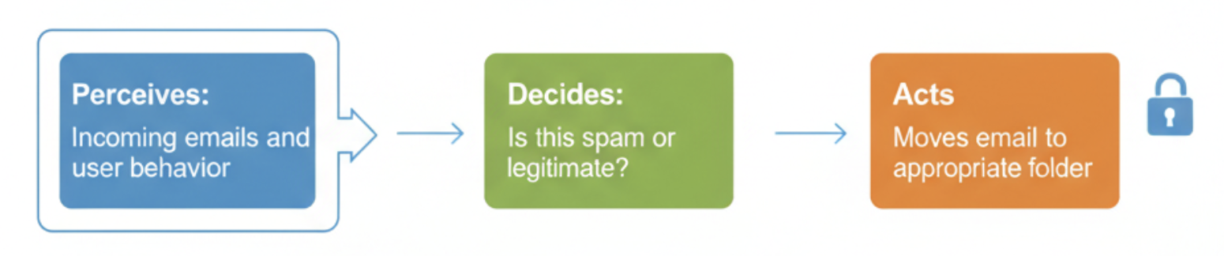
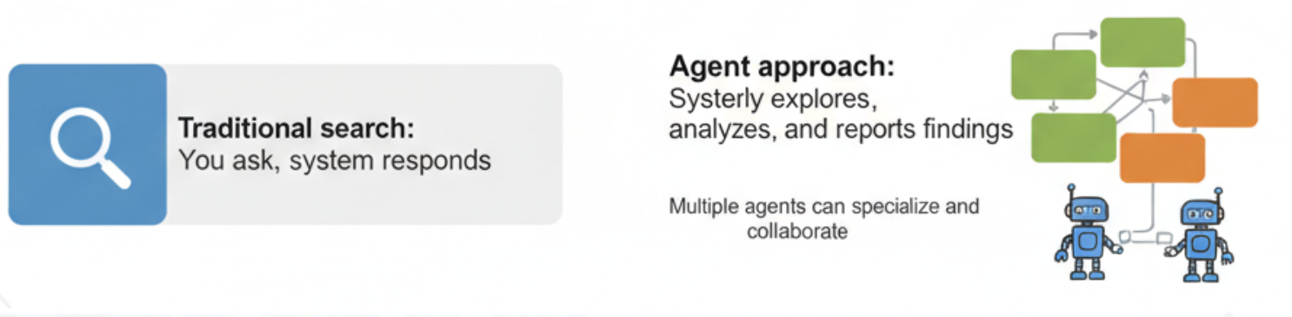
A (Very) Brief Introduction to Agents
The Four Essential Properties:
Autonomy: Makes decisions independently
Perception: Gathers information from its environment
Action: Takes steps to achieve goals
Goal-oriented: Works toward specific objectives
Simple Example - Email Filter Agent
Perceives: Incoming emails and user behavior
Decides: Is this spam or legitimate?
Acts: Moves email to appropriate folder
Research Context
Traditional search: You ask, system responds
Agent approach: System actively explores, analyzes, and reports findings
Multiple agents can specialize and collaborate
Email Classification Agent
Research Example
Agent Approach:
Systematically Explores, analyzes, and reports findings

Slide 8
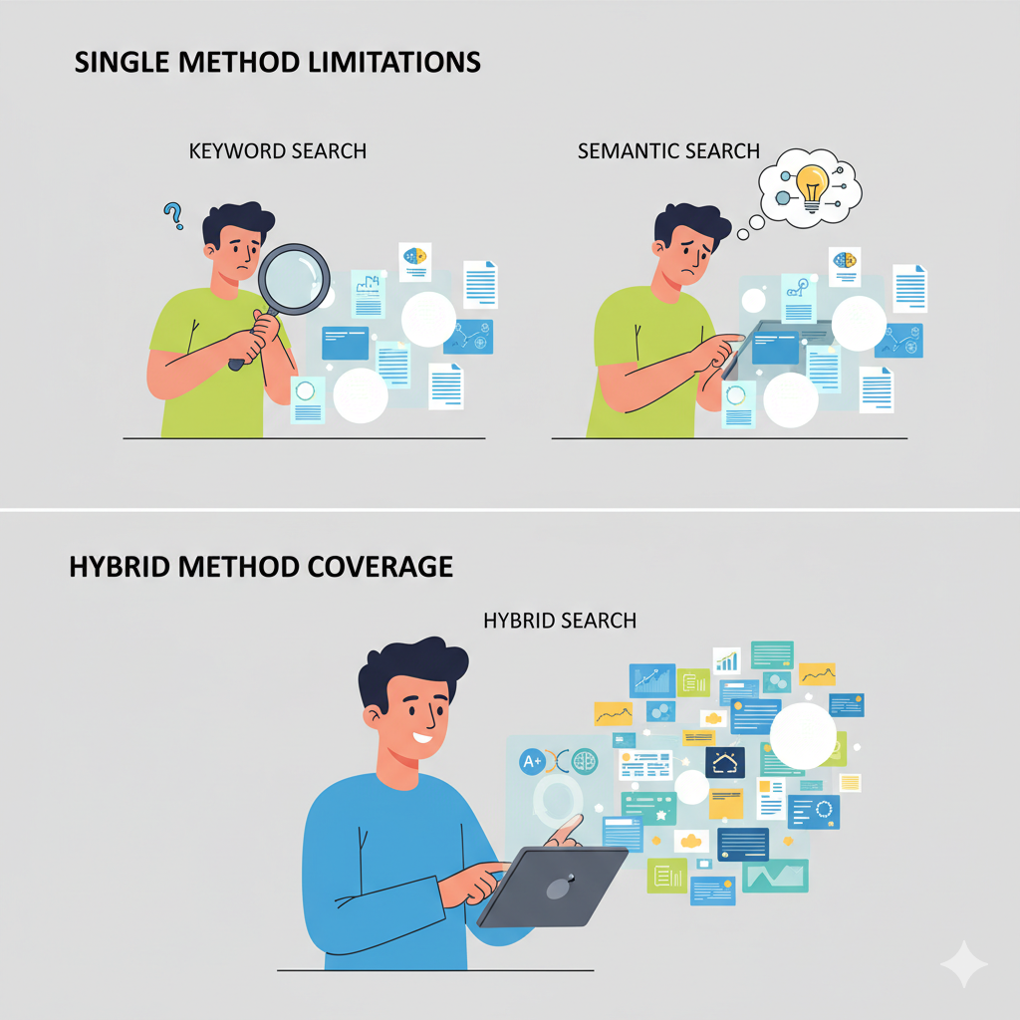
Information Retrieval (Search)
Information Retrieval - Hybrid Search
Combines keyword matching with semantic similarity search
Runs both methods simultaneously on every query
Produces unified rankings through weighted score combination
Keyword Search Component
Traditional exact-match search for specific terminology
Fast and precise when you know the right terms
Misses papers using different vocabulary for same concepts
Semantic Search Component
Finds papers based on conceptual similarity rather than word matching
Discovers research using different terminology but similar meaning
Can be less precise for exact technical term searches
Combined Approach Benefits
Addresses vocabulary mismatch problem in academic literature
Maintains precision of keyword matching
Adds discovery power of semantic understanding
Improves overall search completeness and relevance

Slide 9
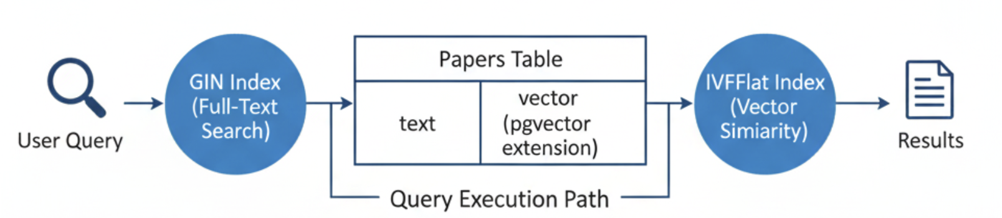
Database Architecture
PostgreSQL as Foundation
ACID compliance for data integrity
Concurrent access for multiple users
Mature query optimization
pgvector Extension Benefits
Native vector operations in SQL
Indexed similarity search (IVFFlat algorithm)
Scales to millions of papers efficiently
Index Strategy
Generalized Inverted Index (GIN) indexes for full-text search
Inverted File with Flat compression (IVFFlat) indexes for vector similarity
Composite indexes for common query patterns
Performance Characteristics
Sub-second search on 100K+ paper collections
Linear scaling with proper indexing
Memory-efficient vector storage
Improves overall search completeness and relevance

Slide 10
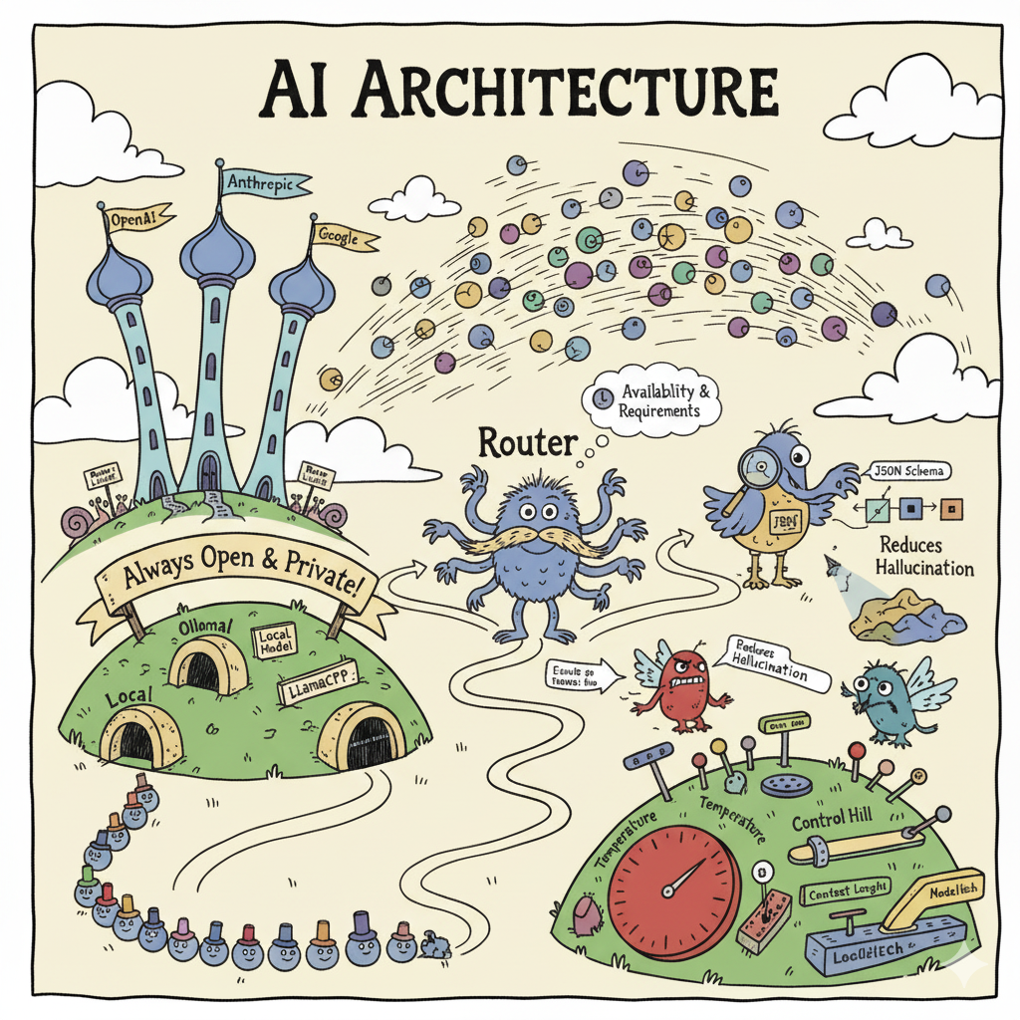
Model Integration and Design Decisions
Multi-Provider Architecture Cloud APIs:
OpenAI, Anthropic, Google (high quality, rate limited)
Local Models:
Ollama, LlamaCPP, Custom OAI (private, unlimited usage)
Automatic Routing
Based on availability and requirements
Structured Output Support
JSON schema enforcement for compatible providers
Automatic fallback parsing for others
Reduces hallucination and improves reliability
Resource Management
Sequential queuing for local models (prevents conflicts)
Concurrent execution for cloud APIs
Rate limiting and error handling
Configuration Flexibility
Model-specific parameters (temperature, context length)
Provider-specific optimizations
Runtime model switching

Slide 11
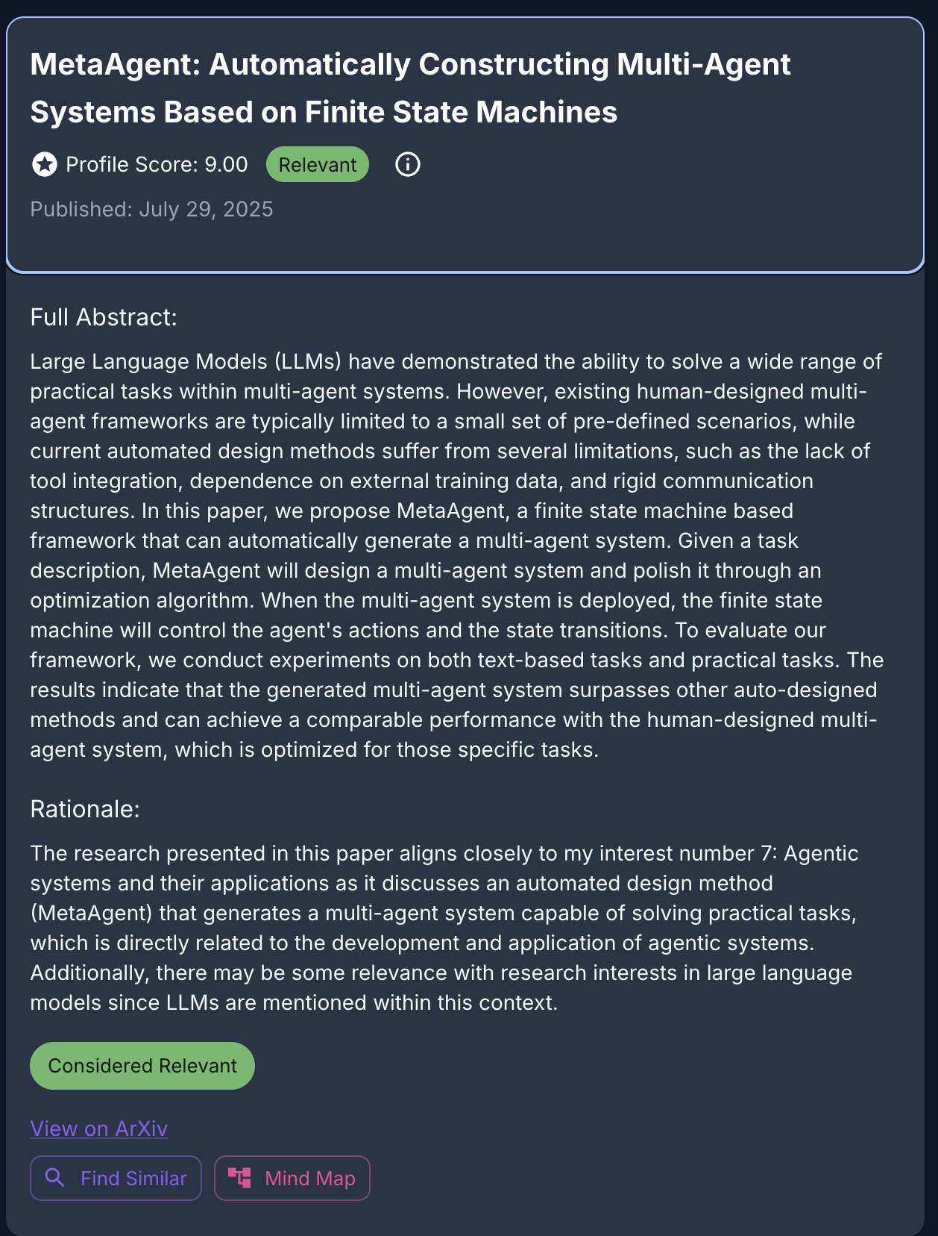
Quality Control & Filtering
Relevance Scoring System
Semantic similarity matching against research interests (threshold-based quality gate)
LLM as a judge with rubric for determining relevance scoring and rationale for score.
Research Interest Integration
User-defined interest profiles for personalization
Multi-profile support for collaborative teams
Dynamic interest learning from user feedback

Slide 12
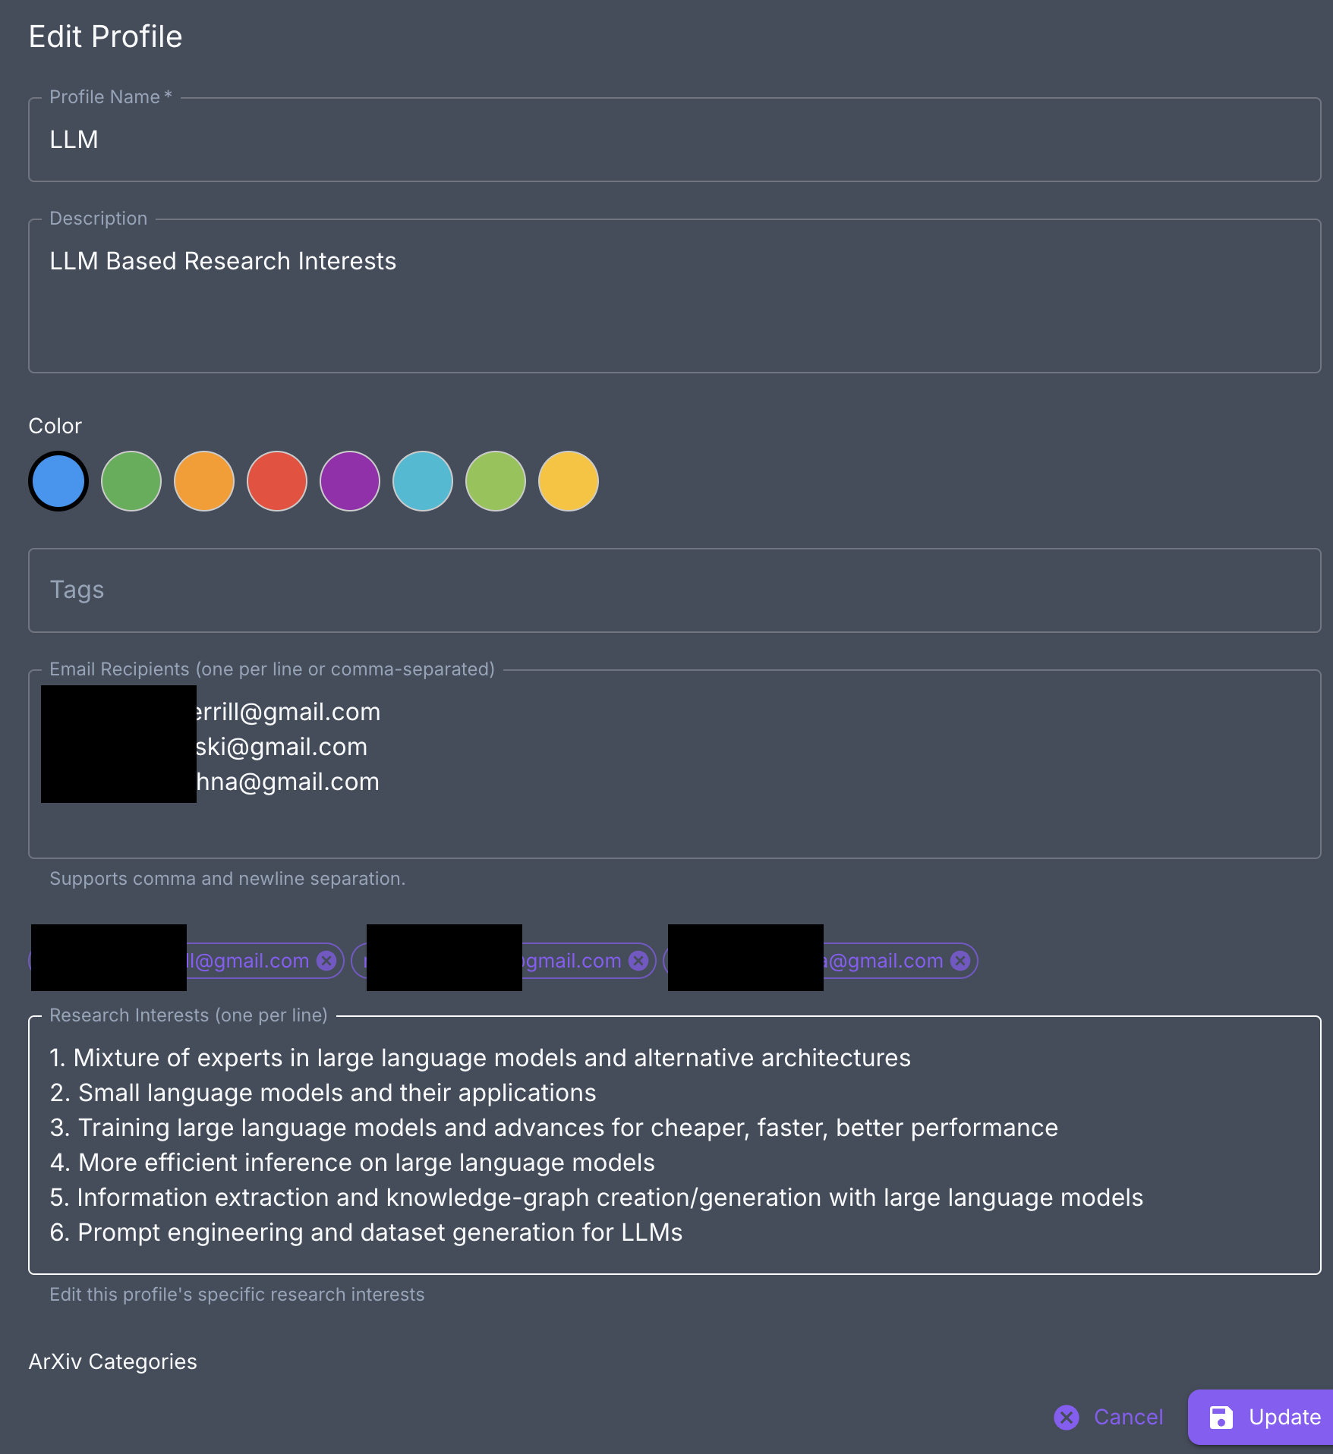
Personalization Framework
Multi-Profile System
Individual researcher profiles with custom interests or multiple profiles per user
Profiles configurable in natural language
Filtering configurable at profile level
Configuration Management
Flexible interest weighting and priority setting
Custom content formats and delivery schedules
Can schedule ingestion, content generation, etc.

Slide 13
System Architecture – Content Curation and Creation
Data Loader
Embedding Model
Yes
LLM Judge
Yes
Summarizer
Cutoff
Recommend
No
Author
Postgres DB
Email

Slide 14
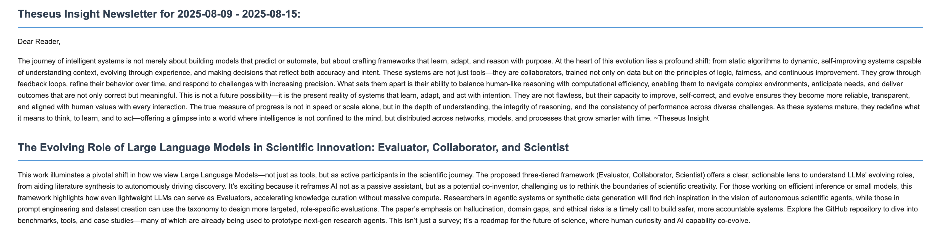
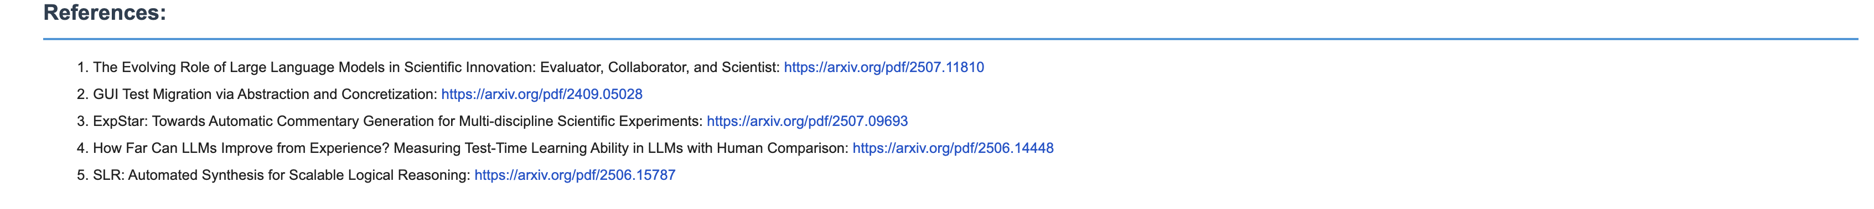
…

Slide 15
System Architecture – Research Agents Single Agent
User Query
Query Planner
Query Planner: Primary orchestrating model that can handle all workflow nodes
Node-Specific Models: Optional specialized models for specific workflow steps
Iterative Research: Multiple research loops with evidence accumulation
Adaptive Compression: Automatic context compression when token budgets are exceeded
Context Management: Intelligent handling of large evidence sets
Search
Research Loop
Evidence Selector
Compressor
Author
Final Answer

Slide 16
System Architecture – Research Agents Multi Agent
Research Agent: Comprehensive information gathering and foundational research
Focus: Breadth of coverage, primary source identification
Strategy: Broad comprehensive search with emphasis on authoritative sources
Analysis Agent: Deep analytical insights and pattern recognition
Focus: Trends, contradictions, methodological analysis
Strategy: Targeted analytical search with emphasis on comparative studies
Verification Agent: Fact-checking and source validation
Focus: Accuracy, credibility, cross-validation
Strategy: Verification-focused search with emphasis on authoritative sources
Contrarian Agent: Contrarian views and edge cases
Focus: Alternative viewpoints, limitations, criticisms
Strategy: Alternative-seeking search with emphasis on diverse perspectives
User Query
Question Generator
Parallel Agent Execution
Research Agent
Analysis Agent
Verification Agent
Contrarian Agent
Synthesis Agent
Final Answer

Slide 17
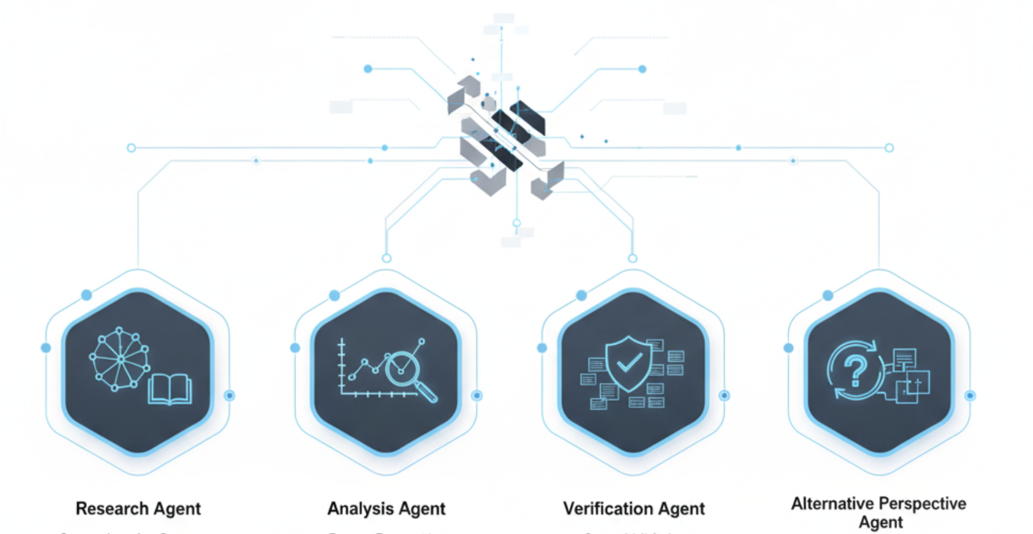
Agent Specialization Strategies
Research Agent Focus
Comprehensive literature coverage prioritizing breadth
Authoritative source identification and primary research
Foundation building for other agents to build upon
Analysis Agent Focus
Methodological analysis and comparative studies
Trend identification and pattern recognition
Technical deep-dives and implementation details
Verification Agent Focus
Cross-validation of claims across multiple sources
Source credibility assessment and bias detection
Fact-checking and accuracy validation
Alternative Perspective Agent Focus
Contrarian viewpoints and dissenting opinions
Limitation identification and critical assessment
Edge cases and alternative interpretations
Search Strategy Differentiation
Each agent uses tailored search terms and filters
Different emphasis on recency vs authority vs coverage
Specialized evaluation criteria for source selection

Slide 18
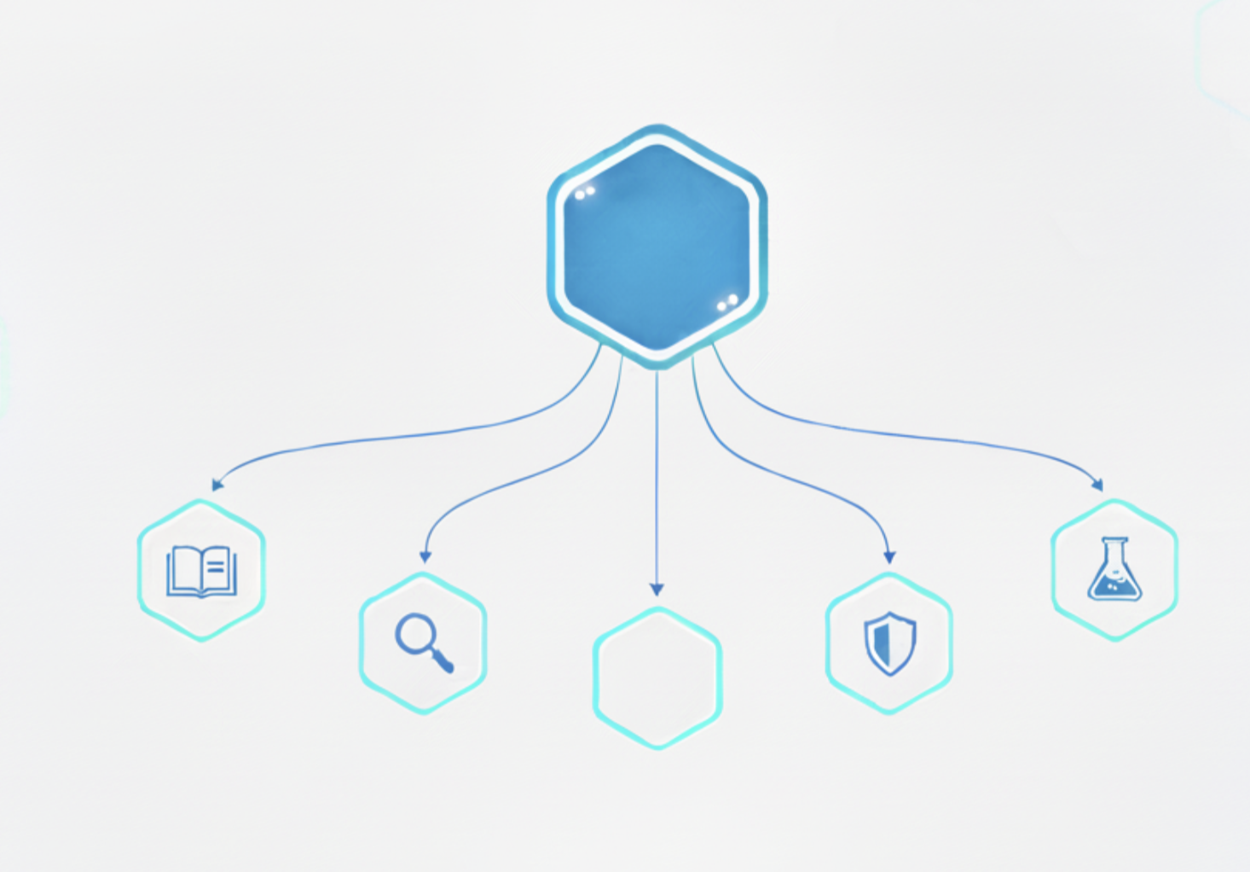

Question Decomposition Process (Query Expansion)
Intelligent Question Breaking
AI analyzes complex research questions for key components
Identifies different angles and perspectives needed
Generates 4-6 specialized sub-questions for parallel investigation
Question Type Examples
Original: "What are the latest developments in transformer architectures?”
Research: "What new transformer variants and improvements have been proposed?"
Analysis: "How do recent transformer innovations compare to existing architectures?”
Verification: "What empirical evidence supports these new transformer approaches?”
Alternative: "What are the limitations and computational challenges of these new methods?"
Quality Assurance
Ensures sub-questions cover different aspects of original question
Prevents excessive overlap between agent assignments
Validates that sub-questions are answerable and specific
Adaptive Complexity
Simple questions may use fewer agents
Complex questions get more specialized decomposition
Question difficulty determines resource allocation
?
Original Question
research
synthesize
analyze
alternative
verify

Slide 19
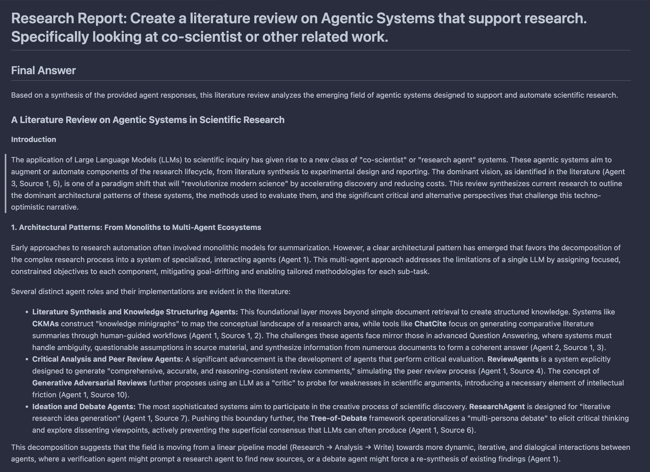

Slide 20
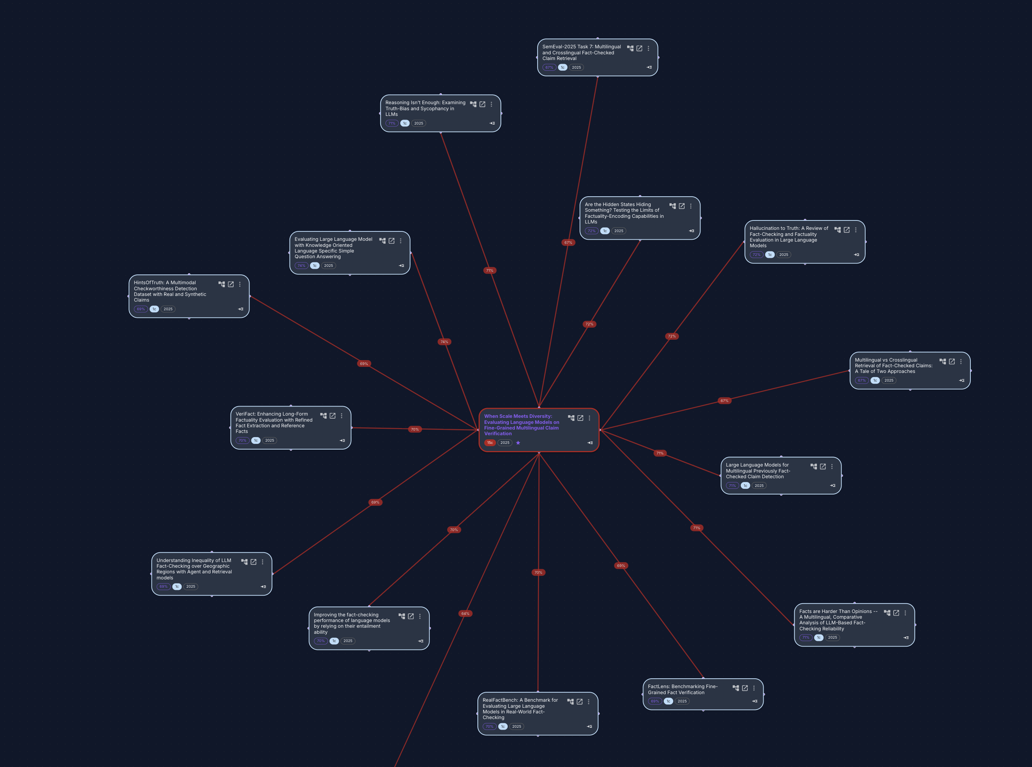
Network Analysis & Visualization
Semantic Similarity Networks
Paper-to-paper relationship mapping based on content similarity
Multi-order relationship exploration
Dynamic network visualization with interactive exploration
Interactive Exploration Tools
Zoom and filter capabilities for large networks
Color coded relationship strength
Export capabilities for further analysis

Slide 21
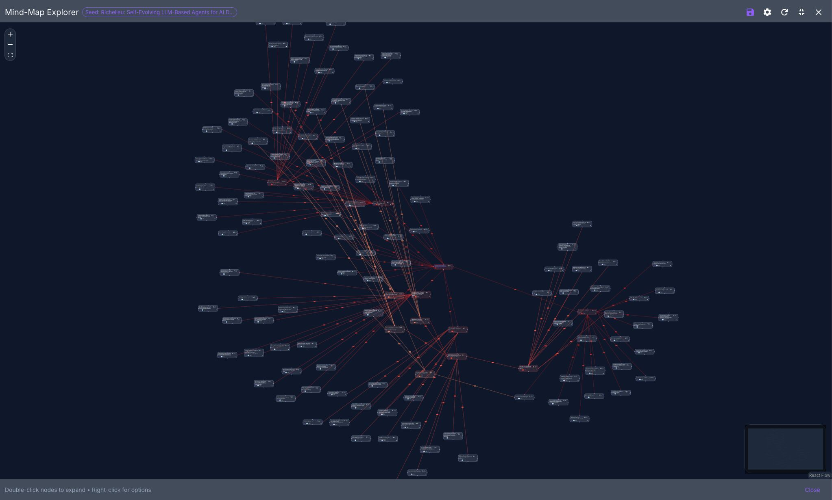

Slide 22
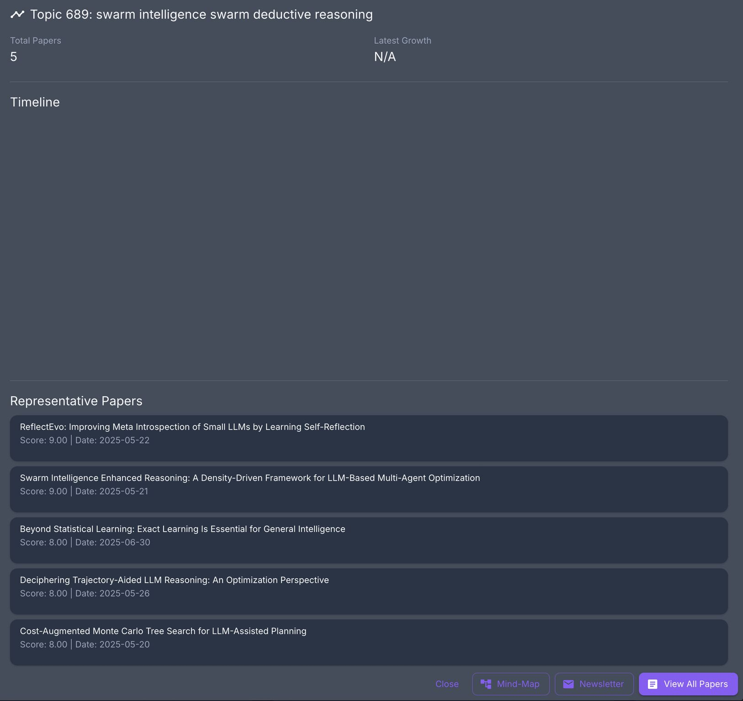
Time-Series Forecasting and Topic Modeling
Prophet-Based Modeling
Time-series decomposition into trend, seasonal, and irregular components
Automatic refreshing based on user schedules
Prediction Horizons
Configurable prediction horizons
Automatic Topic Modeling
Configurable by time horizon

Slide 23
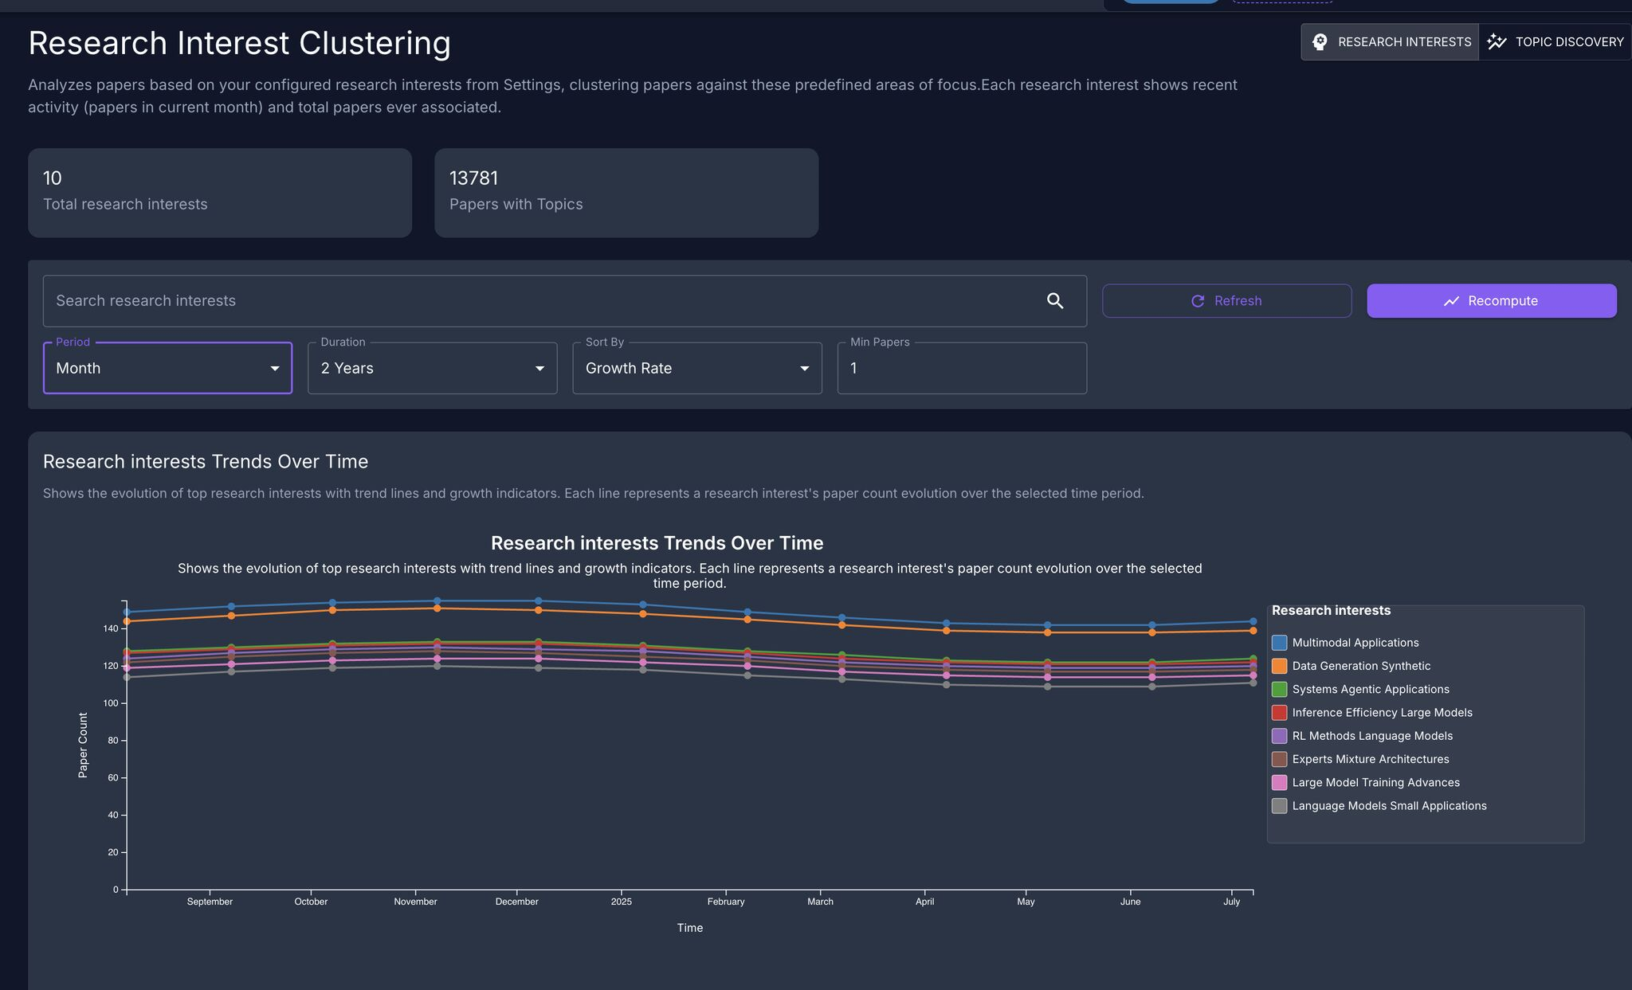

Slide 24
Open-Source Application Link
https://github.com/M-Chimiste/TheseusInsight
License: Apache 2.0
Slides: CC BY-SA

Slide 25
Thank You

