Slide 1
Patient-Centric Drug Development: Perspectives from
the National Organization for Rare Disorders (NORD)
Edward Neilan, MD, PhD, Chief Medical and Scientific Officer, NORD
NERDS Symposium – Oct 10th, 2025

Slide 2
Our Mission
Improving the health and well-being of people with rare diseases by driving advances in care, research, and policy.
NORD, a 501(c)(3) nonprofit, is a patient advocacy organization dedicated to individuals with rare diseases and the organizations that serve them. We collaborate widely with stakeholders interested in rare diseases, working closely, for example with FDA, NIH, and our more than 350 NORD Member Organizations (each an independent nonprofit).
While maintaining our independence of thought and action, NORD also regularly communicates with the ~100 companies that are members our Corporate Council.

Slide 3
Outline:
The history of NORD, including the related creation of the Orphan Drug Act in 1983
Brief notes on progress over the past 42 years
A summary of patient perspectives on the urgency of the vast unmet medical need in rare diseases
Some of the free information and services NORD offers the rare diseases community
NORD’s “umbrella organization” function and its ongoing partnership with >350 more disease-specific NORD Member Organizations
NORD’s research and clinical programs including the patient-centered IAMRARE Registry and Natural History Study Program and the NORD Rare Disease Centers of Excellence
Opportunities to collaborate with NORD
My thoughts on some of the existing (or proposed) “pathways” for rare disease drug development
NORD’s main annual events (hoping to get you engaged)
Opportunities to volunteer with NORD

Slide 4
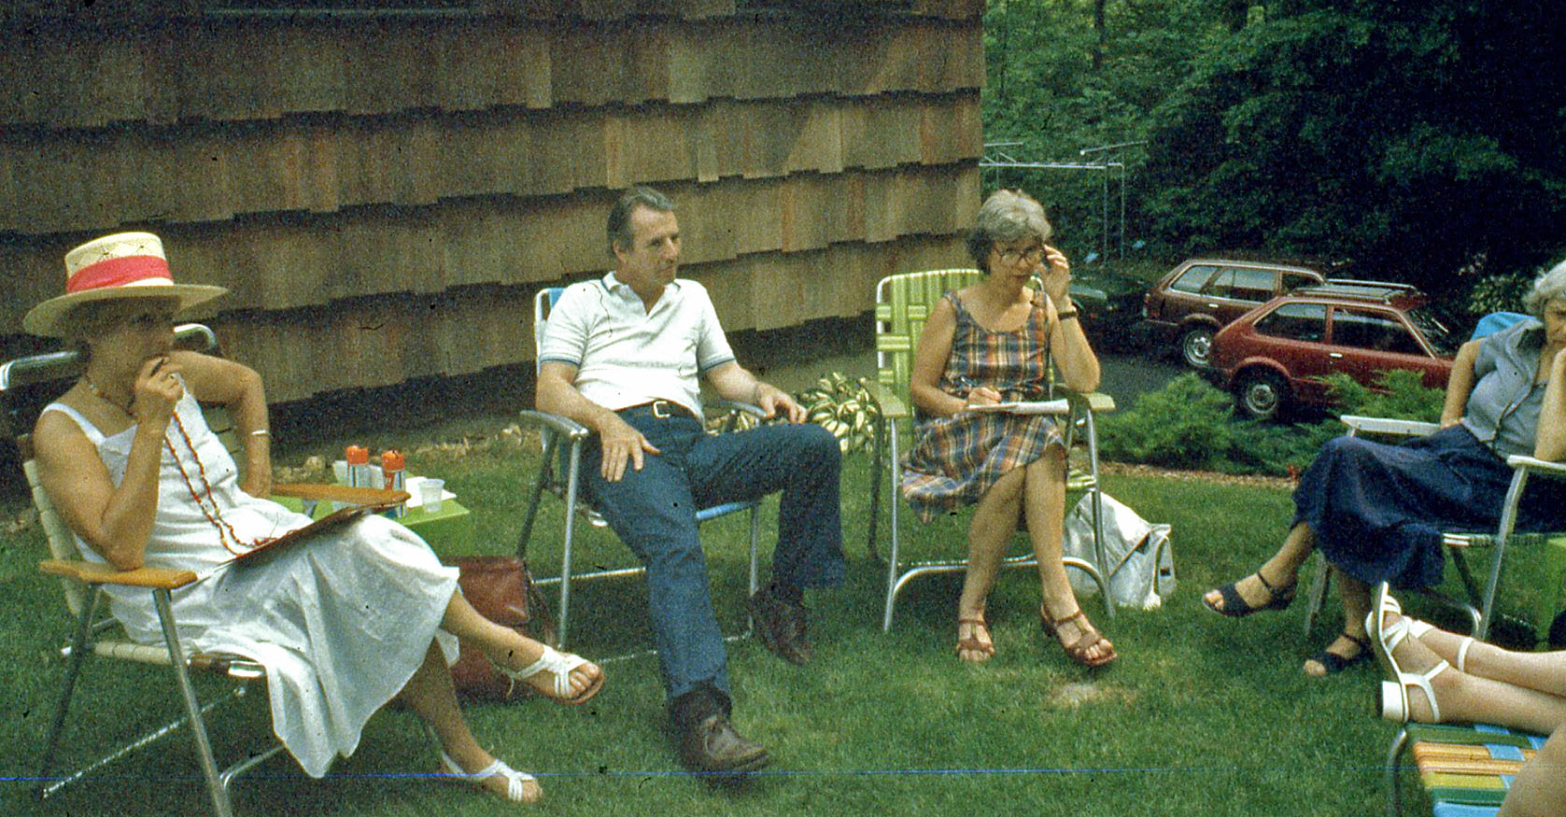
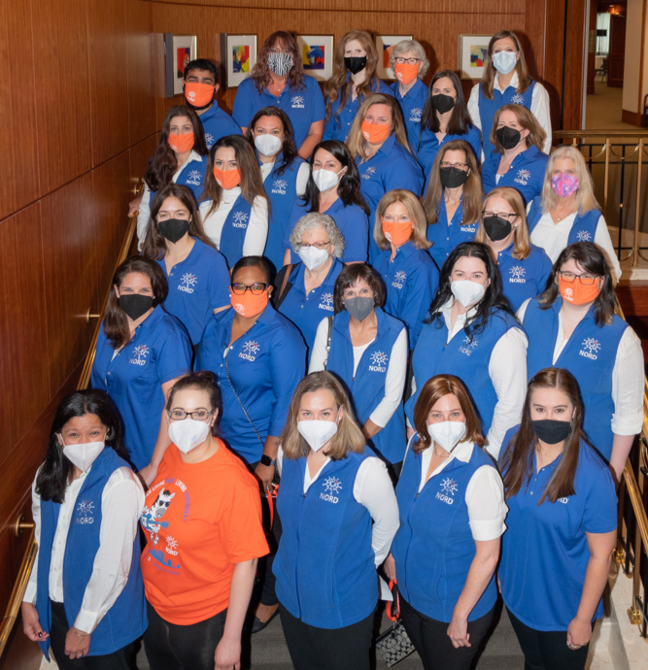
NORD’s History
Founded in 1983 by an ad hoc coalition of advocates shortly following their successful advocacy for passage of the Orphan Drug Act
Prior to 1983, only <40 treatments had been developed for rare diseases. Today, more than 650 are now available because of the ODA
Since then, NORD has led the rare disease community: helping to connect patients, organizations, researchers, clinicians, and all stakeholders in the pursuit of improving the lives of those living with a rare disease
Notes:
Speak to NORD’s growth in staff, etc.

Slide 5
Orphan Drug Act
Defines a rare disease as affecting fewer than 200,000 people (in the USA)
Sets a framework for Orphan Product Designation (by indication, i.e., by disease)
Orphan Tax Credit – Provides a tax credit to help offset the costs of qualified expenses incurred in clinical trials
FDA Application User Fee Waiver – Waives the application fee usually required for FDA review
Orphan Drug Exclusivity – Grants 7 years of market exclusivity
Research Grants – FDA research grants for clinical trials and natural history studies to advance rare disease product development

Slide 6
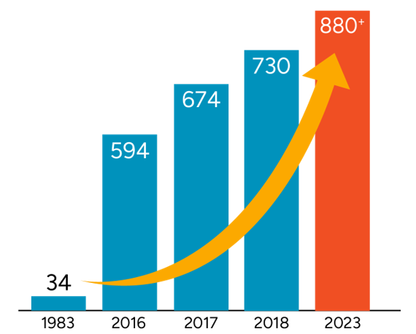
40 PLUS YEARS OF FIRSTS
Orphan Drug Act (1983)
Patient Assistance Program (1987)
Launch Office of Rare Disease Research (1993) + ClincialTrials.org (2000)
Natural History Study Patient Registry – IAMRARE (2014)
NORD Rare Disease Centers of Excellence (2022)
40 Year Impact of the ​
Orphan Drug Act
Notes:
For 40 years, NORD has been a national steward, an unwavering partner and a steadfast presence helping those who battle and care for rare disease feel seen, heard, supported and connected.
We’re a full-service, mission-driven nonprofit reimagining a future where every person with a rare disease, and their families can live their best lives.
We are patients, family members, clinicians and researchers united by a single purpose – solve the greatest challenges and unmet needs in rare disease patient care, treatment and research.

Slide 7
Unaddressed Needs in Rare Disease Care and Research
90% of rare diseases lack FDA-approved therapies.
6+ Years: Average time for patients to receive a diagnosis.
Over 10,000 rare diseases exist, but fewer than 2,000 have dedicated patient organizations.
Missed Opportunities: Innovation happens in silos, delaying progress for the entire community.
CONFIDENTIAL AND PROPRIETARY​

Slide 8
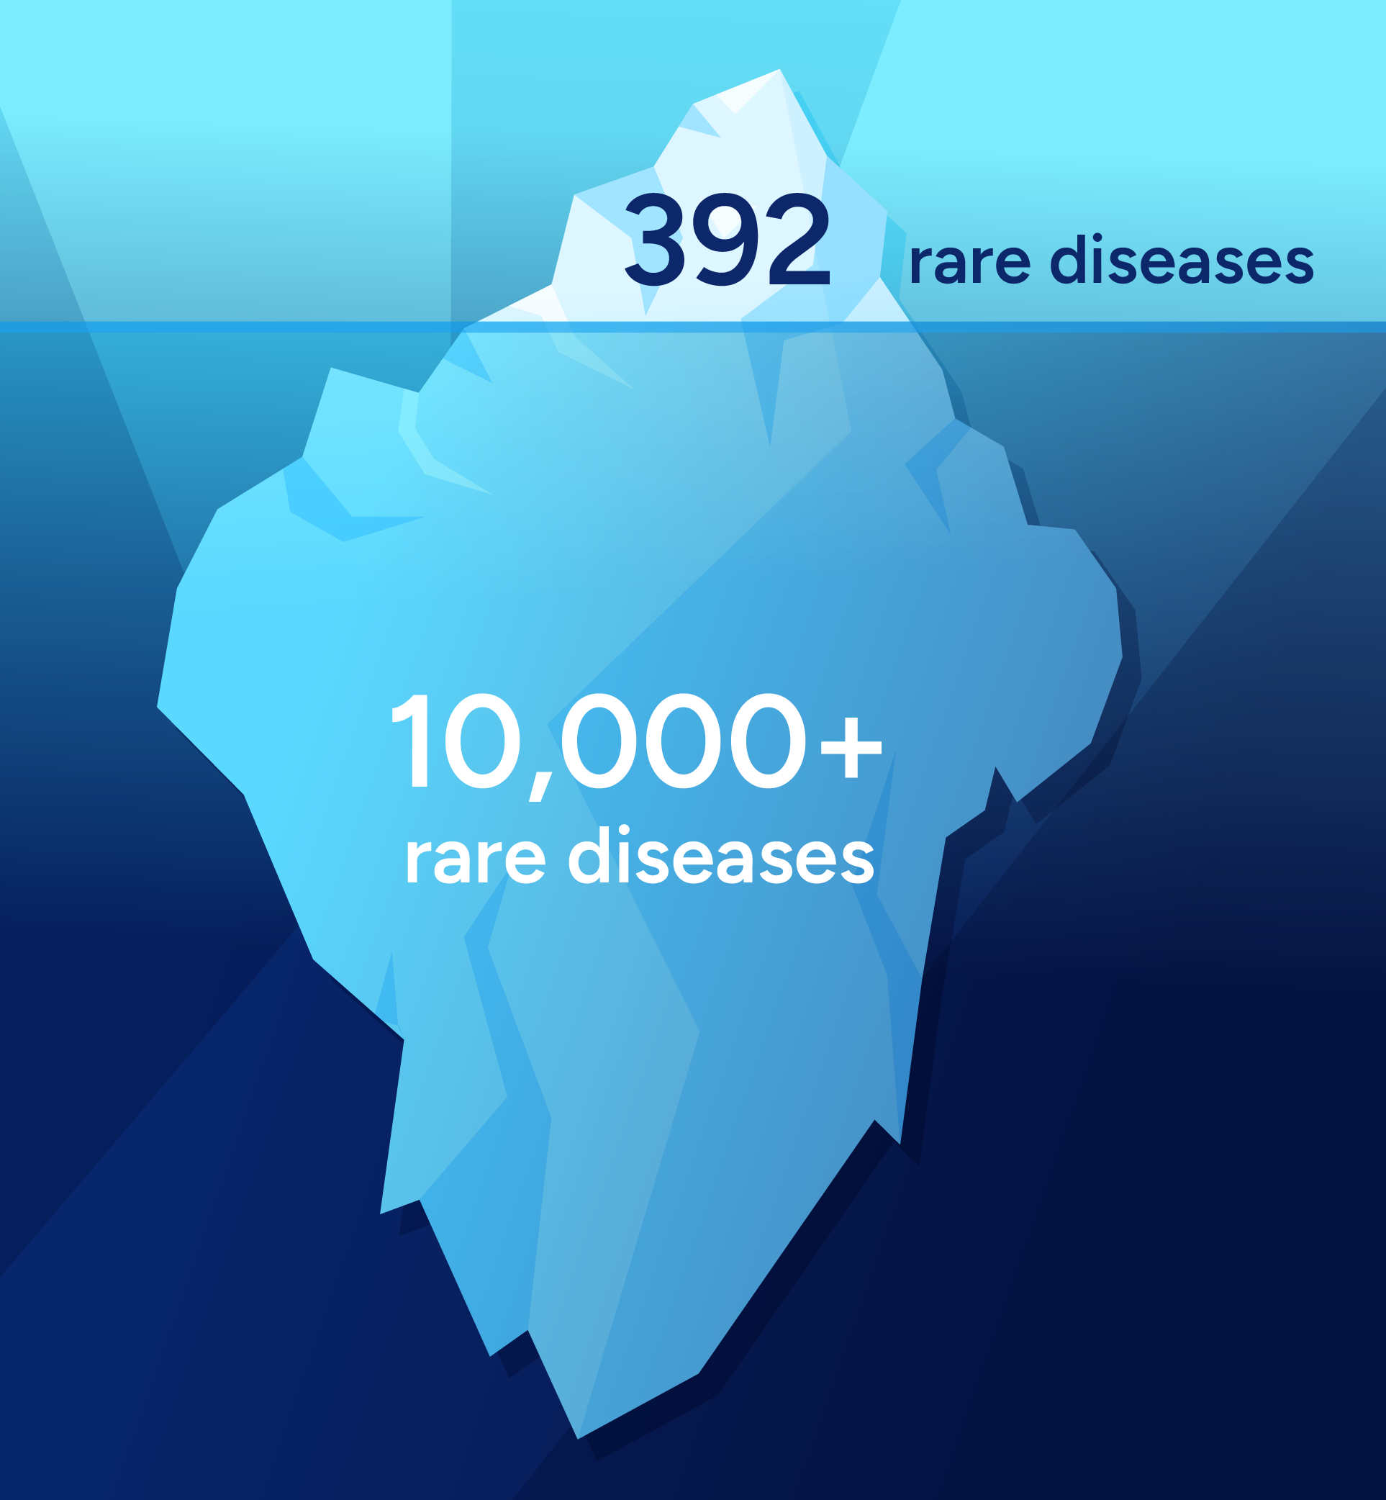
Progress Has Only Touched
The Tip of the Iceberg
“At the current rate, it will be over 2,000 years before there is a treatment for every rare disease.” - Dr. Chris Austin, former Director of NIH NCATS
Only 882 approved drugs for 392 rare diseases
96% of rare diseases remain without treatments
Current treatments are often not curative, and many do not slow disease progression
People can't wait: 30 million lives are at stake
CONFIDENTIAL AND PROPRIETARY​

Slide 9
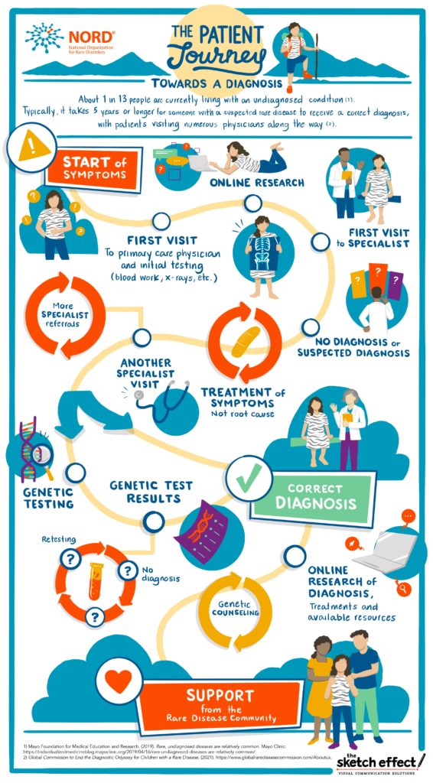
DIAGNOSTIC ODYSSEY
The average timeline for a rare disease diagnosis is five years and many cases take more than 10 years in comparison to days, weeks or months for other diseases like cancer, heart disease, dementia and diabetes (1,2)
https://rarediseases.org/new-patient-journey-infographic-gives-a-glimpse-into-the-diagnostic-odyssey/

Slide 10
Rare Disease Patient Perspectives on Clinical Research:
Very strong sense of Urgency
Fear of being forgotten
Eager to participate
Eager to be listened to
Concerns regarding endpoints
Concerns regarding study burdens
Want to maximize use of their data
Patient view: RD urgency >/= COVID-19
Many rare diseases have ~0 research
Few drugs; so Trials often the best hope
Patient knowledge in some ways > MD’s
Meaningfulness? Approvability?
Hard life; added trial burden, benefit/risk
They want data shared widely, not siloed

Slide 11
NORD’s Role Today
An umbrella organization working with and helping to represent its ~340 Member Organizations
Driving collaboration and progress by creating unique networks
Rare Disease Advisory Councils
Centers of Excellence
Understanding community needs and delivering solutions through those networks
Generating data insights
Driving public policies and fostering collaborations to solve challenges across diagnosis, research and patient care

Slide 12
NORD Programs & Services
Patient & Family Services
Patient Advocacy Group (PAG) Support
Education Programs
Policy & Advocacy Programs
Research Programs

Slide 13


Historically, the system for rare disease care and research has been fragmented and inefficient.
CONFIDENTIAL AND PROPRIETARY​
Alone we are rare. Together we are strong.®

Slide 14
Some Specific NORD activities related to RD Research
US Federal & State public policy initiatives and advocacy (40 years)
NORD Pilot Grant Program (>30 years; but limited & disease specific funding)
>50 NORD “IAMRARE” Registries & Patient-reported natural history studies
Decentralized NORD “HOME Study” of MLD natural history/current outcomes
Rare Disease Clinical Outcome Assessment (COA) Consortium (with C-Path)
“NUCOAT” project, developing new COA’s (with Northwestern University)
Rare Disease Cures Accelerator Data Analytics Platform (with C-Path)
CDISC (Clinical Data Interchange Standards Consortium) Rare Disease Therapeutic Area User Guide (Supported by NORD)

Slide 15
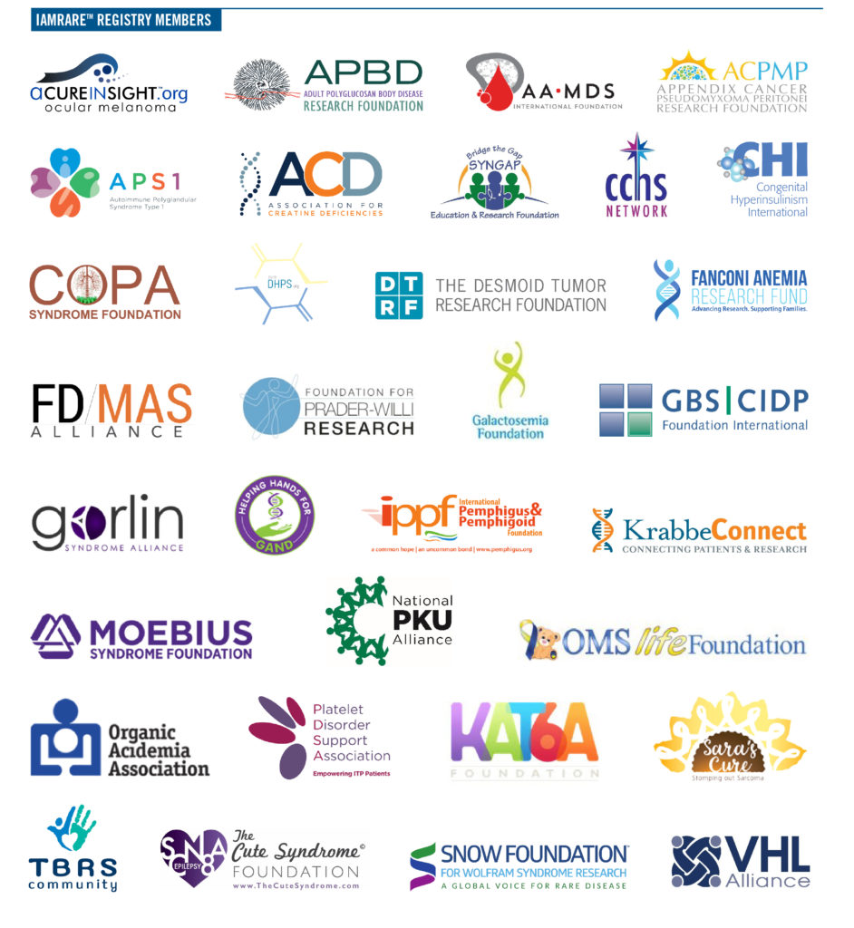
NORD’S “IAMRARE” REGISTRY PROGRAM
Developed to empower patient advocacy groups to build patient registries and collect patient/caregiver-reported natural history data on their diseases
Proprietary, secure, mobile-friendly, online data collection platform, developed by NORD
First study launched in 2014, with support from FDA
IAMRARE core data dictionary includes validated assessments and other standardized data elements
Each IAMRARE registry is also includes surveys customized for its patient advocacy group (PAG)
Now includes ~50 registry studies and data on ~18,000 patients representing ~75 rare diseases
What Others Are Saying
“Our IAMRARE registry currently contains seven surveys, 2,000 registered users and became the anchor of PDSA’s research program.” - Caroline Kruse, President & CEO, Platelet Disorder Support Association (PDSA)

Slide 16
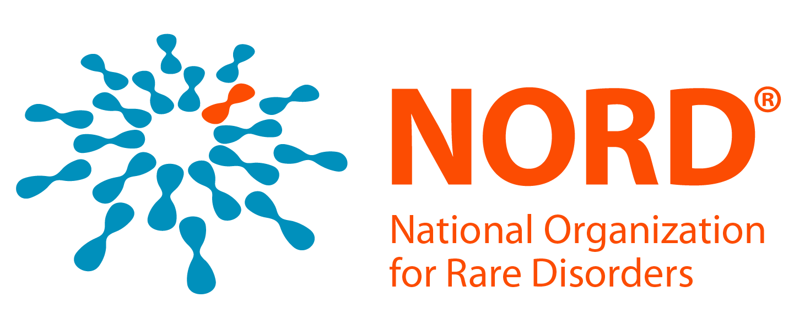
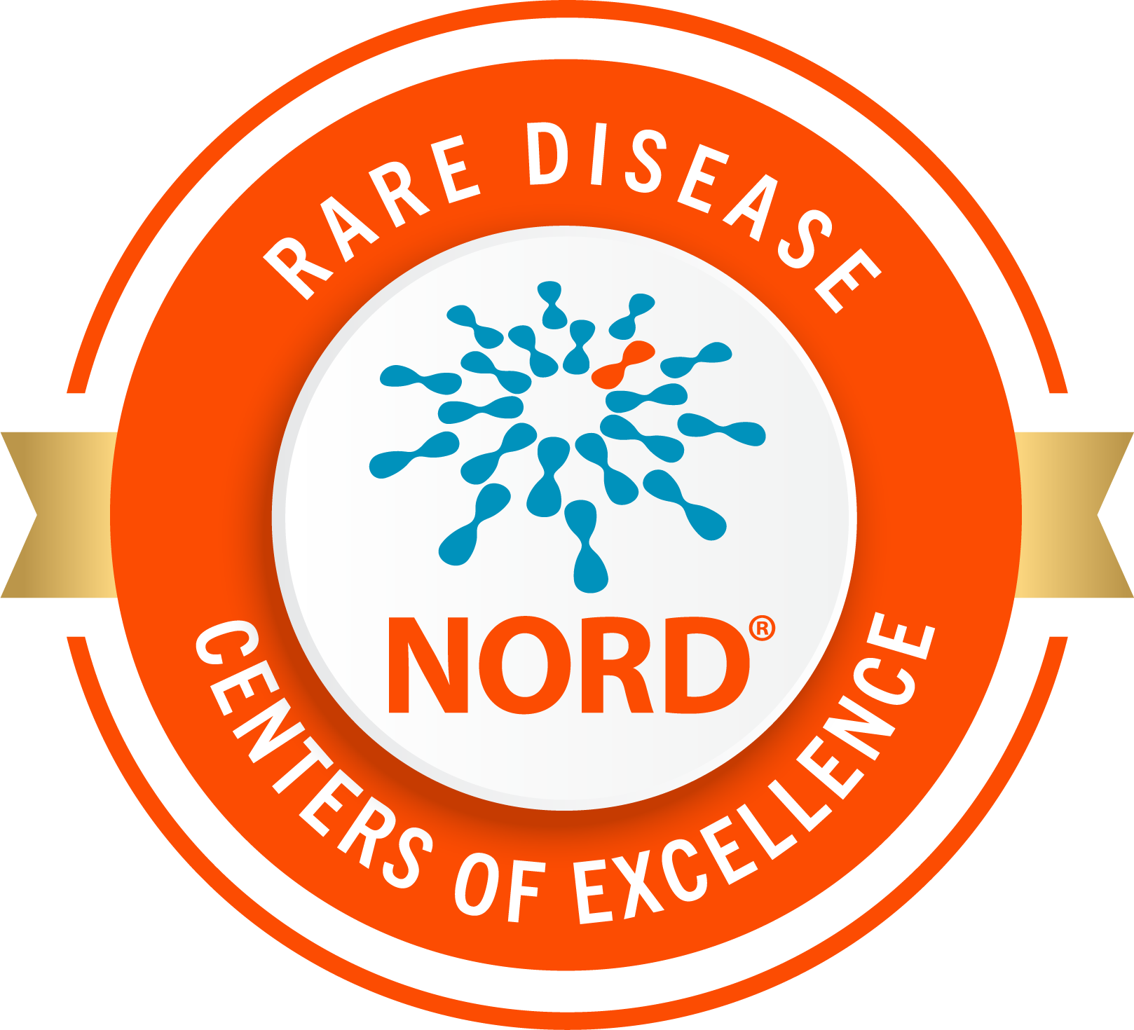
Progress is accelerated by a collaborative approach
Accelerate
diagnosis
Patients and families
Academic researchers and clinicians
Improve health and quality of life for people with rare diseases
Accelerate translational and clinical research
Industry partners
Policymakers
Improve access to appropriate care and treatments
CONFIDENTIAL AND PROPRIETARY​
Notes:
=

Slide 17
NORD RD CoEs – 40 Centers, 60+ Institutions
Baylor College of Medicine/ Texas Children’s Hospital
Children's Hospital of Orange County/University of California Irvine
Children's National Hospital
Cincinnati Children's Hospital Medical Center/University of Cincinnati
Cleveland Clinic
Columbia University Irving Medical Center
Duke University
Emory University
Harvard Medical School Affiliated Hospitals (Boston Children’s Hospital/Massachusetts General Hospital/Brigham and Women’s Hospital)
Indiana University
Johns Hopkins Medical Center/Kennedy Krieger Institute
Lurie Children’s Hospital of Chicago/Northwestern University
Mayo Clinic
McGovern Medical School/UT Houston
Michigan Medicine NORD Center of Excellence
Nationwide Children’s Hospital/ Ohio State University
New York Center for Rare Diseases at Montefiore
New York-Presbyterian/Weill Cornell Rare Disease Center
NORD Rare Disease Center for Excellence at Ann & Robert H. Lurie Children’s Hospital of Chicago and Northwestern University
Penn Medicine/Children’s Hospital of Philadelphia
Stanford Medicine Children’s Health – NORD Center of Excellence for Rare Disorders
UAB Medicine/Children’s of Alabama
UNC Children's - North Carolina Children's Hospital
University of California Los Angeles - NORD Center of Excellence
University of California, San Francisco & UCSF Benioff Children's Hospitals
Children’s Hospital of Los Angeles and USC Medical School
University of Colorado Anschutz Medical Campus/Children’s Hospital Colorado/UCHealth
University of Iowa Health Care
University of Miami Miller School of Medicine
University of Minnesota / M Health Fairview Masonic Children’s Hospital
University of Pittsburgh Medical Center - Center for Rare Disease Therapy
University of Utah Medical Genetics
University of Washington SOM and Seattle Children's Hospital NORD Rare Disease Center of Excellence
University of Wisconsin Center for Rare Diseases
Medical College of Wisconsin
UNMC Munroe-Meyer Institute, Omaha Children’s Hospital and Nebraska Medicine
UT Southwestern Medical Center
Vanderbilt University Medical Center
Washington University/BJC Healthcare
Yale NORD Center Of Excellence for Rare Disorders

Slide 18
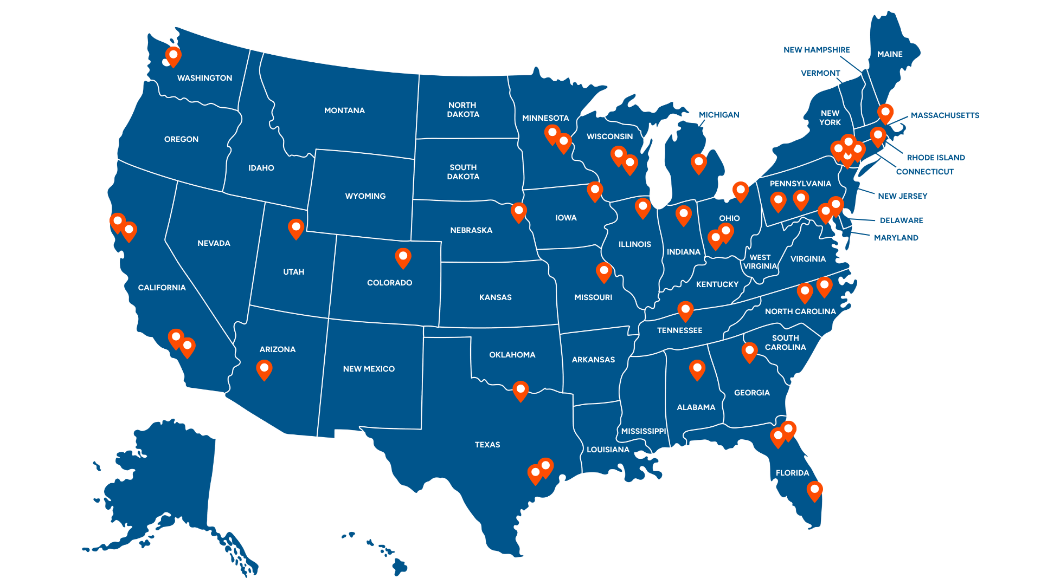
NORD RD CoEs – 40 Centers, 80+ Institutions
Notes:
18 of the top 20 U.S. News & World Report research medical schools
Instead of going to each individual institution, we can streamline that, you have one place to go
Put in meeting chat: https://rarediseases.org/center-of-excellence/

Slide 19
Primary Goals of the NORD Centers of Excellence
Improve Patient Health & Quality of Life
Shorten diagnostic odyssey
Improve access to appropriate care and treatments
Accelerate foundational rare disease research
Facilitate faster therapy development
Ensure Diversity, Equity, and Inclusion
Train the Next Generation of Rare Disease Experts

Slide 20
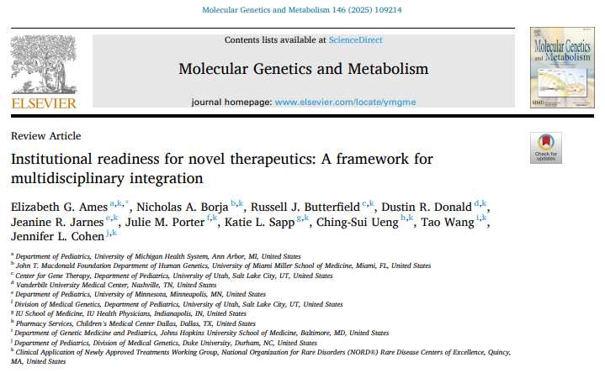
Working Groups
Unmet Need
Working Group
New demands in delivering innovative therapies in the clinical setting
Clinical Application of Newly Approved Treatments Working Group

Slide 21
Working Groups
Key Unmet Need → | Working Group
Special Challenges in operating a general rare disease center of excellence | Director’s Workgroup* on Rare Disease CoE Mechanics and Best Practices *limited to Directors and Associate Directors
Long Diagnostic Odyssey | Diagnostic Approaches / Access to Testing (Diagnostic Odyssey)
Scattered Patients & Rare Expertise | Telemedicine / Inter-site Consultation
Very Few Approved Treatments | Facilitating Multi-site Research & Clinical Studies
Often Limited Clinical Data (Especially for new and ultra-rare diseases) | Shared Data Collection & Analysis
Few Treatment Guidelines and Standards of Care | Treatment Guideline Curation & Development
New demands in delivering innovative therapies in the clinical setting | Clinical Application of Newly Approved Treatments/Label Indication Expansion
Gaps in patient education resources | Patient Education
Workforce limitations / Gaps in medical professionals’ rare disease knowledge and education | Medical Professional Education
Gaps in insurance coverage and adolescent to adult transition of care | Policy & Collective Advocacy/ Transition of Care
Inequities in access to rare disease treatment and in the education and training of rare disease specialists | Opportunity, Access, & Engagement
Efforts to implement WGS as primary NBS often circumvent State NBS Advisory Committees and often don’t reflect the expertise of key stakeholders with a deep understanding of the challenges and processes of the complex U.S. NBS system. | Newborn Screening
Limited resources and education available in other languages/countries for patients and providers. | International Collaboration
CONFIDENTIAL AND PROPRIETARY​

Slide 22
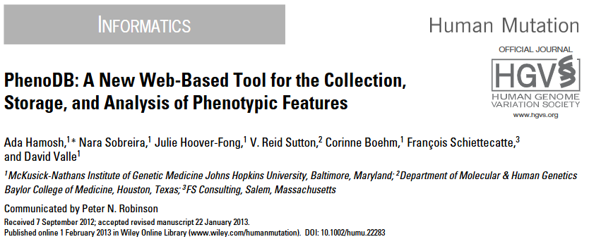
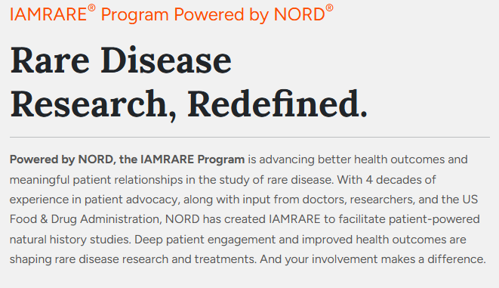
Accelerate Rare Disease Research: Universal Registry
NORD Universal Registry
Combines the PhenoDB database (genetic and phenotypic data) with IAMRARE (patient-collected and EMR data) in one multi-site study for all rare disease patients
Centralized, pre-established infrastructure for data collection and sharing that enables institutions to build patient cohorts across multiple institutions quickly - especially critical for ultra-rare disorders where any one institution may only have 1-2 patients
Leverage common data structures to allow for more rapid analysis, resulting in meaningful knowledge creation more quickly
Importance to Industry
Can contribute to patient identification and trial enrollment
Integration with PhenoDB may permit reclassification of VUSs
Notes:
PhenoDB: tool for clinical researchers, developed by Johns Hopkins and now publicly available. The system stores phenotypic, diagnosis and pedigree data, and allows for analysis of an individual’s genomic sequencing data.
IAMRARE: NORD’s patient-reported registry platform. A clinician interface is in development.
Universal Registry: A centralized tool and shared research protocol that includes patient reported outcomes and clinical genomic data, streamlining cohort building and data sharing across the RD CoE network to support multi-institutional research. This will significantly reduce the administrative burden of establishing patient research cohorts and identifying patients across the network by:

Slide 23
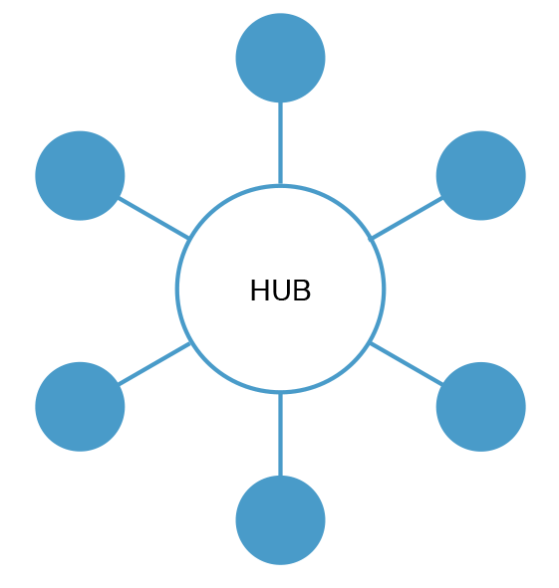
A Coordinated Network of Centers of Excellence
Shared Collaboration
Platform
Linked by a shared collaboration platform, an INTRAnet, & frequent virtual meetings, NORD’s network of Rare Disease Centers of Excellence creates rich opportunities for:
Shared clinical expertise
Shared best practices / protocols
Faster Diagnosis
Collaborative research projects
Improved outcomes for patients
NORD
Lead Site
Research Project “A”
Site
Originating Best
Practice “B”

Slide 24
Examples of Some Key Objectives
Improve Patient Health & Quality of Life
Shorten diagnostic odyssey
Improve access to appropriate care and treatments
Accelerate rare disease research
Advance therapy development
Improve Access to Experts
Increase # Experts
Access to Testing & Diagnostic Tools
Improve Access to Clinical Guidelines
Provide Patient Navigation Resources
Collect Quality Improvement Data
Central IRB/ reliance agreements
Conduct and recruit for Natural History Studies
Accelerate Study Recruitment
Support Clinical Trial Design
Strengthen Trial Network

Slide 25

CASE CONFERENCE SERIES
Rotating schedule for each Center to open up an existing case conference/grand rounds to the Network
Long term vision will be to have 5 case conference series, all offering CMEs, all recorded and available through Intranet (undiagnosed cases can be a part of any of the series):
General Rare / Genetic Disorders
Rare Neurological Disorders
Metabolic/Biochemical Genetics Disorders
Rare Oncology
Rare Immunological & Autoimmune Disorders

Slide 26
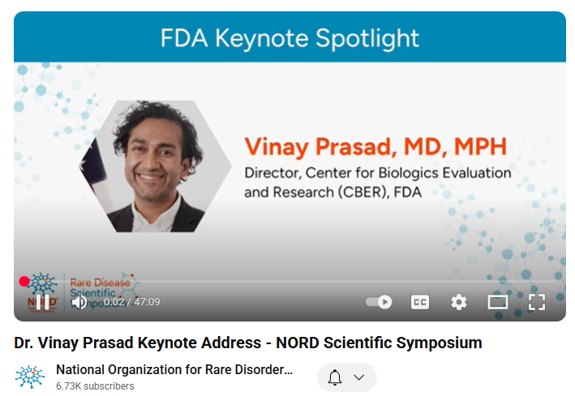
New / Shifting “pathways” for Rare Disease Drug Development !?
Challenges to Accelerated Approval
May 2024 FDA Draft Guidance on “Platform Technology for Drug Development”
June 3, 2025 Vinay Prasad at NORD Scientific Symposium

Slide 27
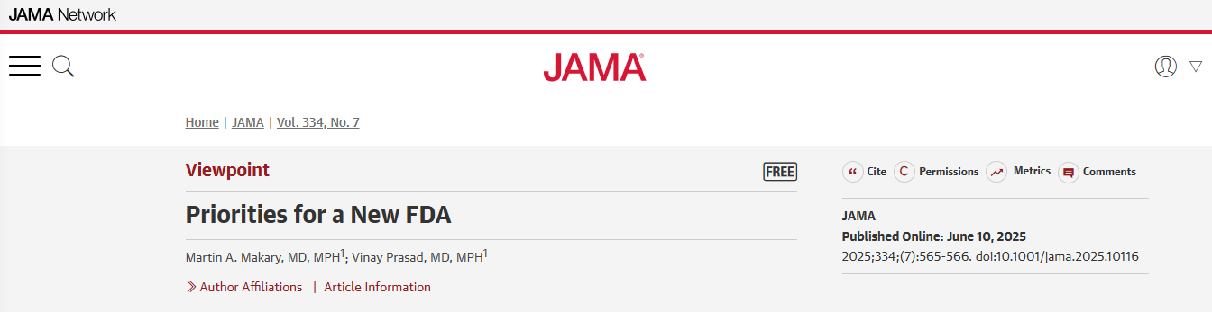
New / Shifting “pathways” for Rare Disease Drug Development !?
June 5, 2025 HHS Cell and Gene Therapy Roundtable
June 10th Vinay Prasad and Mary Makary
Accelerating Cures
Unleashing AI
Healthier Food for Children
Harnessing Big Data
Financial Toxicity (high priced drugs “ripping off the USA”

Slide 28
New / Shifting “pathways” for Rare Disease Drug Development !?
July 22, 2025 Haystack Project / Janet Woodcock white paper on “Redefining Rigor: Fit-for-Purpose Trials to Unlock Rare Disease Therapies”
Sep 3, 2025 CDER/CBER Rare Disease Evidence Principles
The FDA's Rare Disease Evidence Principles (RDEP) is
a proposed framework for expediting the approval of drugs for ultra-rare genetic diseases affecting fewer than 1,000 patients, by allowing for substantial evidence to be demonstrated through a single adequate, well-controlled study and robust confirmatory data. RDEP enables drug developers to align with the FDA on acceptable evidence types, including single-arm trials, preclinical results, and mechanistic data, to meet the safety and efficacy standards for marketing approval.

Slide 29
FDA Rare Disease Evidence Principles
Key Principles and Goals:
• Targeted for Ultra-Rare Genetic Diseases: Eligibility requires the drug to target a population of fewer than 1,000 U.S. patients with a known genetic defect causing the disease and a significant unmet medical need.
• Flexible Evidence Standards: Allows for the use of a single adequate and well-controlled study (which could be single-arm) combined with other strong confirmatory evidence.
• Early Alignment: Sponsors can request to participate in the RDEP process as early as before initiating a pivotal trial, enabling early alignment with the FDA on the types of data needed for approval.
• Rigor within Flexibility: The RDEP process ensures that flexibility is applied within the existing statutory standard of safety and efficacy, maintaining a rigorous path to approval.
• Consultative Approach: Drug review teams consult with the Rare Disease Policy and Portfolio Council to determine eligibility and provide guidance to sponsors on the specific data needed.

Slide 30
FDA Rare Disease Evidence Principles
Eligibility and Participation:
• Sponsor-Driven Application: Developers can apply to have their drugs reviewed under the RDEP process by submitting a formal meeting request before starting a pivotal trial.
• Consultation for Rare Cancers: Sponsors developing treatments for rare cancers should consult with the FDA's Oncology Center of Excellence to see if the RDEP process applies.
Key Considerations:
• Independence from Orphan Drug Designation: Participation in RDEP is separate from the Orphan Drug Designation program, and does not guarantee orphan drug status.
• Postmarketing Requirements: Drugs approved through the RDEP process may be subject to additional postmarketing requirements to further ensure their safety and effectiveness.

Slide 31
Thank You!
NORD’s main annual events (hoping to get you engaged)
NORD Summit (Oct 19-21) and Corporate Council (Oct 22) in Washington, D.C.
NORD Scientific Symposium
NORD Living Rare, Living Stronger patient support meetings
NORD Rare Impact Awards
Opportunities to volunteer with NORD

