Slide 1
Utilizing multiple outcomes from comparative studies for assessing totality of evidence on treatment efficacy/safety
Lee-Jen Wei
Harvard University

Slide 2
Example: Clinical studies for treating DMD
Duchenne muscular dystrophy (DMD) is a genetic disorder characterized by progressive muscle degeneration and weakness.
Two independent comparative studies were conducted.
Primary endpoint is the change in 6-minute walking distance (6MWD) from baseline to week 48.
Secondary endpoints are changes in “10-meter walk/run,” “4-stair climb” and “4-stair descend” times.

Slide 3
How to analyze data from multiple outcomes conventionally?
For each endpoint, use a single statistic such as the average difference between two arms to estimate the treatment effect.
Obtain p-value and confidence interval.
Apply a multi-stage testing procedure to claim statistical significance for the secondary endpoint.

Slide 5
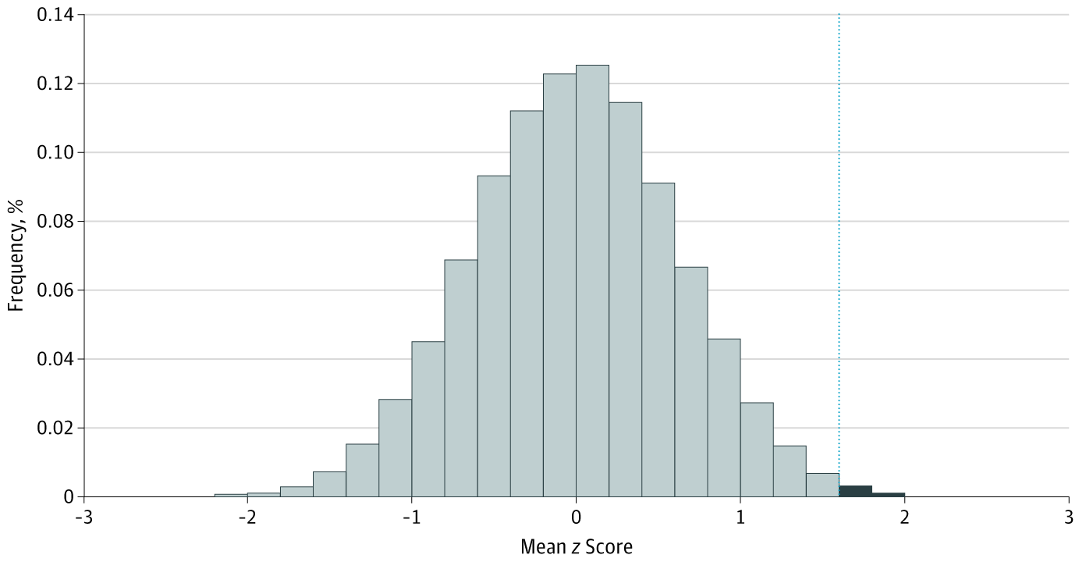

Slide 6
JAMA OPEN
Assessment of Treatment Effect With Multiple Outcomes in 2 Clinical Trials of Patients With Duchenne Muscular Dystrophy

