Slide 1


ADA Assay as CDx
Shuguang Huang, Stat4ward (Shuang@stat4ward.com )
Wenting Wang, Sanofi Cambridge, US
Hong Wang, Sanofi, Cambridge, US

Slide 2
Disclaimer
Shuguang Huang is an employee of Stat4ward, which was contracted by Sanofi for supporting CDx-related clinical trials and general biomarker studies

Slide 3

Typical CDx
Qualitative
  KRAS, BRAF, EGFR, ROS1, ALK, BRCA, PIK3CA, MET, …
  NTRK fusion (FMI – Genentech; Illumina – Loxo)
  RET fusion (Illumina TruSight – Loxo selpercatinib)
  dMMR (Vantana – GSK Dostarlimab)
  …
Semi Quantitative
  HER2, PD-L1
  Fitusiran (Siemens – Sanofi)
  Bepirovirsen (Roche – GSK)
  Roctavian (ARUP – BioMarin)
  AAV8 (## - xx)
  …
: Stat4ward supported

Slide 4
Gene Therapy
Recombinant adeno-associated virus (AAV) vectors are the leading delivery vehicle used for gene therapies.
Pre-existing ADA against the AAV capsid due to prior exposure to wild-type AAVs
ADA binds to the AAV capsid, this could significantly reduce the effectiveness of the treatment by neutralizing the vector
FDA recommends a CDx when pre-existing antibodies to AAV are to be used as an exclusion criterion. And determines if an IDE is needed for those studies that are of significant risk.
Example: AAV5 DetectCDx (https://www.fda.gov/medical-devices/recently-approved-devices/aav5-detectcdx-p190033)

Slide 5
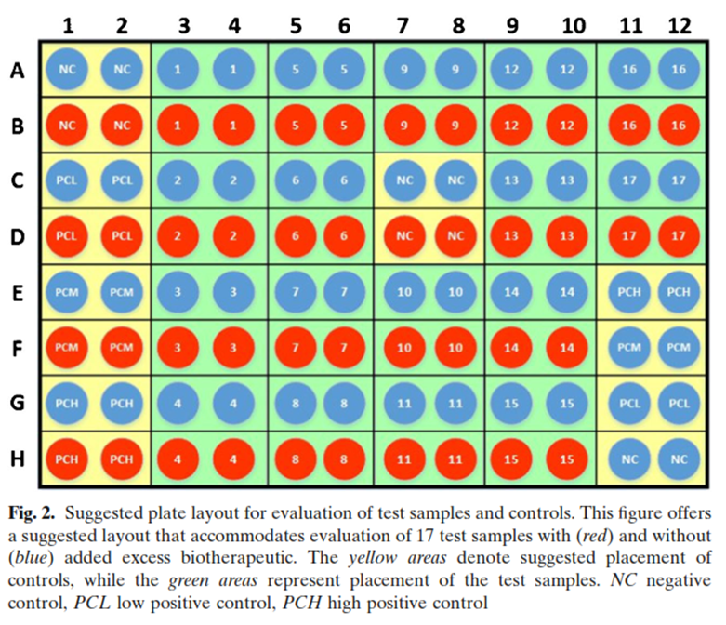
ADA Assay
Drug Emergent ADA
  Therapeutic proteins are recognized by the human immune system. Immune response to therapeutic proteins: Anti-drug antibody (ADA)
Consequences of ADA
  Safety
  PK
  Efficacy
ADA Cutpoint
  Determines if a subject has positive ADA response
FDA guidance for study design
  “The cut-point should be determined statistically with around 50 treatment-naïve samples. Each sample should be tested by at least two analysts on at least three different days for a total of at least six individual measurements.”
ADA Assay
  Screening assay (blue, untreated)
  Confirmation assay (red, treated by drug)
ADA Assay Plate Layout

Slide 6
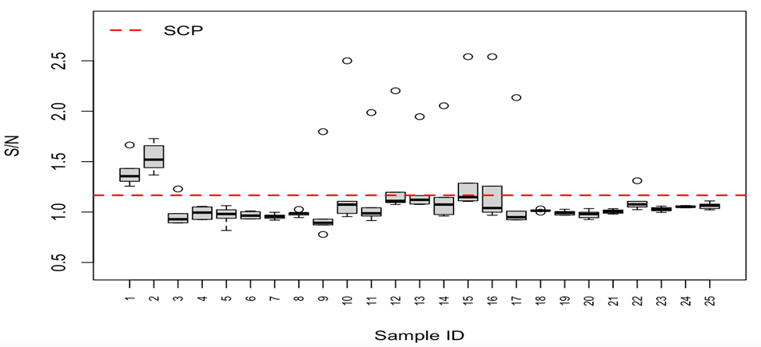
ADA Assay Cutpoint
Screening cutpoint (SCP) aims to control false positive rate at 5%
Confirmation cutpoint (CCP) aims to control false positive rate at 1%
Note: only false positive rate is controlled, false negative rate is unknown/uncontrolled

Slide 7
Analytical Validation
Sensitivity (LoB, LoD, LoQ)
Specificity
Precision
Accuracy
Stability (reagent, sample)
Linearity
Cross contamination
Contrived sample comparability
Robustness
Guard-banding
Pre-analytics
QC limits/control charts
Reagent qualification
Assay change
…
Experimental Design
  Sample selection (sample type, pooling, mixing, spiking, depleting,… )
  Design
    Sample size
    Concentration levels
    Design factors
      Reagent lot, operator, day, run, replicates
Analysis
  DOE < -- > SAP
  Statistics methods
  Acceptance criteria

Slide 8
AV Following CLSI Guidelines
Assay Validation (CLSI guidelines)
  Precision – EP05
  Sensitivity – EP17
  Accuracy – EP09
  Specificity – EP07
  Linearity – EP06
  Stability - EP25
  Reagent lot variability – EP26
  Commutability – C53/EP14
  …
Other Guidelines
  FDA (e.g. ATD in assay migration, Precision on composite score),
  USP, EMEA, ISO, ICH, white papers
E.g. EP17 for LOD
Design of Experiment (e.g. classical approach)
  2 reagent lots
  3 days
  4 blank samples
  1 instrument system
  2 replicates per sample (for each reagent lot, day, instrument system combination)
  4 low measurand content (positive) samples
  60 total blank replicates per reagent lot (across all blank samples, days, and instrument systems)
  60 total low positive sample replicates per reagent lot (across all low positive samples, days, and instrument systems)
Analysis
  Classical approach
  Precision profile
  Probit regression

Slide 9
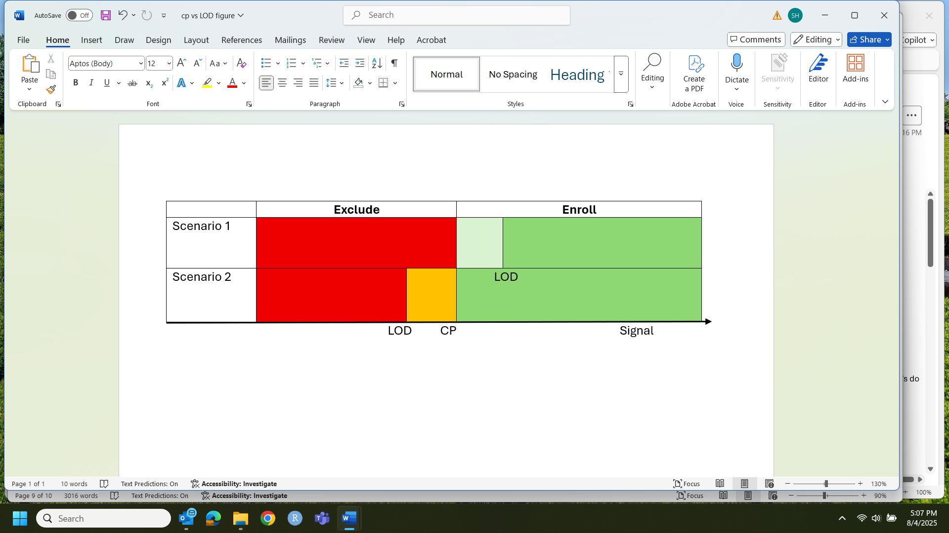
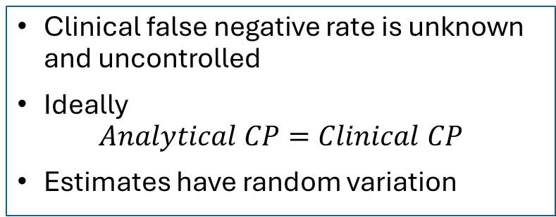
Challenges in ADA Assay CP Determination
Clinical false negative rate is unknown and uncontrolled
Ideally
$$Analytical CP=Clinical CP$$
Estimates have random variation
Error Control | Analytical | Clinical
False Positive | LOB | SCP (or CCP)
False Negative | LOD
Scenario 1: Some ADA negative patients missed the treatment opportunity
Scenario 2: Some ADA positive patients are enrolled

Slide 10
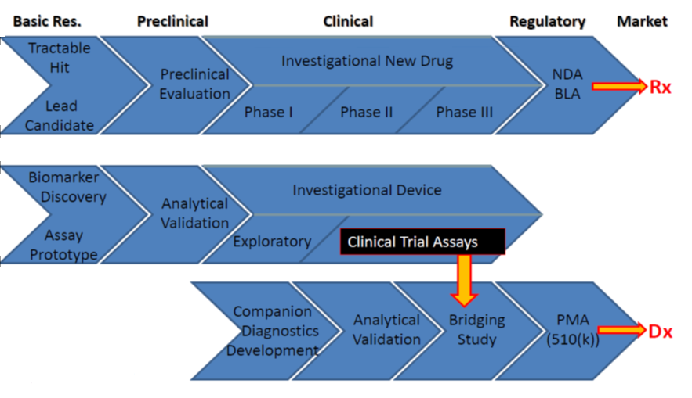
CDx (Biomarker) Clinical Validity
CTA (RUO) → CDx bridging

Slide 11
CDx Clinical Bridging Study
(Enrichment Trial):
  Clinical trial assay (CTA) is RUO
  Observed efficacy E(Y|CTA+)
Goal: estimate E(Y|CDx+)
Study design
Challenges
  Not all the subjects have samples for re-testing
    CTA+ samples
    CTA- samples
  CTA-CDx+ subjects do not have clinical outcomes
External Samples Clinical Trial

Slide 12
Collaborating Between Pharma and CDx Partner
Analytical Validity
Clinical Validity
Assay development and qualification
AV Study Protocols
  Study Design
  Analysis plan
  Acceptance criteria
Data analysis, report
Submission package preparation and review
FDA interaction
Who does the analysis?
  Data transfer
  Familiarity with clinical data and primary analysis
  Statistical expertise
Acceptance criteria
  Point estimates and CI of PPA/NPA
    Assay, technology, math, sample size
  Clinical efficacy
Study Design
  Positive samples
  Negative samples
    Sample size

Slide 13
Interacting with FDA
DOE & SAP
  AV
    FDA/CLSI Guidelines
    Sample/specimen type
    Concentration levels
  CV
    Positive samples
    Negative samples (show effort)
Acceptance Criteria
  AV
    CV for Precision
    % drift for Stability and Interference
    Constant/proportional bias for Accuracy
    Total error for LOQ
  CV
    Analytical Concordance
      Point estimates and LCLs of PPA/NPA
      Assay, sample, technology, math, sample size
    Clinical Efficacy, e.g.
      LCL of ORR
      Non-inferiority/equivalence margin

Slide 14
Statistics Plays a Critical Role in CDx Development
Analytical Validation
Bridging
Submission
F
D
A
Study design
SAP
Acceptance criteria
Submission package
Interaction with FDA
CDx Partner
TM Biomarker
Statistics
Regulatory
Submission Package
FDA interaction
Assay Dev/transfer
Assay validation
FDA interaction
Clinical
Cutoff
Prevalence
Clinical Efficacy
Trial Design

Slide 15
Thanks !
Shuang@stat4ward.com
(724) 602-6644

