Slide 1
Beyond MMRM
The crucial role of Targeted Machine Learning
in RCTs with small sample size and loss to follow-up
New England Rare Disease Workshop
Boston, MA, October 10, 2025
Susan Gruber
sgruber@TLrevolution.com

Slide 2
Acknowledgements
In collaboration with Mark van der Laan
Informed by discussions with research colleagues at the US Food and Drug Administration and UC Berkeley
Hana Lee
Lei Nei
Wonyul Lee
Tianyu Zhou
FDA / UC Berkeley / TL Revolution research collaboration: Innovations in Targeted Learning to Enhance Power of Rare Disease Data Analysis

Slide 3
Targeted Learning in Rare Disease Setting
Challenges for evaluating treatment efficacy and safety
Small sample size due to inherently small population and enrollment difficulties
Difficult to define relevant outcome with sufficient power
due to heterogenous presentation and heterogeneous response to treatment
Unidentified or unmeasured predictors of outcome and potential confounders
little understanding of natural history or characteristics that drive outcomes
lack of expert guidance on important variables to collect or include in analysis
Informative drop out

Slide 4
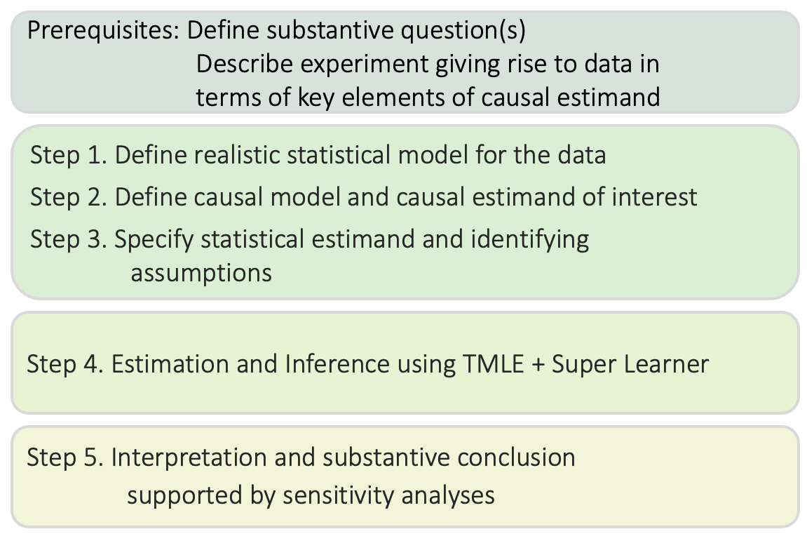
Phase II trial to investigate impact of treatment on change from baseline performance score
Motivating scientific question: Does Study Drug improve patient functioning?
A. Define scientific and causal questions in precise terms and describe the data-generating experiment
B. Translate into statistical problem that can be answered from data
C. Pre-specify the analysis using TMLE+SL
Simulation studies guide tuning parameter specification
D. Sensitivity analysis to examine effect of potential Causal Gap on study finding and substantive conclusion
TL Causal Estimation Roadmap

Slide 5
Phase II trial to investigate impact of treatment on change from baseline performance score
Causal question: Difference in mean performance score at 6 weeks if population treated with study drug vs. placebo
ICH E9 (R1) “estimand” formulation of precise scientific question that can be answered from data
POPULATION | TREATMENT/ COMPARATOR¹ | OUTCOME | SUMMARY MEASURE | INTERCURRENT EVENTS
Oncology patients with rare disease of interest | Study Drug 500 mg tablet 2x daily / Placebo tablet 2x daily | Change in assessment score² at 6 weeks compared with baseline | Additive treatment effect (ATE) | Non-adherence to treatment, loss to follow-up, death³
¹ No more than one pill may be skipped per week
² Sum of 5 component response scores
³ Introduces real-world elements into study

Slide 6
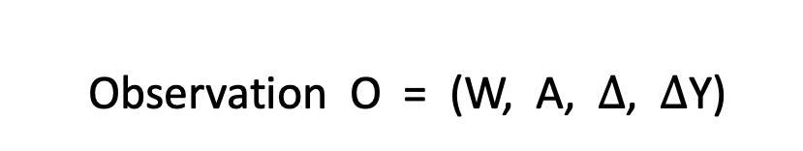

Phase II trial to investigate impact of treatment on change from baseline performance score (Per Protocol)
Start with simplest formulation
RCT study drug vs. placebo (1:1), ignoring time-varying covariates
Baseline covariates, binary treatment, continuous outcome (some missing outcomes anticipated)
L₀
A
$$∆$$
Y
time
Observation O = (W, A, $∆$, $∆$Y)
Baseline (L₀) covariates
Continuous Outcome change from baseline score at 6 weeks (possibly missing)
Binary Treatment Indicator
0: Placebo
1: High Dose
Binary Missingness Indicator
0: outcome missing 1: outcome observed

Slide 7
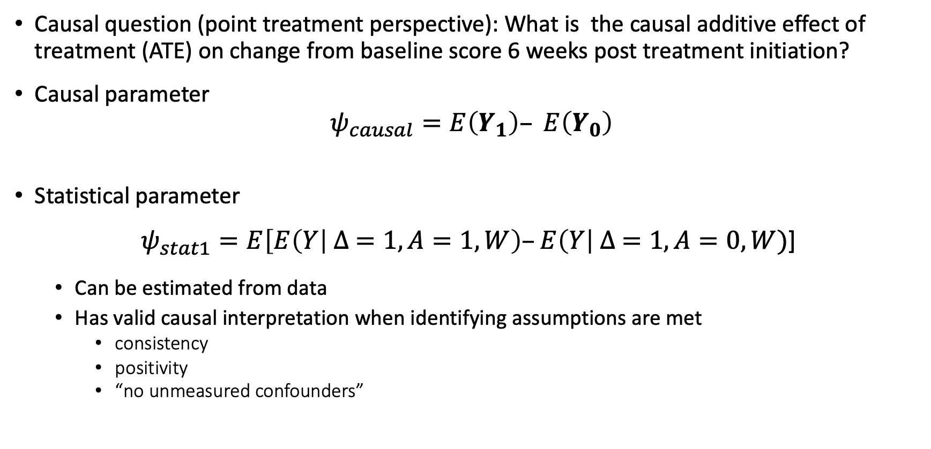
Phase II trial to investigate impact of treatment on change from baseline performance score
Causal question (point treatment perspective): What is the causal additive effect of treatment (ATE) on change from baseline score 6 weeks post treatment initiation?
Causal parameter $ψ_{causal}=E\left(Y_{1}\right)– E\left(Y_{0}\right)$
Statistical parameter
$ψ_{stat1}=E\left[E\left(Y\right| ∆ =1, A=1, W\right)–E\left(Y\right| ∆ =1,A=0, W)$]
Can be estimated from data
Has valid causal interpretation when identifying assumptions are met
consistency
positivity
“no unmeasured confounders”

Slide 8
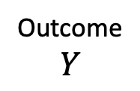
Phase II trial to investigate impact of treatment on change from baseline performance score
Longitudinal process giving rise to the RCT data
Outcome $$Y$$
L₀
A₀
C₁
L₁
A₁
C₂
L₂
...
C₆
L₆
time
change from baseline score at 6 weeks
Covariate and outcome nodes (L₀, ..., L₆)
Treatment and censoring nodes (A₀, C_{1,} ..., A₅, C₆), known as “intervention nodes”
Baseline covariates L₀
Time varying covariates L₁, ..., L₆
Name | Type | Name | Type
score0 | continuous | albumin | continuous
ssr | continuous | age | continuous
dxTime | continuous | sex | binary
numMeds | integer | race | categorical
priorDrug | binary | weight | continuous
familyHistory | binary | region | binary
eGFR | continuous
Name | Type
change_from_baseline_score(t) | continuous
eGFR(t) | continuous

Slide 9

Phase II trial to investigate impact of treatment on change from baseline performance score
Longitudinal perspective on evaluating marginal additive effect of treatment (ATE)
Causal parameter (per protocol*) $ψ_{causal}=E\left[E\left(Y_{\overline{a}=(1,1,1,1,1,1,11,1,1,1,1)}\right)– E\left(Y_{\overline{a}=(0,1,0,1,0,1,0,1,0,1,0,1)}\right)\right]$
“potential outcome” when patient treated with Study Drug and remains uncensored for entire follow-up period
“potential outcome” when patient treated with Placebo and remains uncensored for entire study period
*might be interested in mITT effect: “treat and remain uncensored” vs. “placebo and remain uncensored”
${\overline{a}}_{trt}=\left(1, 1,.,1,.,1,.1,.,1,.,1\right) {\overline{a}}_{ctl}=(0, 1,.,1,.,1,.1,.,1,.,1)$

Slide 10
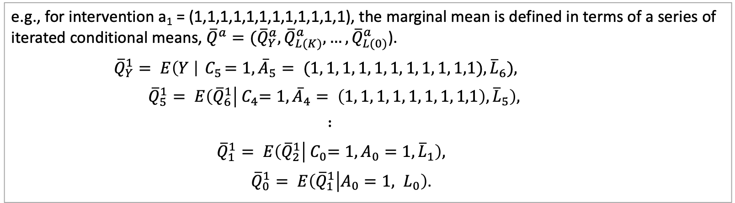

Phase II trial to investigate impact of treatment on change from baseline performance score
Longitudinal perspective
Statistical parameter is difference in two “intervention specific” means
$$ψ_{stat2}=E_{L_{0}}({\overline{Q}}_{0}^{1})\text{ − }E_{L_{0}}({\overline{Q}}_{0}^{0})$$
$ψ_{stat2}$ is equivalent to $ψ_{causal }$ when extended identifying assumptions are met
consistency, positivity hold at each time point, sequential randomization
e.g., for intervention a₁ = (1,1,1,1,1,1,1,1,1,1,1,1), the marginal mean is defined in terms of a series of iterated conditional means, ${\overline{Q}}^{a}=({\overline{Q}}_{Y}^{a}, {\overline{Q}}_{L(K)}^{a}, …, {\overline{Q}}_{L(0)}^{a}$).
$${\overline{Q}}_{Y}^{1}= E\left(Y \right|{ C}_{5}=1,{\overline{A}}_{5}= (1, 1, 1, 1, 1, 1, 1, 1, 1, 1,1),{\overline{L}}_{6}),$$
$${\overline{Q}}_{5}^{1}= E\left({\overline{Q}}_{6}^{1} | {{ C}_{4}=1,\overline{A}}_{4}= \left(1, 1, 1, 1, 1, 1, 1, 1,1\right),{\overline{L}}_{5}\right),$$
$$∶$$
$${\overline{Q}}_{1}^{1}= E\left({\overline{Q}}_{2}^{1} | { C}_{0}=1, A_{0}=1,{\overline{L}}_{1}\right),$$
${\overline{Q}}_{0}^{1}= E\left({\overline{Q}}_{1}^{1} | A_{0}=1, L_{0}\right)$.

Slide 11
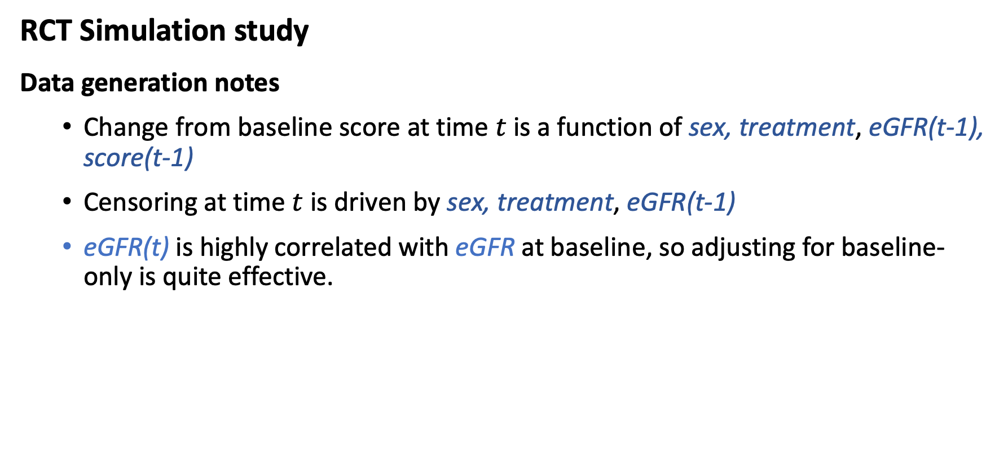
Phase II trial to investigate impact of treatment on change from baseline performance score
RCT Simulation study
Data generation notes
Change from baseline score at time $t$ is a function of sex, treatment, eGFR(t-1), score(t-1)
Censoring at time $t$ is driven by sex, treatment, eGFR(t-1)
eGFR(t) is highly correlated with eGFR at baseline, so adjusting for baseline-only is quite effective.

Slide 12
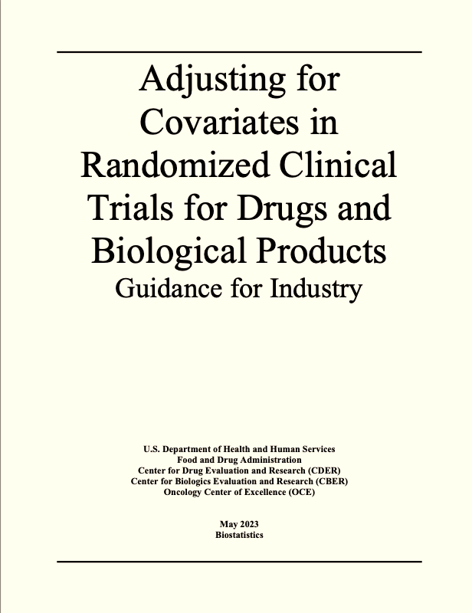
Phase II trial to investigate impact of treatment on change from baseline performance score
RCT Simulation study to compare methods for evaluating the ATE
Data Generation (n = 160)
Treatment randomized (1:1)
chance imbalances may exist
gain efficiency by adjusting for baseline covariates predictive of outcome even in RCT
Data simulated at weekly intervals conditional on baseline and most recent past
25% lost to follow-up over time
informative LTFU depends on treatment and eGFR (risk increases monotonically with eGFR, but not linearly)
Challenges
Cannot adjust for all measured covariates, but experts don’t know which are true confounders
Traditional main terms parametric models are slightly misspecified

Slide 13
Phase II trial to investigate impact of treatment on change from baseline performance score: Estimation
Estimators
Unadj: Unadjusted difference in mean outcomes
MMRM: Mixed modeling with repeated measures, all true confounders as main terms
Oracle-MMRM: Correct model specification (main terms + one 3-way interaction)
P-TMLE: TMLE with point treatment formulation
L-TMLE: TMLE with longitudinal formulation
Match: full propensity score (PS) matching with replacement, no post-match adjustment
Match-adj: full PS matching with replacement, post-match adjustment
IPTCW: Inverse probability of treatment and censoring weighting

Slide 14
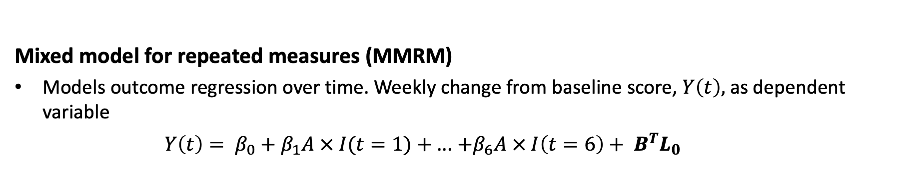

Phase II trial to investigate impact of treatment on change from baseline performance score: Estimation
Mixed model for repeated measures (MMRM)
Models outcome regression over time. Weekly change from baseline score, $Y\left(t\right),$as dependent variable
$Y\left(t\right)= β_{0}+β_{1}A × I(t=1)+$... $+β_{6}A × I\left(t=6\right)+ B^{T}L_{0}$
”$W”$
MMRM estimators
“MMRM”: Main terms outcome model, correctly specified except omitting 3-way interaction
change_{6wks} ~ trt * I(t=1) + ... + trt * I(t==6 )+ score.0 + sex + age + eGFR
“Oracle-MMRM”: Correctly specified outcome model
change_{6wks} ~ trt * I(t=1) + ... + trt * I(t==6 )+ score.0 + sex + age + eGFR + sex * I(age > 40) * week

Slide 15
Targeted Learning Tools for Estimation
Data analysis using targeted maximum likelihood estimation (TMLE) and Super Learner (SL)
Strengths of TMLE+SL
TMLE is maximally efficient Small standard errors produce Narrow confidence intervals Maximal power to detect an effect
TMLE is double-robust Handles baseline and time-dependent confounding Unbiased if either outcome regression or treatment & missingness are well approximated Super learning provides a flexible ML solution for mitigateing model misspecification bias
Valid Inference (analytic and targeted bootstrap options) Confidence intervals with good coverage Accurate p-values and Type-I error control

Slide 16
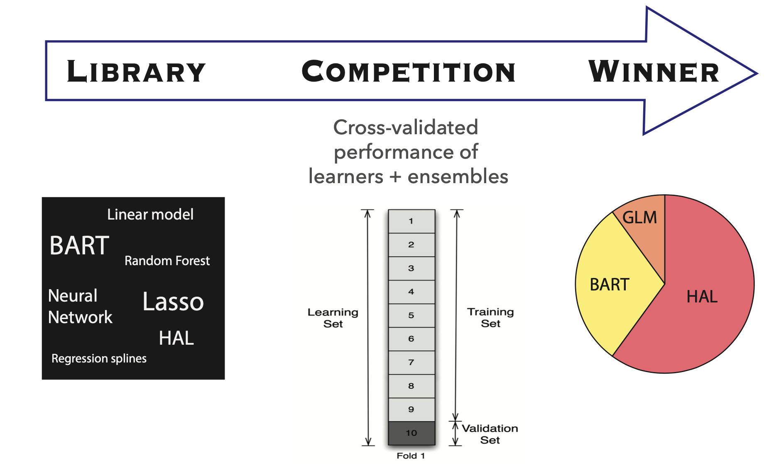
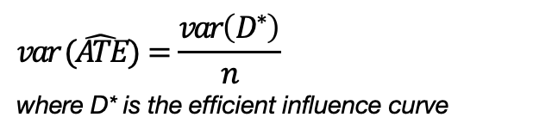
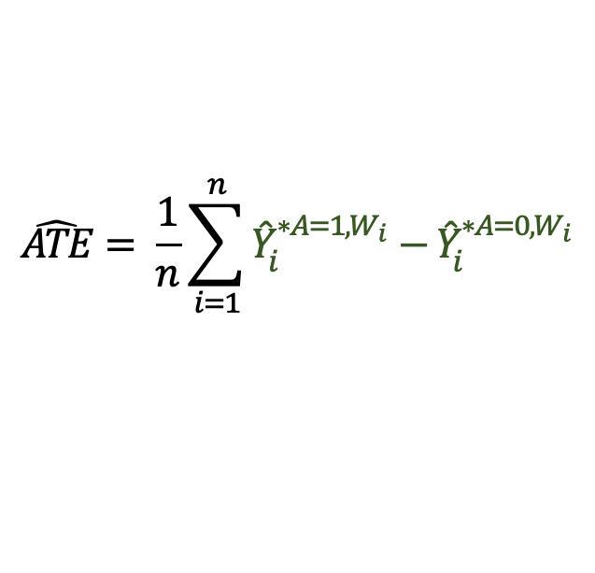

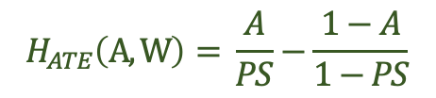
Estimation and inference using TMLE+SL
TMLE for estimating the additive treatment effect ATE
Step 1. Super Learner
Step 2. “Targeting step”
Step 3. “Plug In”
initial outcome estimates when A=1 and A=0
propensity score (PS) estimates
Reduce bias in estimate
update initial outcome values
statistical theory dictates how to use PS for this purpose
evaluate the estimand
calculate the variance
evaluate the confidence interval
Outcome Super Learner
${\hat{Y}}_{1}^{A=0,W_{1}}$, ${\hat{Y}}_{1}^{A=1,W_{1}}$
${\hat{Y}}_{2}^{A=0,W_{2}}$, ${\hat{Y}}_{2}^{A=1,W_{2}}$
$$\hat{ATE}= \frac{1}{n}\sum_{i=1}^{n}{{\hat{Y}}_{i}^{∗A=1,W_{i}}−{\hat{Y}}_{i}^{∗A=0,W_{i}}}$$
${\hat{Y}}_{1}^{∗A=0,W_{1}}$, ${\hat{Y}}_{1}^{∗A=1,W_{1}}$
${\hat{Y}}_{2}^{∗A=0,W_{2}}$, ${\hat{Y}}_{2}^{∗A=1,W_{2}}$
data
...
age sex
37 M
62 F
PS Super Learner
...
$${ \hat{PS}}_{1 }$$
$${ \hat{PS}}_{2}$$
$$var (\hat{ATE})=\frac{var\left(D^{∗}\right)}{n}$$
where D* is the efficient influence curve
...
...
Targeting “clever covariate”
$$H_{ATE}\left(A,W\right)= \frac{A}{PS}−\frac{1−A}{1−PS}$$

Slide 17
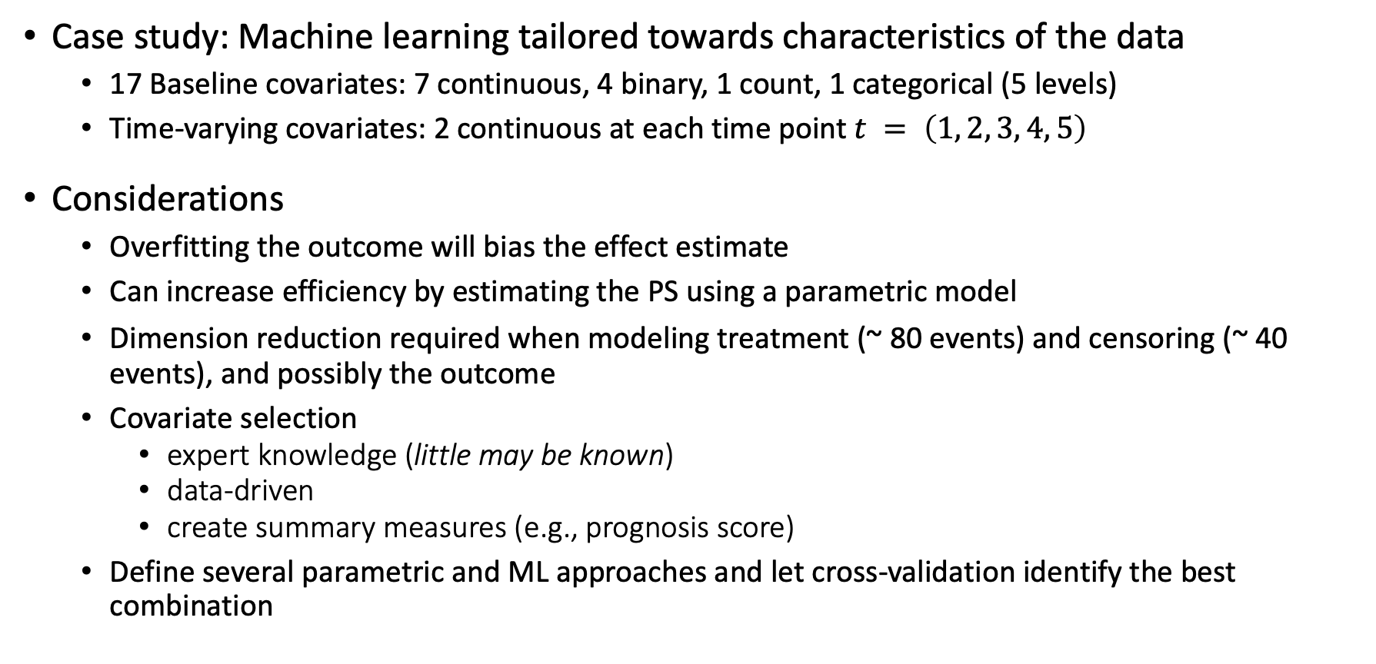
Super Learning in Rare Disease Setting
Case study: Machine learning tailored towards characteristics of the data
17 Baseline covariates: 7 continuous, 4 binary, 1 count, 1 categorical (5 levels)
Time-varying covariates: 2 continuous at each time point $t = \left(1, 2, 3, 4, 5\right)$
Considerations
Overfitting the outcome will bias the effect estimate
Can increase efficiency by estimating the PS using a parametric model
Dimension reduction required when modeling treatment (~ 80 events) and censoring (~ 40 events), and possibly the outcome
Covariate selection
expert knowledge (little may be known)
data-driven
create summary measures (e.g., prognosis score)
Define several parametric and ML approaches and let cross-validation identify the best combination

Slide 18
Phase II trial to investigate impact of treatment on change from baseline performance score
RESULTS
True treatment effect = - 10.0
Bias
P-TMLE, L-TMLE, Match-Adj are least biased
Matching is as biased as Unadjusted
MMRM and IPTCW are biased
Efficiency
P-TMLE and L-TMLE have smallest standard error (SE) and mean squared error (MSE), comparable to Oracle
L-TMLE gains efficiency by exploiting time-varying information
Unadj MMRM Oracle P-TMLE L-TMLE Match Match-adj IPTCW
Bias -1.32 -0.67 0.03 -0.05 0.15 -1.37 -0.02 -0.50
SE 1.31 1.11 0.46 0.67 0.62 1.21 0.84 1.01
MSE 3.45 1.67 0.21 0.44 0.40 3.32 0.71 1.26

Slide 19
Drivers of TMLE + SL performance
Entire TMLE+SL procedure tailored for reducing bias in the ATE
Estimation respects known bounds on the problem to remain within statistical model
Intelligent (targeted) machine learning tuned to provide good finite sample performance
Main terms parametric model is often unrealistic in practice
ignore drug-drug interactions, effect modification
enforce monotonicity even when not warranted
Tree-based machine learning algorithms, generalized additive models, and others will naturally model non-linearities and interactions
SL uses cross-validation to identify best functional form among set of parametric and machine learning algorithms specified in the library
Targeting step tuned for beneficial bias/variance trade off by bounding the values of the “clever covariate” at level driven by theory

Slide 20
Drivers of TMLE + SL performance
In contrast to MMRM
MMRM requires correct a priori parametric model specification (except if treatment is randomized and censoring is uninformative)
This is very hard to do in practice
In RCTs with little or no informative dropout MMRM is unbiased, but can still be less efficient than TMLE if specified outcome model is sub-optimal

Slide 21
Lessons Learned
P-TMLE, L-TMLE ideal in rare disease RCTs with limited sample size
Both can handle informative drop-out, minimizes model-misspecification bias
L-TMLE may improve efficiency over P-TMLE by exploiting time-varying covariates
Even in RCTs, traditional reliance on main terms parametric outcome models not as effective as machine learning done with care
motivates collecting many covariates, even when little understanding of natural history, covariate-outcome relationships
SL specification should be tailored toward characteristics of the data and anticipated sparsity of information
Small sample size, rare number of events, high dimensional data signal sparsity
TMLE boundedness, targeting, approach to inference, all tailored toward characteristics of the data

Slide 22
Additional Slides

Slide 23
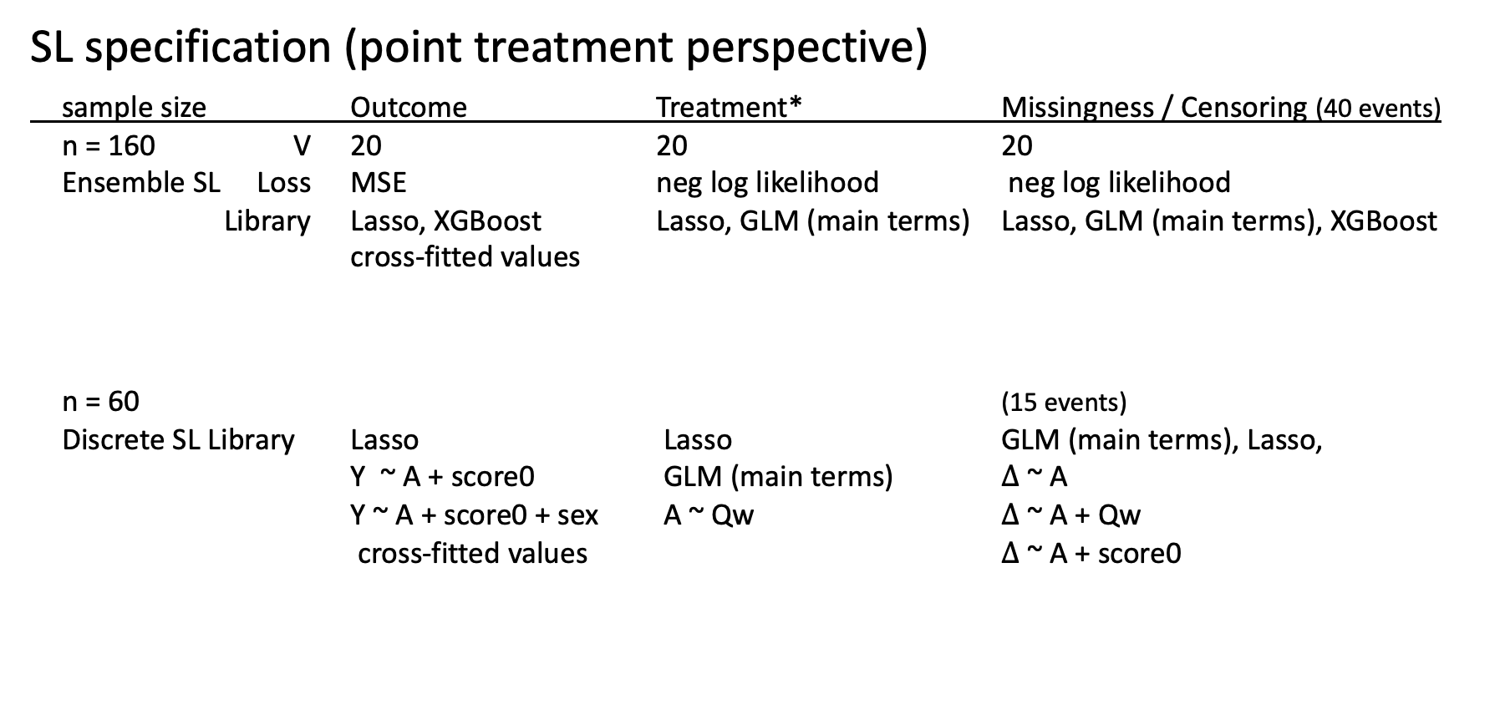
Super Learning in Rare Disease Setting
SL specification (point treatment perspective)
sample size Outcome Treatment* Missingness / Censoring (40 events)
n = 160 V 20 20 20
Ensemble SL Loss MSE neg log likelihood neg log likelihood
Library Lasso, XGBoost Lasso, GLM (main terms) Lasso, GLM (main terms), XGBoost
cross-fitted values
n = 60 (15 events)
Discrete SL Library Lasso Lasso GLM (main terms), Lasso,
Y ~ A + score0 GLM (main terms) $∆$ ~ A Y ~ A + score0 + sex A ~ Qw $∆$ ~ A + Qw
cross-fitted values $∆$ ~ A + score0
less data-adaptive specification for small sample size
subject-level summary measure

Slide 24
Phase II trial to investigate impact of treatment on change from baseline performance score
Point Treatment results with much smaller sample size, n = 60 (500 Monte Carlo replicates)
TMLE is essentially unbiased, smallest SE, best MSE
Matching, Match-Adj no better than Unadj
IPTCW reduces some, but not all bias.
Targeted bootstrap conservative at this sample size
Estimator | Bias | Empirical SE | MSE | Coverage
Unadj | -1.25 | 2.22 | 6.47 | 88.4
P-TMLE | -0.04 | 1.31 | 1.71 | 87.2 (IC) 97.8 (TBS)
Match | -1.13 | 2.38 | 6.95 | 91.8
Match-Adj | 0.19 | 2.48 | 6.18 | 72.1
IPTCW | -0.36 | 1.93 | 3.85 | 96.0
ªIC = influence curve; ^{b}TBS = targeted bootstrap

Slide 25


Estimation and Inference Using TMLE + SL
Control Type-I error rate, achieve nominal confidence interval coverage
Option 1. Construct usual Wald-type 95% CI and p-value using analytic variance estimate
$$σ_{n }^{2}=var(EIC)/n$$
95% CI:
$$ψ_{n, study }±1.96σ_{n }$$
p-value:
$$2Φ\left(−\left|T\right|\right)$$
$$where T={ψ_{n, study }}/{σ_{n }}$$
Option 2. Targeted bootstrap
Only bootstrap targeting step
fast - no additional modeling required
Good coverage in small samples
quantile-based lower and upper CI bounds, p-value
$ψ_{n, 1 }$, ... , $ψ_{n, 250 }\text{, } \text{...} \text{,} ψ_{n,study}\text{,}$... , $ψ_{n, 9750}$ , ... ,${ ψ}_{n, 10000}$

Slide 26
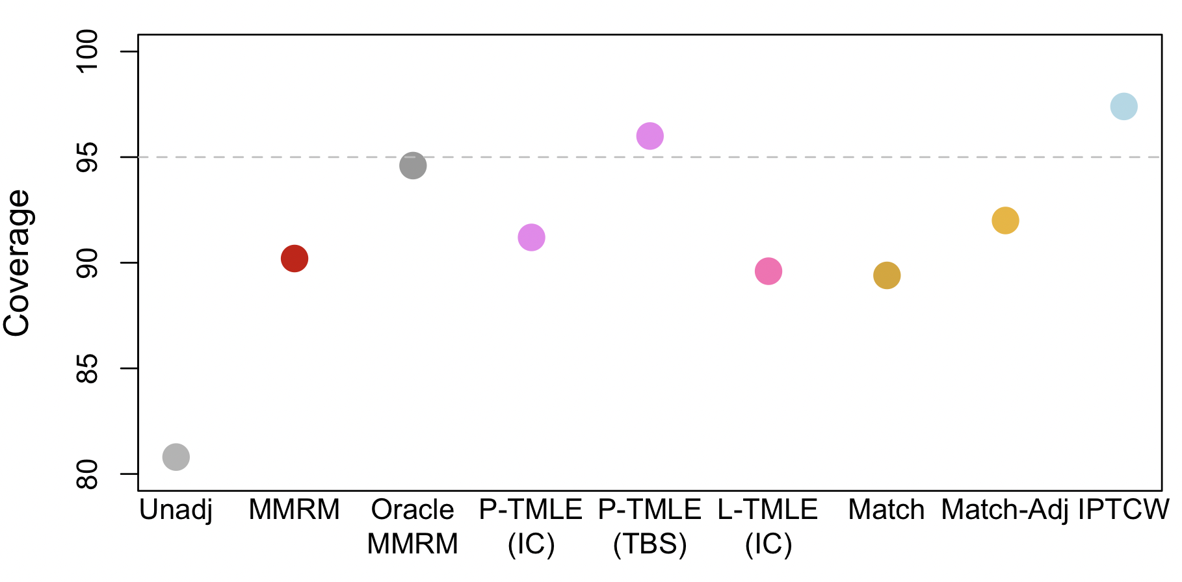
Phase II trial to investigate impact of treatment on change from baseline performance score
RESULTS
Coverage
P-TMLE with targeted bootstrap inference has good coverage (96%)
IPTW slightly conservative (97.4%)
Others are anti-conservative (low coverage)
80.8% 90.2% 94.6% 92.1% 96.0% 89.6% 89.4% 92.0% 97.4%
ªIC = influence curve; ^{b}TBS = targeted bootstrap

Slide 27


To Learn More...
Books
MJ van der Laan and S Rose (2011). Targeted learning: causal inference for observational and experimental data (Vol. 4). New York: Springer.
MJ van der Laan and S Rose (2018). Targeted learning in data science. Cham, Switzerland: Springer International Publishing.
TL Webinars and Instructional Videos on YouTube
Targeted Learning webinar series
www.youtube.com/playlist?list=PLy_CaFomwGGGH10tbq9zSyfHVrdklMaLe
TL Briefs (instructional videos)
www.youtube.com/playlist?list=PLy_CaFomwGGFMxFtf4gkmC70dP9J6Q3Wa
Introductory papers
Mark van der Laan (2015). Why we need a statistical Revolution. Sense about Science USA. https://senseaboutscienceusa.org/super-learning-and-the-revolution-in-knowledge/
ML Petersen, MJ van der Laan (2014). Causal Models and Learning from Data: Integrating Causal Modeling and Statistical Estimation. Epidemiology. 25(3):418-426. doi:10.1097/EDE.0000000000000078
S Gruber, RV Phillips, H Lee, M Ho, J Concato, MJ van der Laan (2024). Targeted Learning: Toward a Future Informed by Real-World Evidence, Stat Biopharm Res, DOI: 10.1080/19466315.2023.2182356
L Dang, et al. (2023). A Causal Roadmap for Generating High-Quality Real-World Evidence. J Clin Transl Sci . 2023 Sep 22;7(1):e212. doi: 10.1017/cts.2023.635.
S Gruber, MJ van der Laan (2024). Targeted Learning for improved causal inference in randomized controlled trials. ASA Biopharmaceutical Report, Winter 2024. https://asabiopreport.substack.com/p/targeted-learning-for-improved-causal .
26

