Slide 1
Artificial Intelligence in Rare Disease Research: Accelerating Relief for the Unrecognized
Timothy J. Smith, PhD
Takeda Pharmaceuticals
October 9, 2025
Notes:
Pre reads: Annual Program Report

Slide 2

What is not so rare about rare?
Notes:
Rare diseases affect over 300 million people worldwide, yet 95% lack approved treatments due to small patient populations, limited research funding, and prolonged diagnostic journeys. This presentation looks at how artificial intelligence and machine learning stand to transform rare disease research across three critical domains: revolutionizing drug discovery, accelerating accurate diagnosis, and optimizing treatment strategies. Using several examples, we examine how AI-powered diagnostic tools are reducing the average 5–7-year diagnostic odyssey. Narcolepsy type 1 has an average of 14 years latency in diagnosis around the world.

Slide 3











MIT-Takeda Program
1
Patients
2
Trust
1
Enable Takeda to embrace AI as a powerful tool to help us gain better data insights and efficiencies and better serve our patients
Review best practices
AI/ML Rigor and Robustness Framework
Machine Learning Compliance Controls Framework (MLCCF)
Structured education and training
9 faculty led webinars
4 tailored AI/ML workshops
Capacity building
16 published manuscripts and posters
3 MIT students hired
Launch in January 2020
130+ Takeda Colleagues
22 Research Projects
9 indications
3
Reputation
4
Business
Aligned with goals of Digital Advisory Board (DAB) and pursued in parallel:
Wholly external investment
Academic collaboration
Grass-roots volunteerism
Philanthropic donation
42 Takeda Fellowships funded
10 MIT SuperUROP students supported
6 Takeda mentors participated in MIT’s DHIVE Program
Obtain tangible solutions to key business problems across the enterprise
Predictive algorithms
Deep learning models
PoC software implemented
Patent application
https://news.mit.edu/2023/mit-takeda-program-fourth-year-projects-0227

Slide 4
22 MIT-Takeda projects were launched across the drug development pipeline
Round 1 (2020-2022)
Deep learning for human-microbiome protein interactions
Early diagnosis of IBD patients and therapy non-responders
Automating liver image analysis
Voice Analytics for FTD
Probabilistic programming for clinical trial oversight
Automating inspection of lyophilized products
Predictive modeling for biologics
Automating unit operations using video data
NLP for adverse effect assessments
Automating the scientific literature review
Target Discovery & Validation
Preclinical Research
Clinical Development and Disease Management
Manufacturing
Post-marketing
& Safety
Commercial
Deep learning to identify biomarkers for Neuroscience
Forecast multiple myeloma patient biomarkers
ML for classification of MLD patients
ML for early diagnosis of Fabry patients
Predictive modeling for early diagnosis of GI patients
Implementing automated inspection of lyophilized products
Implementing automated unit operations
Predictive modeling for biologics
Framework for ML and RWD/RWE
Predictive signal detection and analysis
ML to evaluate RWD/RWE for chronic kidney disease
Optimizing patient and HCP engagement
Round 2 (2022-2024)
Notes:
Rare diseases affect over 300 million people worldwide, yet 95% lack approved treatments due to small patient populations, limited research funding, and prolonged diagnostic journeys. This presentation looks at how artificial intelligence and machine learning stand to transform rare disease research across three critical domains: revolutionizing drug discovery, accelerating accurate diagnosis, and optimizing treatment strategies. Using several examples, we examine how AI-powered diagnostic tools are reducing the average 5–7-year diagnostic odyssey.

Slide 5
MIT-Takeda Project
SMRT: System for Automated Bayesian Data Modeling for Clinical Trial Oversight (D900)
Reduce timeline and cost of monitoring clinical trial data
via AI/ML assistance
Notes:
Welcome to our demo and presentation on SMRT: a System for Automated Bayesian Data Modeling for Clinical Trial Oversight.
SMRT reduces the timeline and cost of monitoring clinical trial data via AI/ML assistance
We think we have achieved this proof of concept
My goal in this talk is to show you how we’ve done it over the past year -- so that we can have a productive conversation together about what would be most valuable for Takeda to do next

Slide 6




How SMRT works
Approved data
Site 1
Site 2
…
Site N
Vendor 1
Vendor 2
….
Vendor N
Patient ID
#1
#2
...
#N
Near real-time
data stream
SMRT
Problematic data
Patient ID
Clinical trial manager
to schedule site visit
Count problems per site
Optional
#1
#2
...
#N
Trial site 4: 10.0% problematic data
Trial site 6: 1.0% problematic data
...
Trial site 8: 0.1% problematic data
Domain expert
provides feedback
Notes:
Let me walk you through how SMRT works.
We start with trial data from many sites and vendors.
This goes into our SMRT system.
SMRT then screens the data for probable anomalies.
Some data gets approved.
Other data is problematic.
the problematic data is AUTOMATICALLY FLAGGED BY OUR TOOL so that it can be reviewed by Takeda staff ---- clinical data solutions / data management, clinops, study team, or even someday the CRO/vendors
Takeda staff can label the data as truly problematic or not, improving SMRT for the next round of results.
SMRT can also monitor the total count of problems per site.
Sites that are problematic can get flagged, to schedule a site visit.
I'm happy to say that in our first year, we built this whole system, and got it working end-to-end.

Slide 7
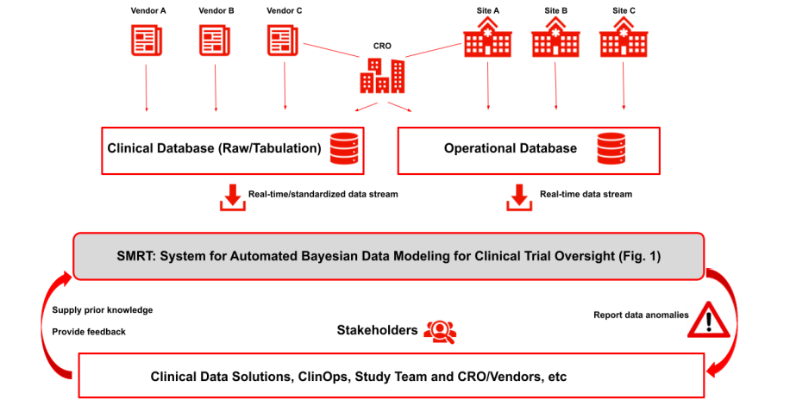
Data Flow
Notes:
Let me walk you through how SMRT works.
We start with trial data from many sites and vendors.
This goes into our SMRT system.
SMRT then screens the data for probable anomalies.
Some data gets approved.
Other data is problematic.
the problematic data is AUTOMATICALLY FLAGGED BY OUR TOOL so that it can be reviewed by Takeda staff ---- clinical data solutions / data management, clinops, study team, or even someday the CRO/vendors
Takeda staff can label the data as truly problematic or not, improving SMRT for the next round of results.
SMRT can also monitor the total count of problems per site.
Sites that are problematic can get flagged, to schedule a site visit.
I'm happy to say that in our first year, we built this whole system, and got it working end-to-end.

Slide 8
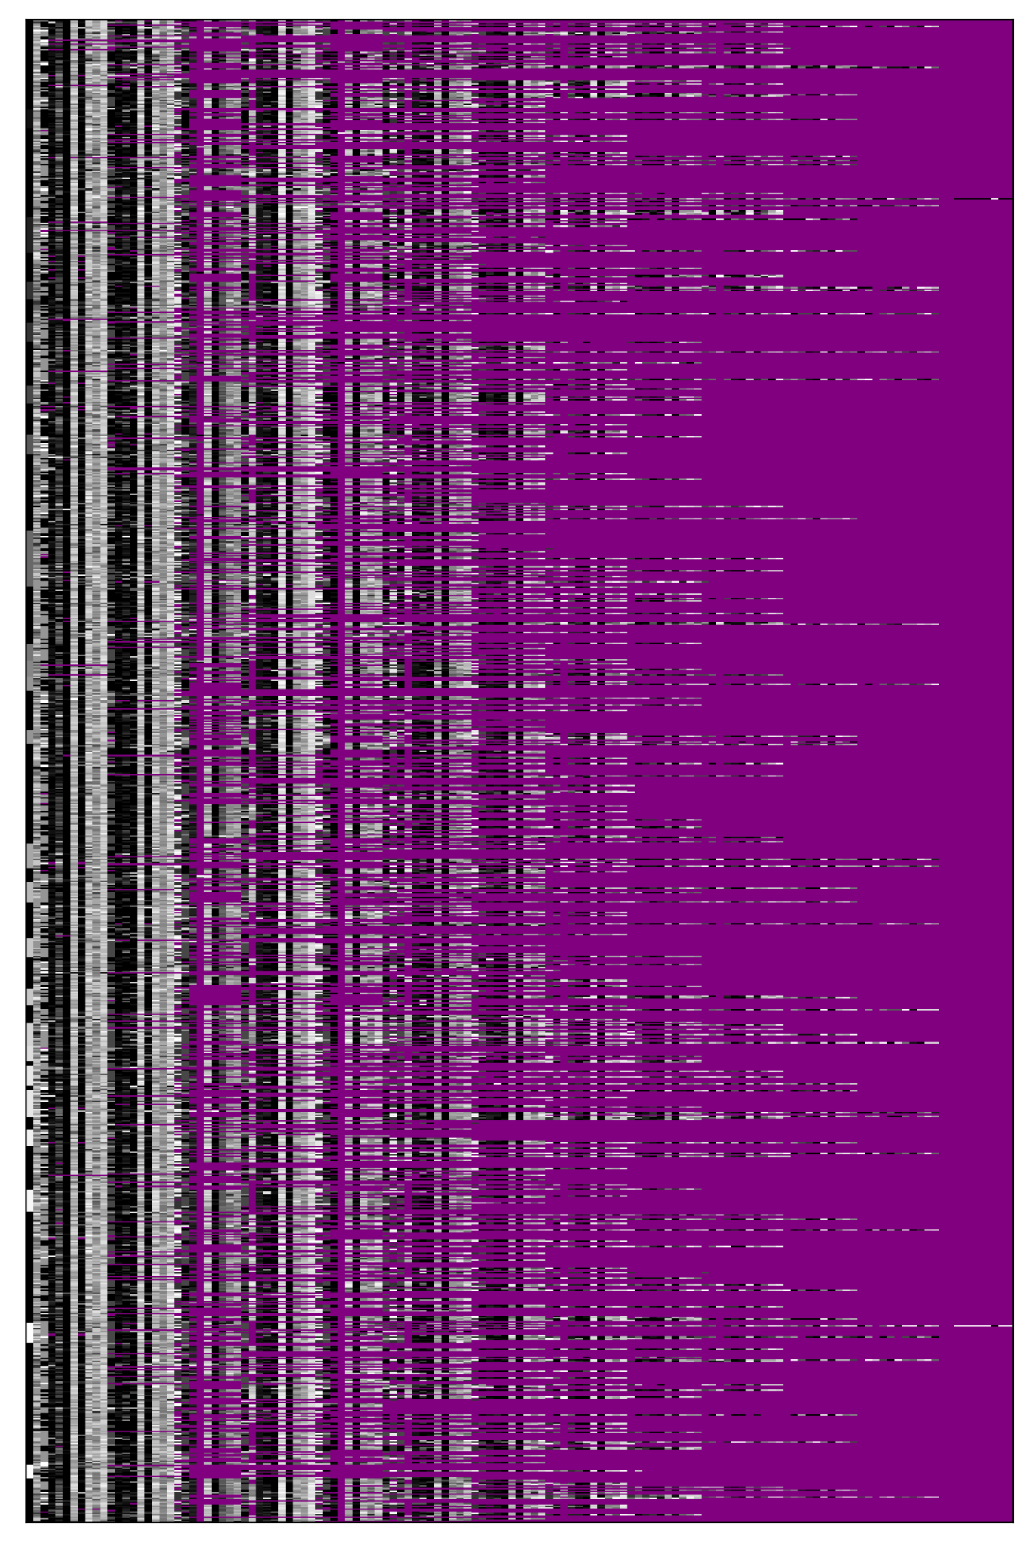

How SMRT works --- TAK-700 trial data
Site 1
Site 2
…
Site N
Vendor 1
Vendor 2
….
Vendor N
Efficacy, eligibility, safety, and covariates (133 total)
----------------------------------------------------------------
| Variable name | Variable value |
----------------------------------------------------------------
|Patient ID | C21005-2125-2574 |
|Trial Site | 125 |
|Age group | 82-89 |
|Eastern_Cooperative_Oncology__visit_#_1 | 0=NORMAL ACTIVITY |
|Lactate_Dehydrogenase_visit_#_1 | 219.0 |
|Blood_Cortisol_visit_#_1 | 65.0 |
|Corticosterone_visit_#_1 | 2.08 |
|Chloride_visit_#_1 | 106.0 |
|Alkaline_Phosphatase_visit_#_1 | 60.0 |
|Phosphate_visit_#_1 | 0.92 |
|Magnesium_visit_#_1 | nan |
|Sodium_visit_#_1 | 144.0 |
|Eastern_Cooperative_Oncology__visit_#_2 | 0=NORMAL ACTIVITY |
|Lactate_Dehydrogenase_visit_#_2 | 195.0 |
| ... | ... |
|Phosphate_visit_#_28 | nan |
|Magnesium_visit_#_28 | nan |
|Sodium_visit_#_28 | nan |
----------------------------------------------------------------
Near real-time
data stream
1099 patients,
260 sites
Trial data
Missing data
Notes:
We tested SMRT with a real Takeda trial, involving 1099 patients that were treated at 260 different sites.
Data streams from such real-world, clinical trials are complex.
Hundreds of different types of variables are measured (in this subset of the trial, we take 133 into account).
63% (over ninety thousand) values are missing. The pattern of the missing data is varied and is itself data-dependent.
Think about it -- healthy people have fewer tests done. So we have more data for patients who aren’t doing well. And because healthy people aren’t getting tested, we have less data toward the end of the trial than we did in the beginning, when Takeda was testing everyone.
Here, with the yellow bar on the right, I am highlighting one patient record. Notice age group, a demographic variable, Eastern Cooperative Oncology status, a key efficacy variable and the many lab tests that are either safety variables or informative for trial eligibility, safety and efficacy.
Modeling all this data manually would take (as one of the original D900 co-leads put it) "a small army of statisticians".

Slide 9
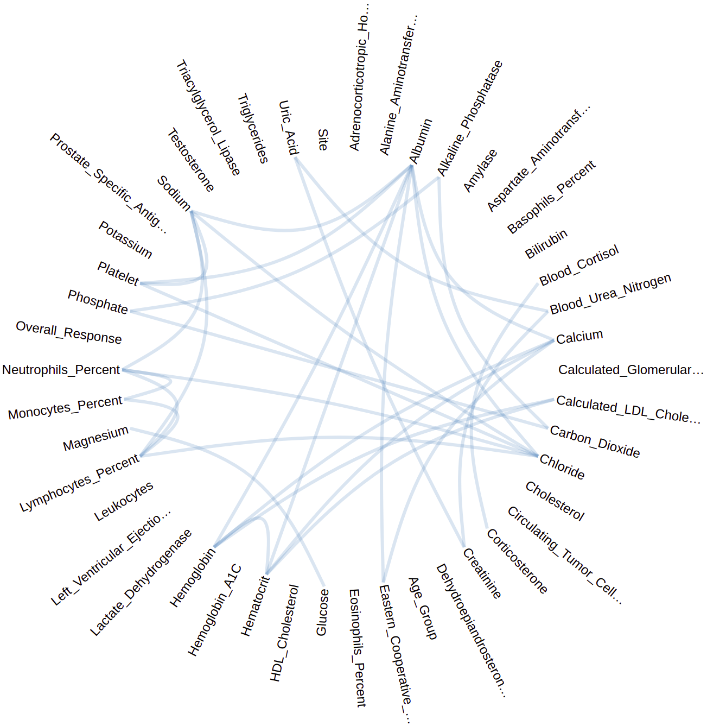
How SMRT works --- modeling trials via probabilistic programs
Site 1
Site 2
…
Site N
Vendor 1
Vendor 2
….
Vendor N
function Eastern_Cooperative_Oncology_Group_categories(index) { var categories = [
"NORMAL ACTIVITY", "AMBULATORY", "IN BED < 50% OF TIME", ...] return categories[index];} function Overall_Response_categories(index) { var categories = ["COMPLETE", "NON-COMPLETE, NON-PROGRESSIVE", ...] return categories[index];} function Age_Group_categories(index) { var categories = [
"42-49", "50-57", "58-65", "66-73", "74-81", "82-89", ">=89"] return categories[index];} ... function view_1_model () { var cluster_id = categorical([0.026, 0.124, 0.095 ...]) + 1; var ret_val; if (cluster_id == 1) { ret_val = { "Neutrophils_Percent": gaussian(60.856, 2.614), "Monocytes_Percent": gaussian(6.034, 1.565), "Lymphocytes_Percent": gaussian(29.386, 2.433), "Uric_Acid": gaussian(298.763, 67.129), "Adrenocorticotropic_Hormone": gaussian(3.621, 1.732), "Leukocytes": gaussian(6.353, 1.728), "Blood_Urea_Nitrogen": gaussian(6.326, 1.735), "Alanine_Aminotransferase": gaussian(19.251, 8.319), "Creatinine": gaussian(71.251, 14.721), "Dehydroepiandrosterone_Sulfate": gaussian(2628.475, 1148.788), "Potassium": gaussian(4.156, 0.401)}; } else if (cluster_id == 2) { ...}} function view_2_model () { var cluster_id = categorical([0.093, 0.167, 0.081, ...]) + 1; var ret_val; if (cluster_id == 1) { ret_val = { "Platelet": gaussian(263.897, 73.265), "HDL_Cholesterol": gaussian(1.157, 0.356), "Hemoglobin": gaussian(135.008, 6.818), "Eastern_Cooperative_Oncology_Group": ECOG_categories(...), "Hematocrit": gaussian(0.438, 0.022), "Testosterone": gaussian(0.103, 0.098), "Blood_Cortisol": gaussian(154.928, 91.209), "Calculated_LDL_Cholesterol": gaussian(4.331, 1.939), "Sodium": gaussian(141.625, 2.177), "Bilirubin": gaussian(7.024, 2.775), "Corticosterone": gaussian(1.491, 2.368), ... "Basophils_Percent": gaussian(0.630, 0.380)};} } else if (cluster_id == 2) {...}} function view_3_model () {...} function model_1() { var view_1 = view_1_model(); var view_2 = view_2_model(); var view_3 = view_3_model(); var view_4 = view_4_model(); return {...view_1, ...view_2, ...view_3, ...view_4};}
Near real-time
data stream
SMRT
SMRT automatically learns human-editable probabilistic programs
Notes:
I will now give you a brief peek into how probabilistic programming works.
The reason I'm showing you an example of these programs is to give you some intuition about how our approach works and why this approach is in fact necessary for real-time clinical trial monitoring.
First, these probabilistic programs are human readable and thus explainable, as well as editable. They are not black boxes like neural networks.
Takeda can save these probabilistic programs as long term assets --- for example, to use them in future phases of the same trial, or future trials with the same vendor, or even to generate virtual control arms in other trials.
The graph on the right explains how the code maps to what is going on in a trial.
SMRT automatically discovers what variables contain information about what other variables. This happens in a completely-data driven way, and emulates and complements domain knowledge a human expert would bring to the table.
SMRT can use this information to decide what data is relevant for the trial. For example, if a certain lab test is completely detached from anything we care about in the trial (for example eligibility, efficacy or safety), we probably do not want to concern ourselves with it.
But that information is often not available ahead of time, when a trial is started. To quote one of my Takeda colleagues: "we don't know what we don't know -- and we don't know which of these unknown unknowns could snowball into a problem later into the trial.”
To boil this point down to one sentence -- SMRT can decide what is relevant and what isn’t.

Slide 10
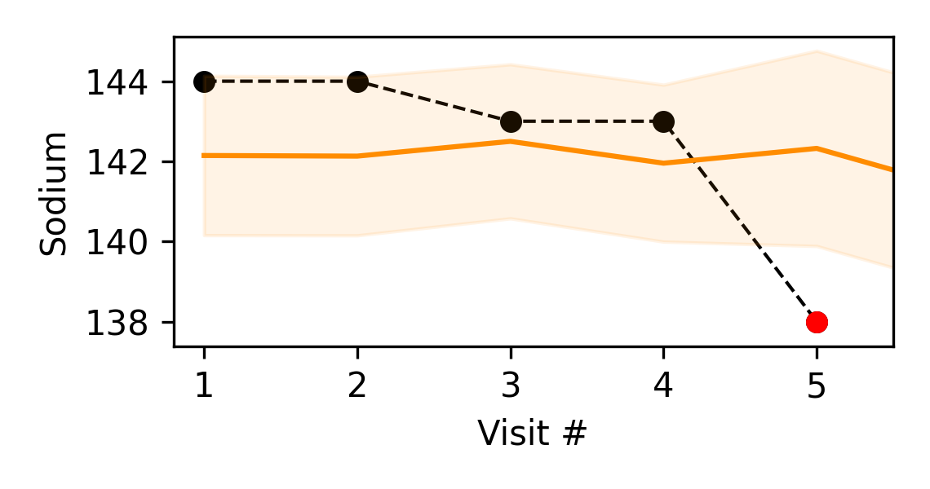
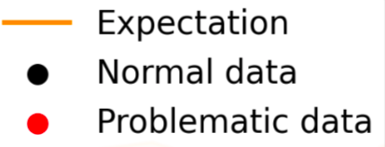
How SMRT works --- screening each data point
Site 1
Site 2
…
Site N
Vendor 1
Vendor 2
….
Vendor N
SMRT contextual model
Near real-time
data stream
SMRT
Notes:
Let's review one of the reported data points together.
On the right, we see SMRT's contextual model for one patient's sodium history over the course of the trial
- alongside the actual observed data in black (for values that were not flagged) and red (for a problematic value).
SMRT models all the patients in all available dimensions.
This context allows SMRT to assess where it should expect a certain value.
This information contributes to the models expectation where the trial data values land.
Orange shows the expected range of where SMRT "expects" the observed values to land over the course of 5 visits.
One could say that SMRT "thinks" "It is 95% certain that the value for Sodium should be here" (in the orange part).
while the patient's sodium level is on the higher side in the first four visits, the black dots are within that orange range. however, the red dot is far outside of the range at visit five, and as SMRT is 95% certain that it should be within the orange bar, it flags the value as anomalous.

Slide 11
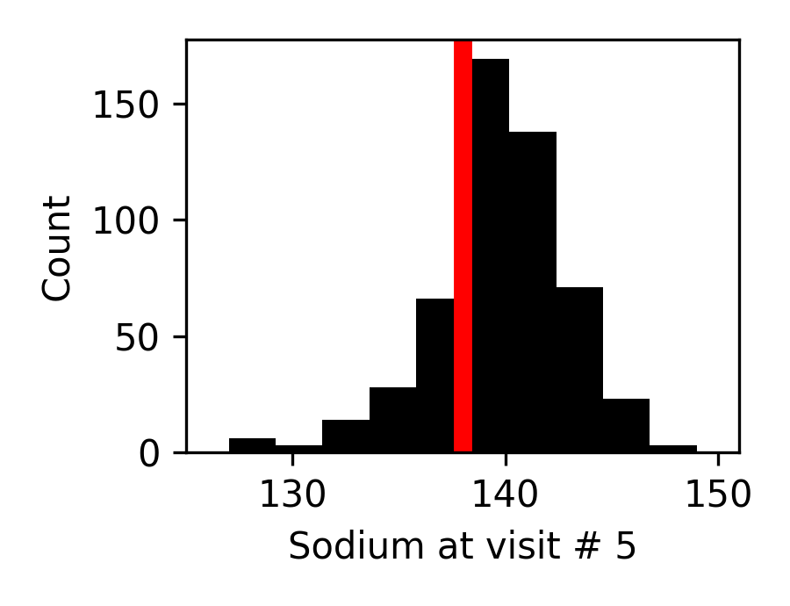
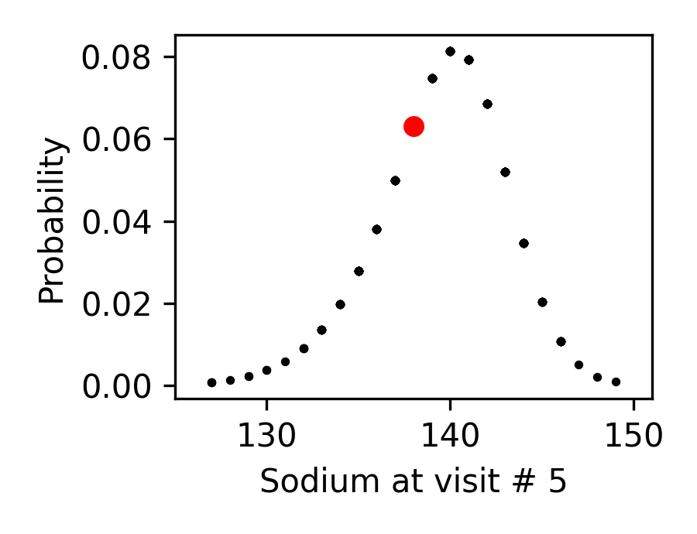
Problematic data analysis using just one dimension of data
TAK-700 data
SMRT univariate model
Looking at just one dimension, this visit 5 value is not an outlier.
Hundreds of other patients have a similar value in the data.
Notes:
Now let's zoom into what is going on with Sodium at visit 5, without any context from the previous four visits and other lab tests.
In the plot in the box on the left, you can see all the Sodium data for all the patients in this trial at their 5th visit. This person’s levels look normal -- shown in red, they are right in the middle of the pack.
On the right, we show the model SMRT encodes for this data. The probability of the value we are interested in is not particularly low and reflects that the value is
rather typical -- if one doesn't take into account context.
If you remember from the earlier slide, it’s actually a problematic data point -- falling much below the average sodium levels we want to see for this patient.
But you wouldn’t know it just looking at the snapshot from vist 5, because hundreds of other patients have similar sodium levels.

Slide 12
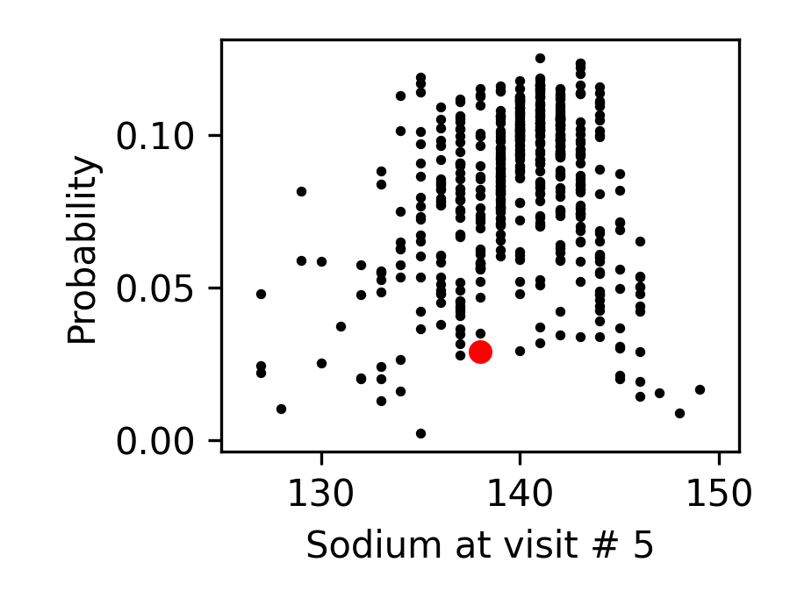
Problematic data analysis using many dimensions for context
SMRT contextualized model
… But actually, this visit 5 value is problematic,
given sodium and chloride at other visits!
Notes:
If we add context, the sodium value at visit 5 is problematic, given Sodium and Chloride measurements at other visits.
SMRT can automatically find the relevant links between variables, and contextualize the measurements given what SMRT learned, to make the decision to flag a data-point.
SMRT can help us learn that even though this person’s sodium falls within the range of normal for the population within the study, it is a problem for this patient and so Takeda employees should take a closer look. The model on the right captures all this context.

Slide 13
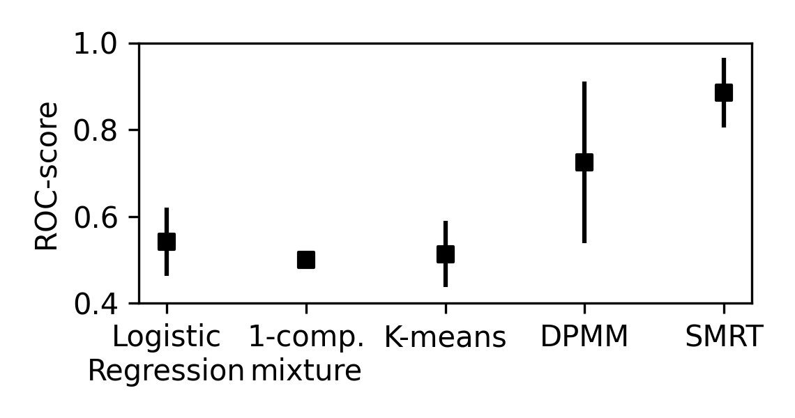
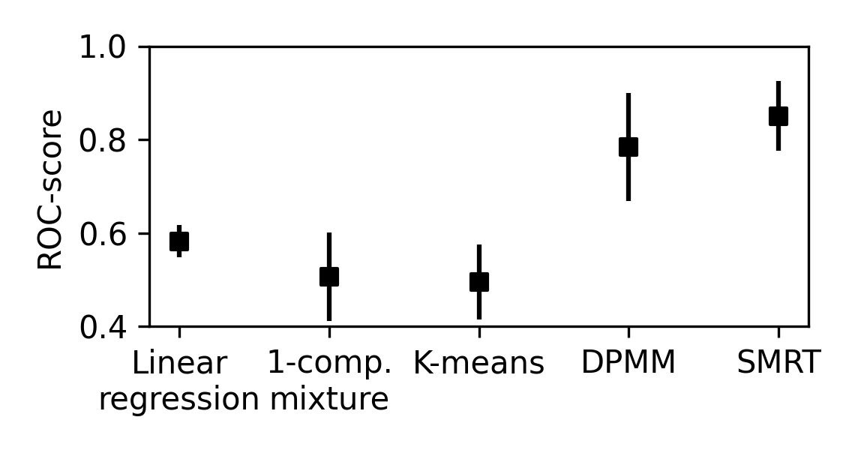


SMRT can be more accurate than baseline statistical methods
Problem type 1: categorical
Problem type 2: numerical
AOC/ROC score
(higher is preferred)
SMRT
SMRT
… but more basic research is needed, to more rigorously quantify accuracy & performance
Notes:
Let’s now look at how SMRTs results compare to other tools used by statisticians at Takeda.
We designed a synthetic study using statistical characteristics that roughly match the real data from TAK-700.
We trained models using this synthetic data for 1,000 patients. We then inserted anomalies and errors into this synthetic data set.
Next, we measured how accurate SMRT was in detecting these anomalies compared to four alternative approaches. As you can see, the SMRT tool outperforms the other approaches on two different types of problems -- categorically-valued anomalies and numerically-valued anomalies.
So what’s next? We can re-use the probabilistic programs we learned in year one, from the TAK-700 study, to generate more synthetic data and anomalies.
Because the SMRT tool is already calibrated against real Takeda data, the synthetic data and anomalies it generates will become more realistic.
One additional benefit of SMRT being a probabilistic program is that SMRT generates a score for how confident it is in any data or anomaly generated or flagged -- which allows us to better assess the quality of the tool.

Slide 14


D900: Leads
Jianchang Lin (Lead; SQS-O Director, DSI)
Prof. Vikash Mansinghka (PI)
Wenwen Zhang (Co-Lead; Associate Director, SQS-GI, DSI)
Prof. David Sontag (co-PI)
Notes:
Creating SMRT was really a team achievement.
Not only did we collaborate across the Takeda and MIT organizations,
But in fact, we brought a diverse set of perspectives at one table: Combining expertise from Takeda team members with statistics and data management background with our experience in computer science research and software engineering.

Slide 15

Key Advantages of Probabilistic Programming in Rare Disease Research
Handling Uncertainty in Small Data
Probabilistic programming effectively manages uncertainty in small datasets common in rare disease research.
Robust Inference with Limited Data
Models generalize well from minimal data by integrating prior knowledge and expert insights.
Personalized Predictions
Supports tailored predictions and treatment strategies based on individual patient characteristics and uncertainties.
Improved Reproducibility and Transparency
Explicit uncertainty representation enhances reproducibility and fosters trust in scientific findings.
Notes:
Probabilistic programming offers a transformative approach to rare disease research by addressing the inherent challenges posed by limited data availability and high uncertainty. One of its primary advantages is its ability to handle uncertainty in small datasets effectively. Rare diseases often involve small patient populations, making traditional statistical methods less reliable. Probabilistic models, however, can incorporate uncertainty directly into their structure, allowing researchers to make more informed inferences even when data is sparse. Another significant benefit is the capability to enable robust inference with limited patient data. Probabilistic programming frameworks allow for the construction of models that can generalize well from minimal data, which is crucial in rare disease contexts where collecting large datasets is often impractical or impossible. These models can also integrate prior knowledge and expert opinion, which is particularly valuable in rare disease research where domain expertise can compensate for data scarcity. By embedding expert insights into the model, researchers can guide the inference process and improve the accuracy of predictions. Furthermore, probabilistic programming supports personalized predictions and treatment strategies. By modeling individual patient characteristics and uncertainties, these approaches can tailor predictions to specific cases, enhancing the precision of diagnostics and therapeutic interventions. This personalization is vital in rare diseases, where variability among patients can be significant. Lastly, probabilistic programming improves reproducibility and transparency in modeling. The explicit representation of uncertainty and assumptions in probabilistic models fosters a clearer understanding of the modeling process, making it easier to replicate and validate findings. This transparency is essential for building trust in research outcomes and facilitating collaboration across institutions. Overall, probabilistic programming equips researchers with powerful tools to navigate the complexities of rare disease research, enabling more accurate, personalized, and reliable scientific insights.

Slide 16
Diagnosis of EoE
Notes:
Rare diseases affect over 300 million people worldwide, yet 95% lack approved treatments due to small patient populations, limited research funding, and prolonged diagnostic journeys. This presentation looks at how artificial intelligence and machine learning stand to transform rare disease research across three critical domains: revolutionizing drug discovery, accelerating accurate diagnosis, and optimizing treatment strategies. Using several examples, we examine how AI-powered diagnostic tools are reducing the average 5–7-year diagnostic odyssey.

Slide 17




Diagnosing Eosinophilic Esophagitis (MT3)
Eosinophilic Esophagitis (EoE) is a chronic, immune-mediated esophageal disease, largely thought to be food-antigen driven⁽¹⁾. The condition is characterized clinically by symptoms of esophageal dysfunction, and histologically by the infiltration of eosinophils in the esophagus.
Symptoms vary from person to person, and may include dysphagia, abdominal pain, chest pain, vomiting and esophageal stricture. Most patients with EoE also have comorbid allergic conditions, such as atopic dermatitis, asthma or food allergies⁽²⁾.
Symptoms
Prevalence in the U.S. is estimated to be 56.7 cases per 100,000 persons. Peak prevalence is in the 35-39 year age range, with higher prevalence rates in men (with a male-to-female ratio close to 3:1). With recognition of EoE growing, rates of diagnosis may result in increasing prevalence rates. EoE also carries a financial burden; it is estimated to cost the U.S. healthcare service $350-947 million per year⁽²⁾⁽³⁾⁽⁴⁾.
Prevalence
Timely diagnosis is critical to prevent the progression to potentially irreversible fibrosis of the esophagus, with the duration of untreated disease the strongest predictor of esophageal stricture. EoE is associated with significant disease burden, long-term complications, and major impacts patients’ quality of life⁽⁵⁾⁽⁶⁾.
Disease Burden
The goals of treatment include histological remission, as well as relieving the symptoms of esophageal dysfunction. The current standard of care includes various treatment strategies, including medication, specialized dietary therapy, and dilation of the esophagus. As a lifelong condition, invasive monitoring is required. However, despite the availability of treatment options, there is no definite agreement on how to establish the endpoints of therapy⁽¹⁾⁽⁷⁾⁽⁸⁾.
Treatment Considerations
Notes:
Bibliography
https://www.sciencedirect.com/science/article/abs/pii/S2213219823007006
https://www.ncbi.nlm.nih.gov/pmc/articles/PMC3952040/#:~:text=When%20standardized%20to%20the%20US,rate%20of%20114.6%2F100%2C000%20persons.
https://www.ncbi.nlm.nih.gov/pmc/articles/PMC7089863/
https://www.ncbi.nlm.nih.gov/pmc/articles/PMC4590991/
https://pubmed.ncbi.nlm.nih.gov/28774845/
https://www.ajmc.com/view/examining-unmet-needs-in-the-management-of-eosinophilic-esophagitis
https://www.ingentaconnect.com/content/wk/ajg/2022/00000117/00000008/art00017
https://journals.lww.com/ajg/Fulltext/2022/08000/Disease_Burden_and_Unmet_Need_in_Eosinophilic.17.aspx
https://aafa.org/wp-content/uploads/2023/05/life-with-EoE-eosinophilic-esophagitis-research-study-report.pdf
https://link.springer.com/article/10.1007/s12325-020-01463-2
https://academic.oup.com/dote/article/35/6/doab073/6414418?login=false
https://onlinelibrary.wiley.com/doi/full/10.1111/apt.15000
https://www.fda.gov/news-events/press-announcements/fda-approves-first-treatment-eosinophilic-esophagitis-chronic-immune-disorder
https://onlinelibrary.wiley.com/doi/10.1002/ueg2.12240
https://www.hcplive.com/view/eosinophilic-esophagitis-the-challenging-journey-to-diagnosis

Slide 18
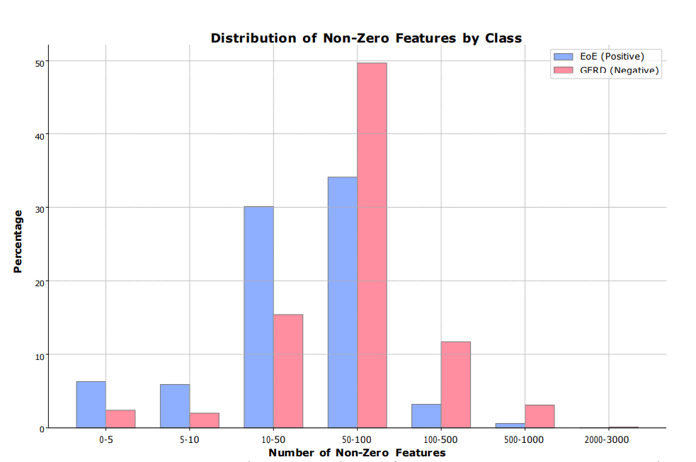
Differentiating Eosinophilic Esophagitis from GERD
Notes:
Rare diseases affect over 300 million people worldwide, yet 95% lack approved treatments due to small patient populations, limited research funding, and prolonged diagnostic journeys. This presentation looks at how artificial intelligence and machine learning stand to transform rare disease research across three critical domains: revolutionizing drug discovery, accelerating accurate diagnosis, and optimizing treatment strategies. Using several examples, we examine how AI-powered diagnostic tools are reducing the average 5–7-year diagnostic odyssey.

Slide 19
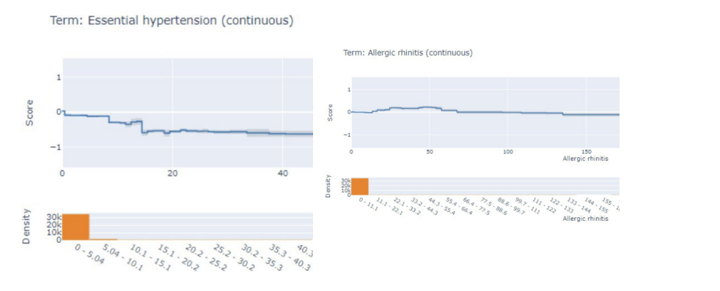
Differentiating Eosinophilic Esophagitis from GERD
Notes:
Rare diseases affect over 300 million people worldwide, yet 95% lack approved treatments due to small patient populations, limited research funding, and prolonged diagnostic journeys. This presentation looks at how artificial intelligence and machine learning stand to transform rare disease research across three critical domains: revolutionizing drug discovery, accelerating accurate diagnosis, and optimizing treatment strategies. Using several examples, we examine how AI-powered diagnostic tools are reducing the average 5–7-year diagnostic odyssey.

Slide 20
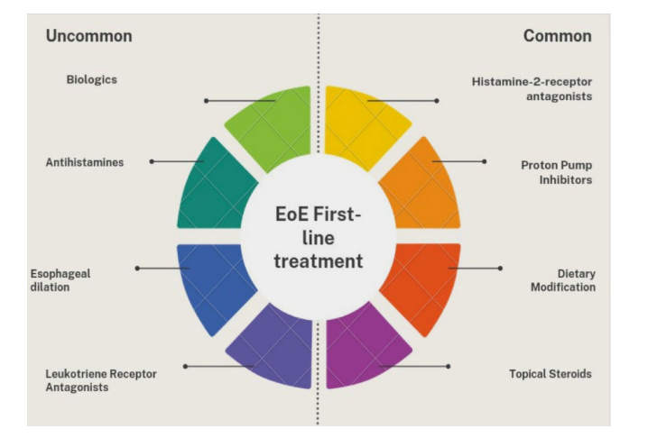
Disease Severity and Patient Treatments
Notes:
Rare diseases affect over 300 million people worldwide, yet 95% lack approved treatments due to small patient populations, limited research funding, and prolonged diagnostic journeys. This presentation looks at how artificial intelligence and machine learning stand to transform rare disease research across three critical domains: revolutionizing drug discovery, accelerating accurate diagnosis, and optimizing treatment strategies. Using several examples, we examine how AI-powered diagnostic tools are reducing the average 5–7-year diagnostic odyssey.

Slide 21
MT3: The Leads
Jeanne Jiang, PhD
Prof. Peter Szolovits (PI)
Tao Fan, PhD
Prof. Rahul Mazumder (co-PI)
Notes:
Creating SMRT was really a team achievement.
Not only did we collaborate across the Takeda and MIT organizations,
But in fact, we brought a diverse set of perspectives at one table: Combining expertise from Takeda team members with statistics and data management background with our experience in computer science research and software engineering.

Slide 22

Key Challenges facing AI/ML tools for Rare Disease Diagnosis
Challenges of AI/ML Tools in Early Diagnosis of Rare Diseases
Key Challenges:
Limited availability of labeled training data
High variability in disease presentation
Difficulty in validating models due to small patient populations
Risk of overfitting and poor generalization
Integration with clinical workflows and data systems
Ethical and regulatory concerns in medical AI applications
Notes:
Rare diseases affect over 300 million people worldwide, yet 95% lack approved treatments due to small patient populations, limited research funding, and prolonged diagnostic journeys. This presentation looks at how artificial intelligence and machine learning stand to transform rare disease research across three critical domains: revolutionizing drug discovery, accelerating accurate diagnosis, and optimizing treatment strategies. Using several examples, we examine how AI-powered diagnostic tools are reducing the average 5–7-year diagnostic odyssey.

