Slide 1
Propensity score-based unequal matching for rare disease clinical trials with external controls
Yusuke Yamaguchi
Astellas Pharma Global Development Inc.
Joint work with Cong Han (Astellas) and Xuewei Wang (Astellas)

Slide 2
Disclaimer
The speaker is a paid employee of Astellas. This presentation is intended for informational purposes only and does not replace independent professional judgment. This presentation is not intended to provide medical or legal advice. Statements of fact, positions taken and opinions expressed are those of the speaker individually and, unless expressly stated to the contrary, do not necessarily reflect the opinion or position of the speaker’s employer, Astellas, or any of its subsidiaries and/or related entities.

Slide 3
Introduction: Externally controlled designs in rare disease trials
Single-arm design
Hybrid control design
External control pool
(n=12)
Treatment
(n=12)
External control pool
(n=12)
R
Treatment
(n=12)
Propensity score-matched
external control
(n=6)
Propensity score-matched
external control
(n=6)
vs.
Control
(n=6)
2:1 matching of Treatment vs. External control pool
Nonparametric test: Treatment vs. Matched-External control
3:1 matching of RCT (Treatment + Control) vs. External control pool
Nonparametric test: Treatment vs. Control + Matched-External control
Propensity score-based matching helps eliminate systematic imbalances in measured confounders between patients in the current trial and external controls.
Due to small sample size, consider using nonparametric analysis approaches such as Wilcoxon rank sum test and Hodges-Lehmann estimate.

Slide 4
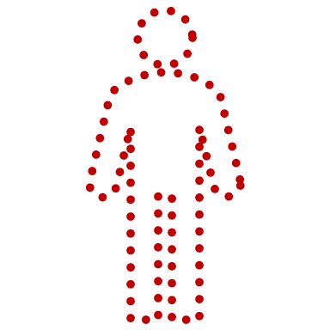


Key challenge: Unequal matching
Fewer external control patients are to be matched to more treated patients (matching ratio < 1), which cannot be handled by standard pairwise matching.
Matching
2:1
Treatment
(n=12)
External Control Pool
(n=12)
External Control
(n=6)
Treatment
External control
??

Slide 5

Method 1: Caliper adjustment
Matching with a caliper width of X, where X must be tuned iteratively to obtain the fixed number of matched external control (n=6).
Treatment
External control
0.0
0.5
1.0
Propensity score
*Same as the way proposed by Lin et al. (2019), DOI: 10.1002/pst.1918

Slide 6


Method 2: Equally splitting, followed by 1:1 matching
Equally split treatment patients to subsets, where the number of subsets is the same as the desired number of external controls (n=6).
Calculate mean propensity scores within each subset.
Perform 1:1 matching between treatment subsets vs external control pool.
Treatment
External control
0.0
0.5
1.0
Propensity score

Slide 7
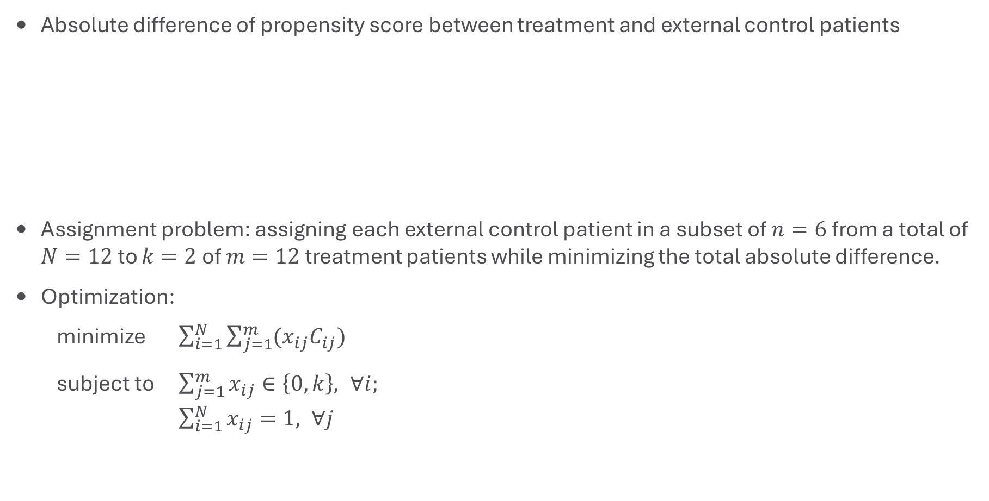
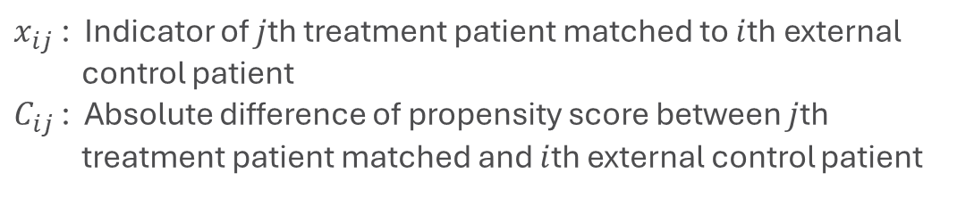
Method 3: Assignment algorithm
Absolute difference of propensity score between treatment and external control patients
Assignment problem: assigning each external control patient in a subset of $n=6$ from a total of $N=12$ to $k=2$ of $m=12$ treatment patients while minimizing the total absolute difference.
Optimization:
minimize $\sum_{i=1}^{N}{\sum_{j=1}^{m}{(x_{ij}C_{ij})}}$
subject to $\sum_{j=1}^{m}{x_{ij}}∈\left\{0,k\right\}, ∀i;$
$\sum_{i=1}^{N}{x_{ij}}=1, ∀j$
 | External control #1 | External control #2 | ... | External control #11 | External control #12
Treatment #1 | X.XXX | X.XXX | ... | X.XXX | X.XXX
... | ... | ... | ... | ... | ...
Treatment #12 | X.XXX | X.XXX | ... | X.XXX | X.XXX
$x_{ij}$ : Indicator of $j$th treatment patient matched to $i$th external control patient
$C_{ij}$ : Absolute difference of propensity score between $j$th treatment patient matched and $i$th external control patient

Slide 8
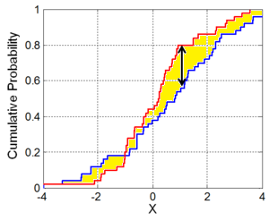
Method 4: Searching all possible combinations
Calculate a distance measure for treatment (n=12) vs. a set of external control (n=6), where the possible combinations are 6 out of 12, leading to ₁₂C₆ = 924 sets of external controls.
Select a set of external control which minimize the distance measure.
Wasserstein distance may be the best distance measure.
Other distance measures ruled out by a preliminary assessment:
Overlapping coefficient
Kolmogorov-Smirnov distance
Lévy metric, etc.
Treatment
x 924
External control
Wasserstein distance

Slide 9
Simulation study
Matching
2:1
Treatment
(n=12)
External Control Pool
(n=12)
External Control
(n=6)
Continuous endpoint
Comparison: Treatment (n=12) vs Matched External Control (n=6)
Statistical test: Wilcoxon rank sum test
Estimation: Hodges-Lehmann estimate based on Wilcoxon rank sum test
Propensity score matching methods to be compared:
Caliper adjustment (Reference)
Equally splitting, followed by 1:1 matching
Assignment algorithm
Searching all possible combinations
Bias?
Power?
Type I error rate?

Slide 10
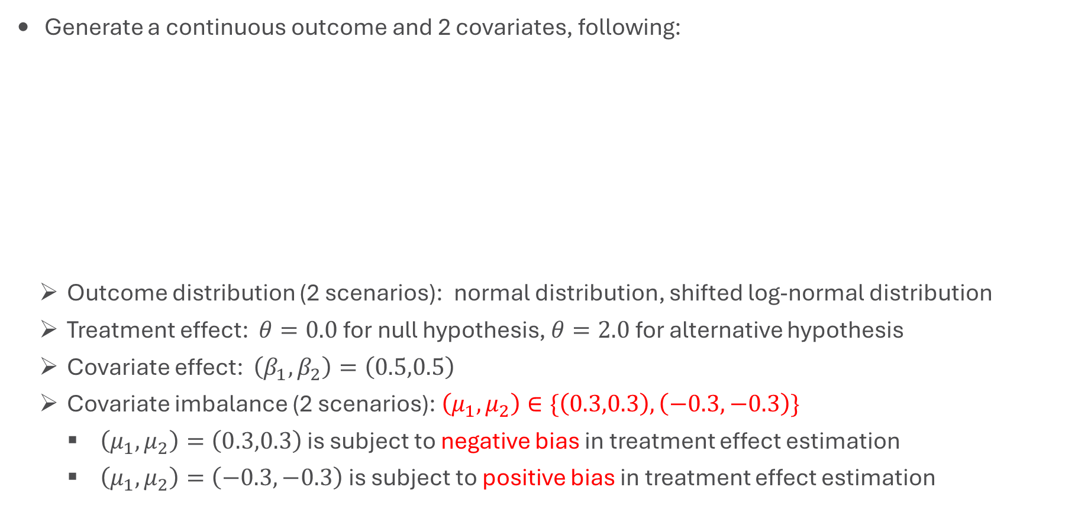
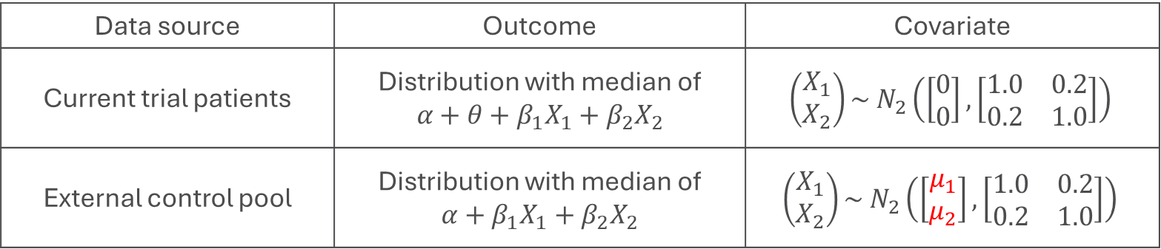
Data generation
Generate a continuous outcome and 2 covariates, following:
Outcome distribution (2 scenarios): normal distribution, shifted log-normal distribution
Treatment effect: $θ=0.0$for null hypothesis, $θ=2.0$ for alternative hypothesis
Covariate effect: $\left(β_{1},β_{2}\right)=\left(0.5,0.5\right)$
Covariate imbalance (2 scenarios): $\left(μ_{1},μ_{2}\right)∈\{\left(0.3,0.3\right),\left(−0.3,−0.3\right)\}$
$\left(μ_{1},μ_{2}\right)=\left(0.3,0.3\right)$ is subject to negative bias in treatment effect estimation
$\left(μ_{1},μ_{2}\right)=\left(−0.3,−0.3\right)$ is subject to positive bias in treatment effect estimation
Data source | Outcome | Covariate
Current trial patients | Distribution with median of $$α+θ+β_{1}X_{1}+β_{2}X_{2}$$ | $$\left(\begin{matrix}X_{1} \\ X_{2}\end{matrix}\right)\sim N_{2}\left(\left[\begin{matrix}0 \\ 0\end{matrix}\right],\left[\begin{matrix}1.0 & 0.2 \\ 0.2 & 1.0\end{matrix}\right]\right)$$
External control pool | Distribution with median of $$α+β_{1}X_{1}+β_{2}X_{2}$$ | $$\left(\begin{matrix}X_{1} \\ X_{2}\end{matrix}\right)\sim N_{2}\left(\left[\begin{matrix}μ_{1} \\ μ_{2}\end{matrix}\right],\left[\begin{matrix}1.0 & 0.2 \\ 0.2 & 1.0\end{matrix}\right]\right)$$

Slide 11
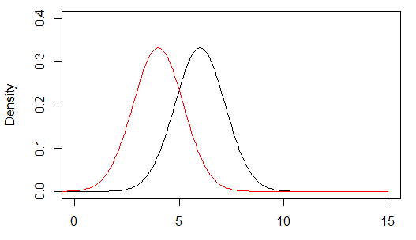
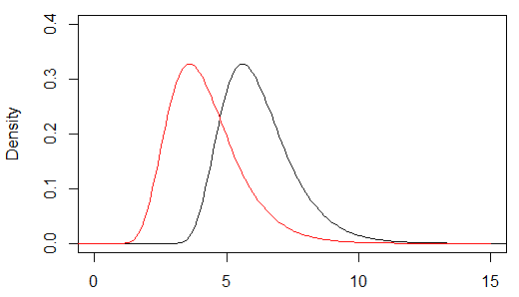
Outcome distribution
Normal distribution
Shifted log-normal distribution
─ Treatment
─ External Control
─ Treatment
─ External Control
Median of difference = Difference in median = 2.0
Power = 83.2%, in RCT settings (n=12 vs 6) with normal outcome and one-sided alpha=0.025

Slide 12
Results - null hypothesis
Outcome distribution | Covariate imbalance | Measure | Caliper adjustment | Equally splitting | Assignment algorithm | Searching combinations
Normal | Negative | Bias | -0.159 | -0.092 | -0.093 | -0.093
 |  | Type I error rate | 0.006 | 0.010 | 0.009 | 0.009
 | Positive | Bias | 0.164 | 0.099 | 0.098 | 0.099
 |  | Type I error rate | 0.034 | 0.021 | 0.021 | 0.022
Log-normal | Negative | Bias | -0.200 | -0.130 | -0.133 | -0.131
 |  | Type I error rate | 0.007 | 0.009 | 0.010 | 0.010
 | Positive | Bias | 0.127 | 0.060 | 0.064 | 0.061
 |  | Type I error rate | 0.036 | 0.020 | 0.021 | 0.021

Slide 13
Results - alternative hypothesis
Outcome distribution | Covariate imbalance | Measure | Caliper adjustment | Equally splitting | Assignment algorithm | Searching combinations
Normal | Negative | Bias | -0.155 | -0.093 | -0.093 | -0.094
 |  | Power | 0.616 | 0.691 | 0.692 | 0.691
 | Positive | Bias | 0.165 | 0.099 | 0.101 | 0.100
 |  | Power | 0.813 | 0.778 | 0.778 | 0.777
Log-normal | Negative | Bias | -0.195 | -0.134 | -0.133 | -0.132
 |  | Power | 0.558 | 0.618 | 0.619 | 0.621
 | Positive | Bias | 0.131 | 0.064 | 0.067 | 0.066
 |  | Power | 0.734 | 0.710 | 0.709 | 0.709

Slide 14
Bias reduction with the larger external control pool (n=18)
Size of external control pool
Size of external control pool

Slide 15
Summary
Unequal matching has not been well-addressed in the context of externally controlled design, and the three methods proposed are comparable and would be promising options.
Equally splitting, followed by 1:1 matching
There are other possible ways to split treatment patients to subsets, such as k-means.
Searching all possible combinations
The number of combinations quickly grows with the larger size of external control pool, and then the searching may be computationally impossible.
Genetic algorithm can be used to search the optimal set of matched-external controls.

