Slide 1

Integrating Natural History Insights into Clinical Development Planning for Gene Therapy in a Rare Neurological Indication
NERDS 2025
Alex Sverdlov, PhD
Joint work with EJP RD WP20 Innovation
Statistics consortium “EVIDENCE-RND”

Slide 2
Disclaimer
The opinions expressed in this presentation are solely those of the author and should not be interpreted as representing the views, positions, or policies of Novartis, the author’s employer.

Slide 3
Outline
The challenge: Proving gene therapy (GTx) efficacy in a rare neurology
Our solution: A model-based framework for virtual trials
Putting it to test: A case study in Autosomal-Recessive Spastic Ataxia Charlevoix Saguenay (ARSACS)
  Natural history data (ARCA registry)
  Longitudinal models of individual patient disease trajectories
  Pharmacometrics-informed clinical scenario evaluation

Slide 4
The Challenge of Rare Neurological Diseases (RNDs)
RNDs: Unmet medical need
Key challenges in treatment development
Over 300 million people worldwide are affected by rare diseases
Many RNDs have a genetic basis, are likely to start in childhood, and last into adulthood
With over 3,500 ultra-rare RNDs, they represent a significant collective health burden
Disease-modifying treatments are emerging for many RNDs, but the lack of robust study methods is a major bottleneck for therapeutic progress
Lack of trial design and analysis methods capable of generating robust evidence of treatment effects in small patient populations
Highly variable symptoms, not just between different RNDs but also among individuals with the same diagnosis
Validated, disease-specific outcome measures are often missing. Tools developed for more common diseases are frequently used in RNDs without systematic validation
Notes:
Rare Disease =
Ultra-Rare Disease =

Slide 5

Gene Therapy (GTx): A New Hope for RNDs
🧬
Why Gene Therapy for RNDs?
Gene therapy is a technique that modifies a person’s genes to treat or cure disease.
Addressing root causes: Targeting the underlying genetic defect
Many GTx are one-time administration: Reducing the burden of chronic treatment regimens
Targeting non-dividing cells: Neurons are terminally differentiated, which makes them ideal targets for GTx
Potential for early intervention before irreversible damage occurs
Growing technological advances in vector development (AAVs), delivery methods, and gene editing technologies
Gene Therapy Modalities for RNDs
Gene replacement: Introducing a healthy copy of a gene to compensate for a mutated or missing one
Gene editing: Precisely correcting mutations in a patient’s own DNA
Gene silencing: Turning off genes that are producing harmful proteins

Slide 6
Challenges and Opportunities in Clinical Development of GTx for RNDs
Challenges
Opportunities
Lack of understanding of disease mechanism
Conduct advanced basic and translational research (‘omics, animal models, etc.)
Limited historical data (or no data at all for some ultra-rare RNDs)
Integrate relevant data from registry, natural history, and observational studies
Very small sample sizes and limited trial duration
Utilize innovative trial design and analysis approaches (master protocols, adaptive designs, Bayesian methods)
Complex interplay among dose–biodistribution–response
Develop/validate drug–disease progression models
Lack of reliable clinical outcome measures
Develop novel clinically relevant endpoints
Utilize digital endpoints (from wearable/sensor technologies)

Slide 7
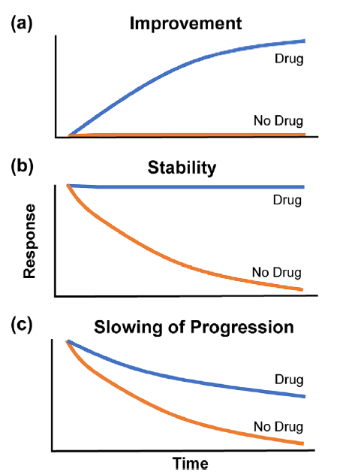
How to quantify disease-modifying effect in an RND clinical trial?
Improvement: likely not feasible with GTx in for neurodegenerative indication?
Stability: is it what we are aiming for?
Slowing of progression: this may be what we observe in the short term, due to onset of the drug (unknown), or in the long term (transduction is not enough)
  May also need to show improvement in QoL in this case
Cox, Gerald F. "The art and science of choosing efficacy endpoints for rare disease clinical trials." American Journal of Medical Genetics Part A 176.4 (2018): 759-772.
To formally compare these scenarios and power of a trial, we must first build a quantitative model of the underlying disease trajectory.

Slide 8
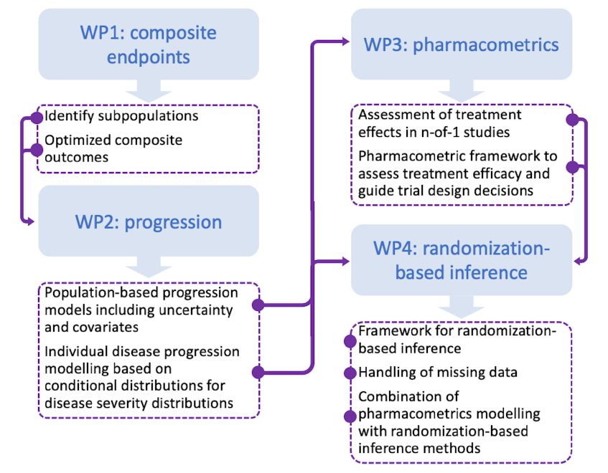
EVIDENCE-RND Project: The EU-funded research and innovation programme
EVIDENCE-RND was a cross-functional research partnership (2022–2025)
Four work packages (WPs) were established / completed
A toolbox of complementary innovative statistical methodologies to support trials in ultra-rare RNDs was developed

Slide 9
EVIDENCE-RND: Scientific Output

Slide 10

Case Study: Autosomal-Recessive Spastic Ataxia Charlevoix Saguenay (ARSACS)
ARSACS – rare neurodegenerative disorder caused by mutations in the SACS gene, leading to spasticity, ataxia, and peripheral neuropathy
No approved disease-modifying therapies; progressive disability leads to loss of ambulation and independence
Current SoC is symptomatic treatment – physical therapy, occupational therapy, and assistive devices
Early-stage research and preclinical studies underway
Dataset: Autosomal Recessive Cerebellar Ataxias (ARCA) Registry
990 patients
1932 visits
1-9 annual visits
69% of patients have genetically defined diagnosis
115 ARCA genetic subpopulations

Slide 11

How to measure the ataxia severity? Scale for the Assessment and Rating of Ataxia (SARA)
Gait
(0-8)
Stance
(0-6)
Sitting
(0-4)
Speech disturbance
(0-6)
Heel-shin slide
(0-4)
Finger chase test
(0-4)
Nose-finger test
(0-4)
Fast-alternating hand movements
(0-4)
The most widely used outcome measure for ataxias
Developed in 2004
Clinician reported outcome
Advantages: Relatively quick to administer, provides a comprehensive overview of ataxia symptoms
Limitations: Has some subjectivity and may not always capture subtle changes in early disease
L
R
+
2
Sum
0
No ataxia
40
most severe ataxia

Slide 12
Longitudinal Progression of Total SARA Score of ARSACS patients from the ARCA Registry
Total SARA score as a function of TSO (time since onset of symptoms) in the 173 ARSACS patients
173 patients
349 measurements (Median: 2 timepoints per patient)
Important covariates: BMI, Age of onset (yr), Sex, genotype of mutation
Hendrickx et al. AAPSJ 2024 doi: 10.1208/s12248-024-00925-7

Slide 13
Nonlinear Mixed Effects Model (NLMEM) of Total SARA Score
NLMEM was developed to model individual patient disease trajectories
  4-parameter logistic function (a sigmoid curve that captures the floor, ceiling, and the progression rate of the disease) for SARA score as a function of TSO
  Covariate effects + population parameter uncertainty was quantified
Model predicts well changes in total SARA score within different covariate categories and at the individual patient level
Hendrickx et al. AAPSJ 2024 doi: 10.1208/s12248-024-00925-7

Slide 14
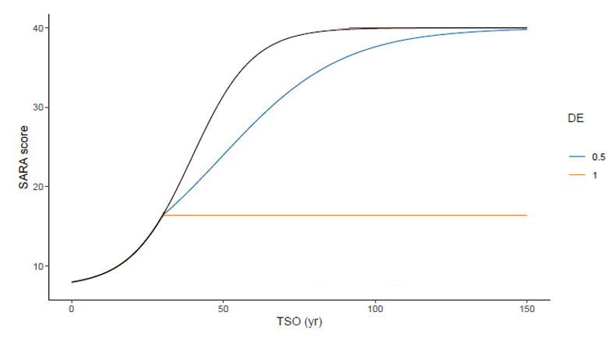
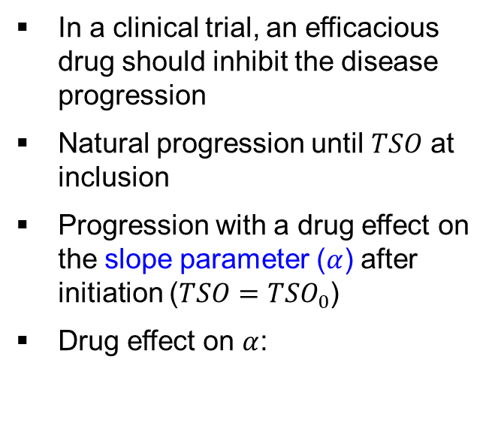
Hypothesizing a treatment effect on the disease progression slope
In a clinical trial, an efficacious drug should inhibit the disease progression
Natural progression until $TSO$ at inclusion
Progression with a drug effect on the slope parameter ($α$) after initiation ($TSO=TSO_{0}$)
Drug effect on $α$:
Treatment start
DE=0: no effect/placebo
DE=0.5: 50% slowing of progression
DE=1: 100% slowing / arrested progression

Slide 15
Pharmacometrics-informed Clinical Scenario Evaluation framework (CSE-PMx)
(1) Disease Model
(2) Trial Design Options
(3) Simulation Engine
(4) Performance Metrics
Strategic Question
(e.g., NLMEM disease progression model)
Which design options (combinations of randomization design, primary endpoint, and data analysis method) would provide valid, efficient, and robust strategies for a clinical research study to evaluate disease-modifying treatment effect in a limited patient population with a given RND?
Competing design and analysis methods
In-silico assessment/ optimization of trial design
Statistical (power, bias);
Patient burden (visits, duration)
Feasibility (cost, complexity)

Slide 16
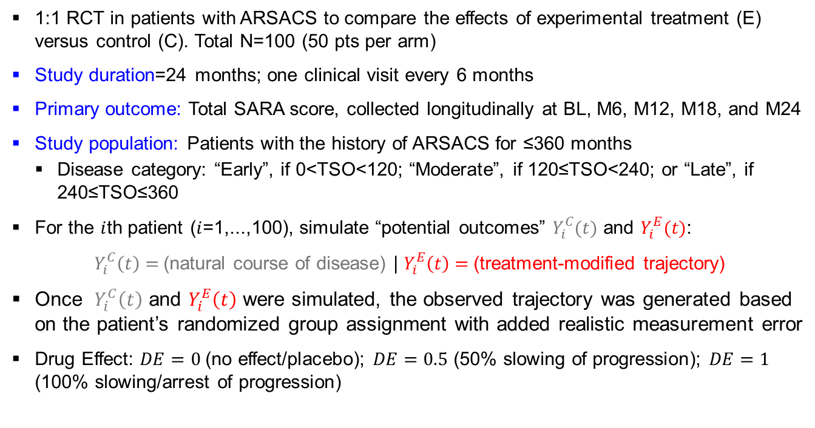
The virtual trial: Simulating a 2-year ARSACS study
1:1 RCT in patients with ARSACS to compare the effects of experimental treatment (E) versus control (C). Total N=100 (50 pts per arm)
Study duration=24 months; one clinical visit every 6 months
Primary outcome: Total SARA score, collected longitudinally at BL, M6, M12, M18, and M24
Study population: Patients with the history of ARSACS for ≤360 months
  Disease category: “Early”, if 0<TSO<120; “Moderate”, if 120≤TSO<240; or “Late”, if 240≤TSO≤360
For the $i$th patient ($i$=1,...,100), simulate “potential outcomes” $Y_{i}^{C}(t)$ and $Y_{i}^{E}(t)$:
$Y_{i}^{C}\left(t\right)=$(natural course of disease) | $Y_{i}^{E}\left(t\right)=$(treatment-modified trajectory)
Once $Y_{i}^{C}\left(t\right)$ and $Y_{i}^{E}\left(t\right)$ were simulated, the observed trajectory was generated based on the patient’s randomized group assignment with added realistic measurement error
Drug Effect: $DE=0$ (no effect/placebo); $DE=0.5$ (50% slowing of progression); $DE=1$ (100% slowing/arrest of progression)

Slide 17
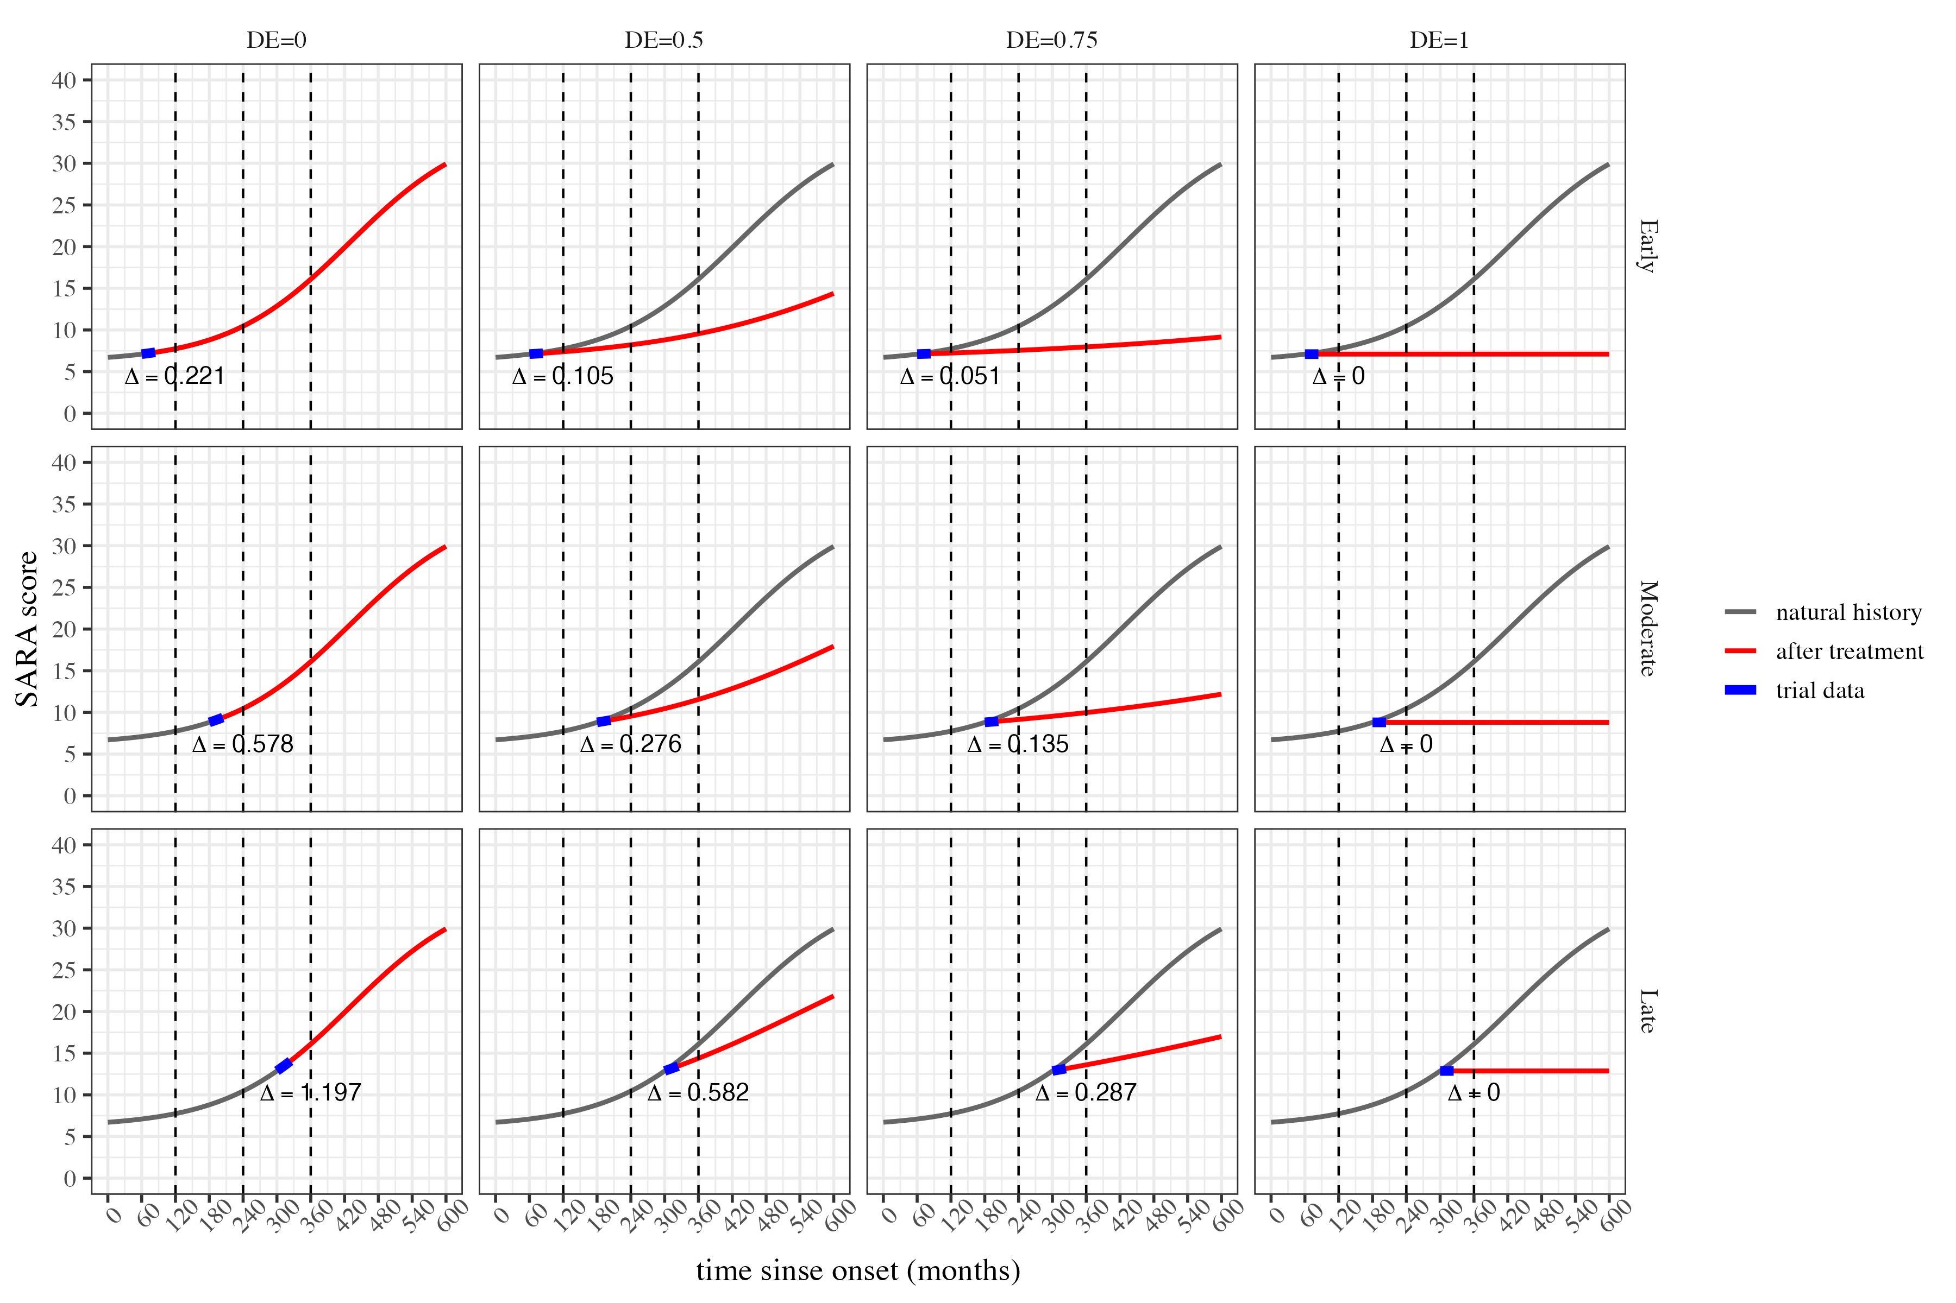
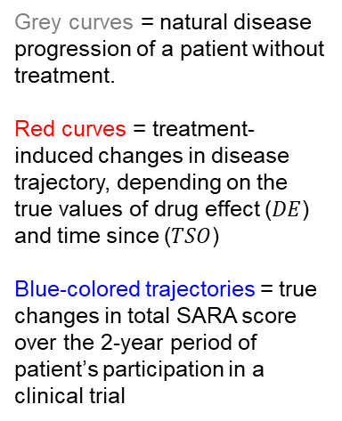
Potential outcomes: An illustration
The earlier an efficacious treatment (with $DE>0$) is given, the better is its potential to modify the course of the disease by maintaining smaller values of SARA score over time
Grey curves = natural disease progression of a patient without treatment.
Red curves = treatment-induced changes in disease trajectory, depending on the true values of drug effect ($DE$) and time since ($TSO$)
Blue-colored trajectories = true changes in total SARA score over the 2-year period of patient’s participation in a clinical trial

Slide 18
Comparing the strategies
Statistical analysis methods:
Statistical analysis approach:
Two-sample t-test (2STT)
  Change from baseline to M24 in total SARA score
Analysis of covariance (ANCOVA)
  Change from baseline to M24 in total SARA score, adjusting for the baseline values of total SARA score and TSO
NLMEM
  4-parameter logistic model for total SARA score over time; consistent with data generating mechanism
Population-based
  Normal random sampling is assumed
  Inference on the treatment effect is conditional on the treatment assignments
Randomization-based
  The strength of evidence against (H0: Treatment effect = 0) is quantified using tail probabilities of the re-randomization distribution of a linear rank test statistic based on residuals

Slide 19
Simulation setup
Clinical scenarios: Assumptions | 4 levels of Drug Effect (DE): {0, 0.5, 0.75, 1}
 | 2 enrollment scenarios: Time trend determined by TSO at Baseline {No, Yes} “No” => a random sample of patients with TSO in the range 0–360 months “Yes” => patients with larger values of TSO are enrolled earlier in the trial
Clinical scenarios: Options | 2 Randomization designs: {Rand, TBD} Rand = Random Allocation Rule; TBD = Truncated Binomial Design
 | 3 Statistical analysis methods: {two-sample t-test, ANCOVA, NLMEM}
 | 2 Statistical analysis approaches: {Population-based, Randomization-based}
A total of 96 scenarios (=4×2×2×3×2) were investigated. For each scenario, a 1:1 RCT with N=100 patients was simulated 2,500 times.
The operating characteristics included type I error rate (T1ER) when DE=0, and power to reject H0: no treatment effect when the true effect was present (DE=0.5; 0.75; 1).

Slide 20
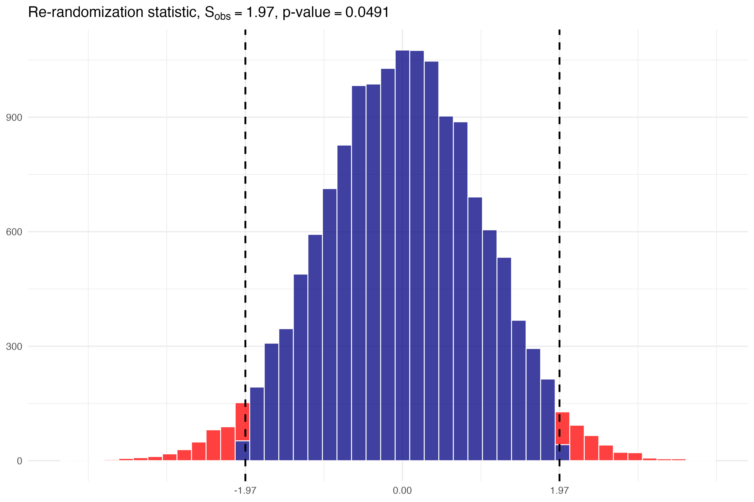
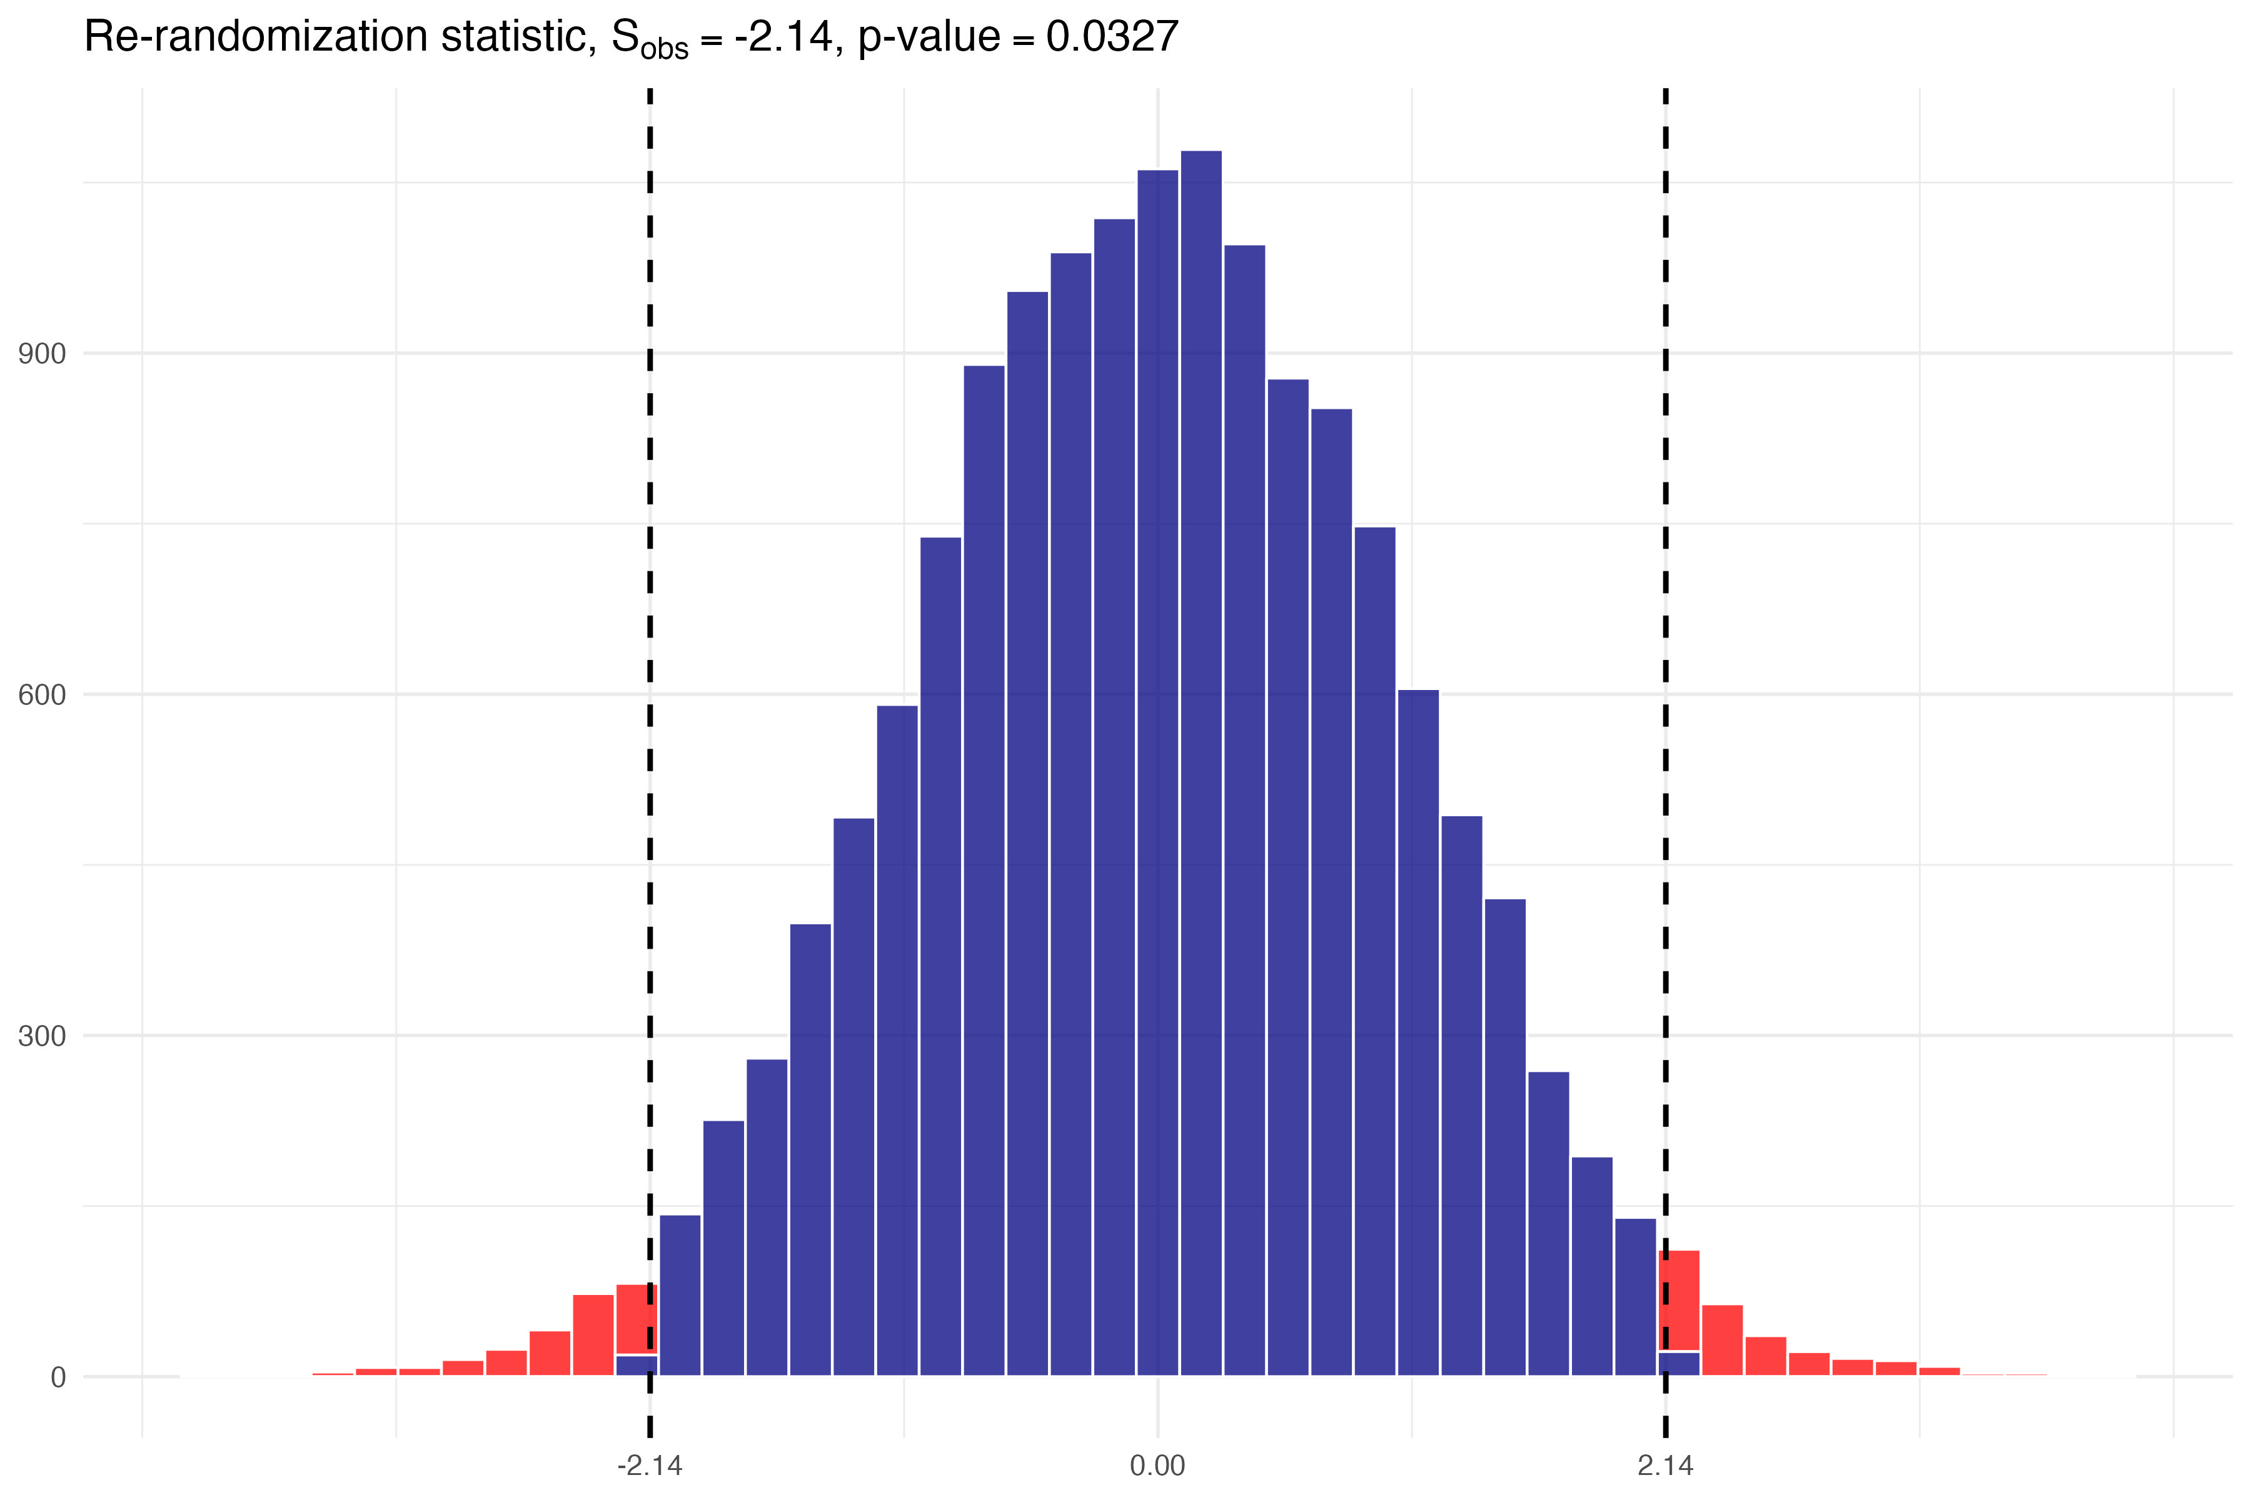
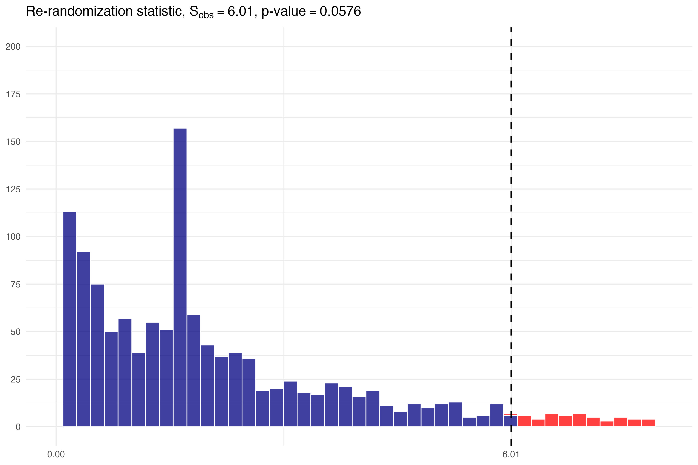
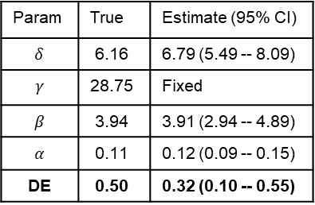
One simulated trial
Randomization method = Rand
Time trend = No
Two-sample t-test:
ANCOVA
NLMEM
Population-based analysis
Param | True | Estimate (95% CI)
$$δ$$ | 6.16 | 6.79 (5.49 -- 8.09)
$$γ$$ | 28.75 | Fixed
$$β$$ | 3.94 | 3.91 (2.94 -- 4.89)
$$α$$ | 0.11 | 0.12 (0.09 -- 0.15)
DE | 0.50 | 0.32 (0.10 -- 0.55)
Mean Diff | t-stat. | P-value
-0.366 | -1.97 | 0.0514
Term | Estimate | SE | Statistic | P-value
(Intercept) | 0.791 | 0.121 | 6.55 | <0.0001
TRT | -0.366 | 0.171 | -2.14 | 0.0346
TSO BL | 0.000527 | 0.000920 | 0.573 | 0.568
SARA BL | 0.0465 | 0.0123 | 3.78 | 0.000273
Statistically significant! (p=0.014)
Randomization-based analysis
Rando-based p = 0.049
Rando-based p = 0.0576
Rando-based p = 0.0327

Slide 21
A key methodological finding: Inferential framework matters for complex models
 | 2STT | ANCOVA | NLMEM
Population-based | 0.0514 | 0.0346 | 0.0140
Randomization-based | 0.0490 | 0.0327 | 0.0576
NLMEM: Population-based analysis yields most significant p-value; however, randomization-based NLMEM analysis is conservative
ANCOVA p-values are significant using both population- and randomization-based analyses
2-sample t-test (2STT) p-values are more conservative than for ANCOVA
Caution: The presented results are from only one trial example; the test decisions may change from simulation to simulation. To estimate type I error rate / power, Monte Carlo simulations must be run under various experimental scenarios
For powerful, complex models like NLMEM, the choice of inferential framework can lead to different trial conclusions. This reveals a critical trade-off between model-based power and the robustness of randomization-based inference.

Slide 22
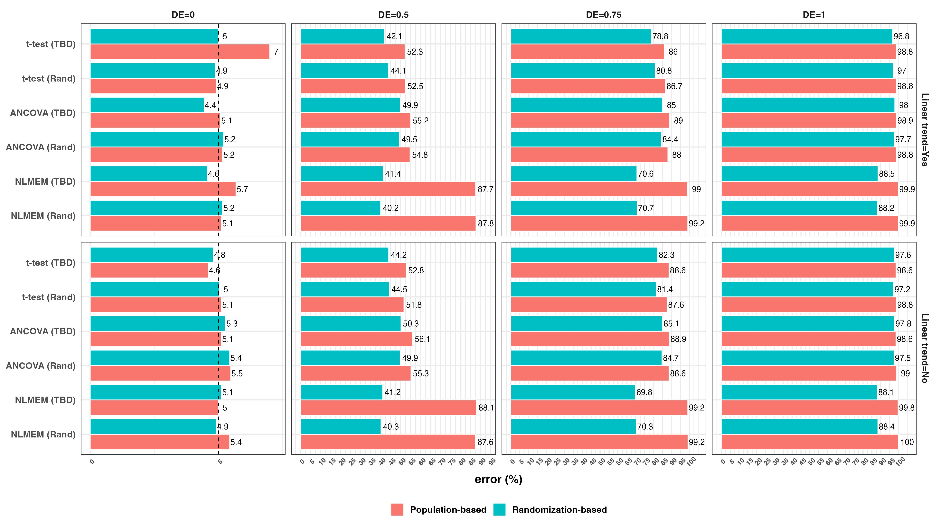
Type I error rate and Power
(assuming time trend is present – patients with larger values of time since onset of the disease are enrolled earlier in the trial)
Under H0: DE=0, all methods maintained T1ER at the nominal level of 5% except for population-based t-test following TBD
Among the population-based analysis methods, NLMEM is most powerful
Randomization-based test with NLMEM is less powerful than randomization-based tests with t-test or ANCOVA
ANCOVA is consistently more powerful than 2-sample t-test, regardless of the approach (population- or randomization-based) and irrespective of the randomization design

Slide 23
Overall summary
Natural history data (ARCA registry) was used to develop ARSACS disease progression model accounting for relevant covariates and uncertainties
Drug-disease model was developed to quantify disease-modifying treatment effect in a randomized controlled trial
CSE-PMx framework was developed and applied to evaluate various options and optimize trial design/analysis strategy
For our considered example, the best (valid and most powerful) strategy is population-based NLMEM
  It is assumed that clinical investigators and other relevant stakeholders are familiar with the nonlinear model and can properly interpret the estimated drug effect
  If a simpler endpoint is required, ANCOVA (population- or randomization-based) provides a robust and more powerful alternative to a standard two-sample t-test

Slide 24
Acknowledgement
The author would like to acknowledge his research collaborators on EJP RD WP20 Innovation Statistics consortium “EVIDENCE-RND”:
Yevgen Ryeznik¹, Ralf-Dieter Hilgers², Nicole Heussen^{2,7}
Alzahra Hamdan¹, Xiaomei Chen¹, Andrew C. Hooker¹, Mats O. Karlsson¹
Emmanuelle Comets^{6, 8}, Niels Hendrickx⁶, France Mentré⁶
Rebecca Schüle^{3, 4, 5}, Matthis Synofzik^{3, 4}
¹ Department of Pharmacy, Uppsala University, Uppsala Sweden
² Department of Medical Statistics, RWTH Aachen University, Aachen, Germany
³ Division Translational Genomics of Neurodegenerative Diseases, Hertie Institute for Clinical Brain Research (HIH), University of Tübingen, Tübingen, Germany
⁴ German Center for Neurodegenerative Diseases (DZNE), Tübingen, Germany
⁵ Division of Neurodegenerative Diseases, Department of Neurology, Heidelberg University Hospital, Germany
⁶ Université Paris Cité and Université Sorbonne Paris Nord, Inserm, IAME, F-75018 Paris, France
⁷ Medical School, Sigmund Freud Private University, Vienna, Austria
⁸ Univ Rennes, Inserm, EHESP, Irset (Institut de recherche en santé, environnement et travail) - UMR_S 1085, F-35000 Rennes, France

Slide 25
Key References
Hendrickx N, Mentré F, Traschütz A, Gagnon C, Schüle R; ARCA Study Group; EVIDENCE-R. N. D. consortium; Synofzik M, and Comets E. “Prediction of individual disease progression including parameter uncertainty in rare neurodegenerative diseases: The example of Autosomal-Recessive Spastic Ataxia Charlevoix Saguenay (ARSACS). AAPS Journal 2024; 26(3):57. doi: 10.1208/s12248-024-00925-7.
Ryeznik Y, Hilgers RD, Heussen N, Hamdan A, Chen X, Hooker AC, Karlsson MO, Comets E, Hendrickx N, Mentré F, Schüle R, Synofzik M, and Sverdlov O. “A pharmacometrics-informed trial simulation framework for optimizing study designs for disease-modifying treatments in rare neurological disorders.” CPT: Pharmacometrics & Systems Pharmacology 2025. doi: 10.1002/psp4.70082

Slide 26

Thank You! Questions?

