Slide 1
Considerations in Gene and Cell Therapy Development
Daniel Li, PhD
The 8thAnnual New England Rare Disease Statistics (NERDS) Workshop
Oct 9, 2025

Slide 2
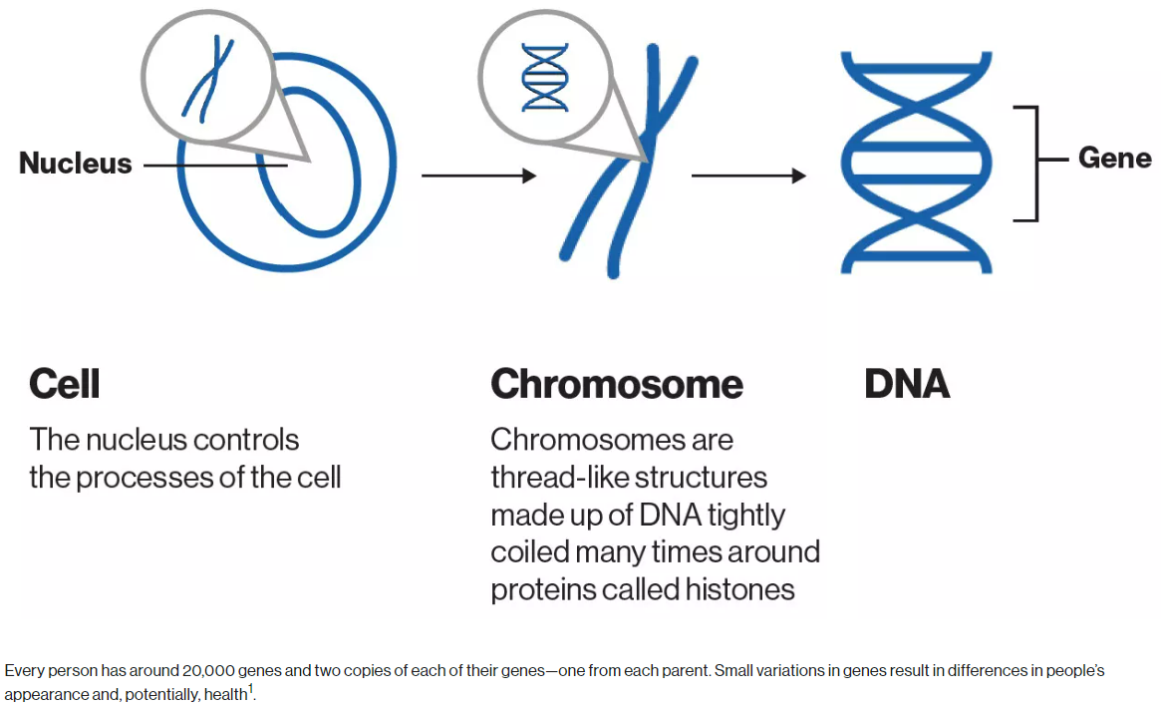
Brief introduction to CGT
Gene therapies: Treat diseases by manipulating or correcting the genetic material in a cell through adding a gene, editing a gene, replacing a gene or silencing a gene (Friedmann 1992; Lapteva et al. 2020)
Cell therapy: Involves infusing various cell types, including unmanipulated immune cells and stem cells, and genetically modified immune cells such as chimeric receptor antigen (CAR) T-cells (Feins et al. 2019), and stem cells or other cells to replace defective cells or harness the body’s immune system to treat diseases
Cell therapies are considered autologous when they use the patient’s own cells to develop the therapy, or allogeneic when a donor source is used.
Ref:
National Institutes of Health (NIH) U.S. National library of medicine. What is a gene? Available at: https://ghr.nlm.nih.gov/primer/basics/gene
Figure is extracted from https://www.novartis.com/about/novartis-gene-therapies/what-cell-and-gene-therapy#:~:text=With%20cell%20therapy%2C%20cells%20are,donor%20(allogeneic%20cells)6.

Slide 3
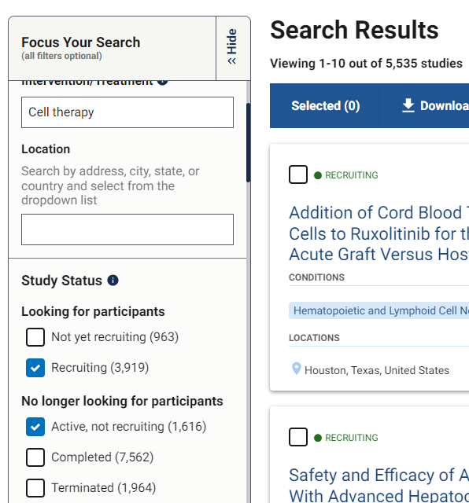
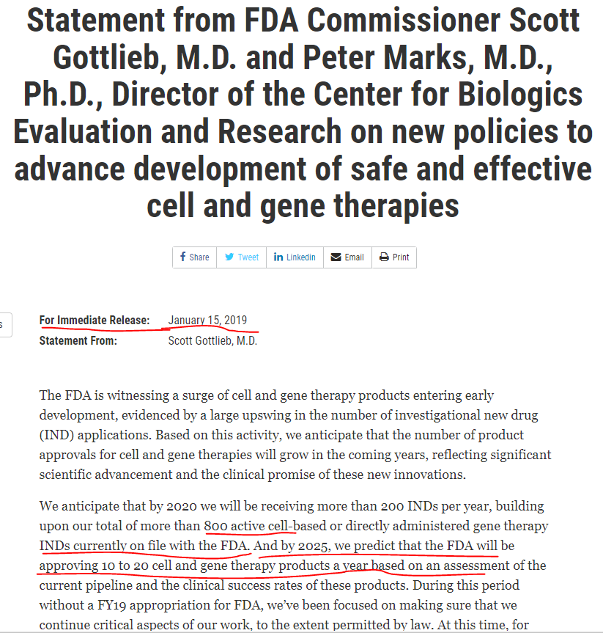
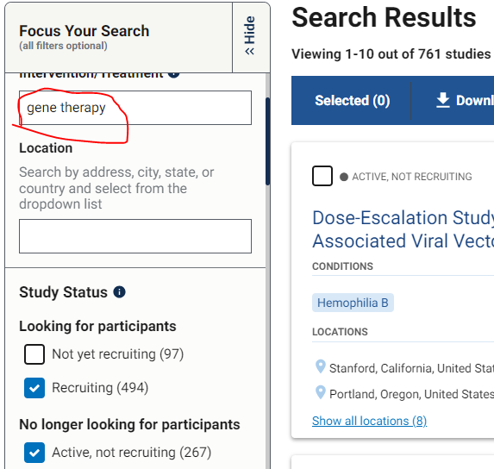
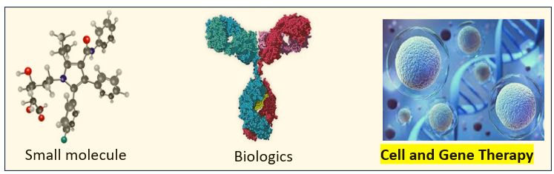
“Looming Boom in Cell and Gene Therapy”
https://www.fda.gov/news-events/press-announcements/statement-fda-commissioner-scott-gottlieb-md-and-peter-marks-md-phd-director-center-biologics
Notes:
The global cell and gene therapy market size is calculated at USD 25 billion in 2025 and is forecasted to reach around USD 117 billion by 2034 (>18% annual growth rate) . US is the biggest (~50%) and fastest-growing market, driven by an increased target patient population, regulatory body support, and higher access to healthcare due to relatively well-established healthcare infrastructure.

Slide 4
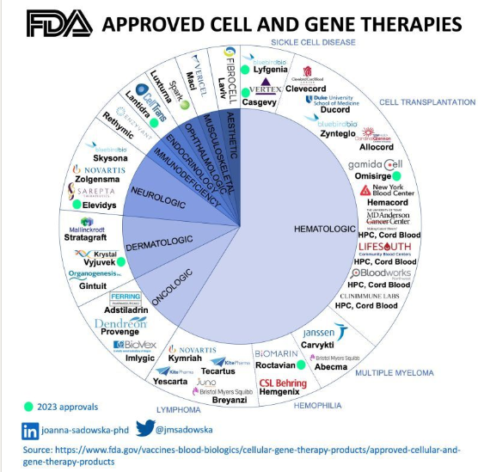
More than 40 FDA Approved CGTs
Source: https://www.fda.gov/vaccines-blood-biologics/cellular-gene-therapy-products/approved-cellular-and-gene-therapy-products
Notes:
More than 40 CGTs have been approved by the FDA, including various types of therapies in several indications including but not limited to oncology.

Slide 5
Overview of Presentations and Common Themes
Gene Therapy Trial Design - Yang Song
  Single arm confirmatory trials address challenges in gene therapy development with limited patient samples.
Modifier-Directed Therapeutics – Lisa J. Strug
  Targeting specific genetic modifiers like SLC26A9 advances treatment strategies for cystic fibrosis patients.
Companion Diagnostic Assays – Shuguang Huang
  ADA assays function as companion diagnostics to improve personalized treatment in gene therapy.
Model-Informed Drug Development – Avery McIntosh
  Statistical models guide drug development for cell and gene therapies ensuring robust assumptions and design.
Notes:
This session brings together four key presentations that explore the challenges and innovations in gene and cell therapy development. The presentations include: 'Single Arm Confirmatory Trial Design for Gene Therapy Development' by Yang Song, 'Model-Informed Drug Development for Cell & Gene Therapy' by Avery McIntosh, 'Modifier-Directed Therapeutics in Cystic Fibrosis: Targeting SLC26A9' by Lisa J. Strug, and 'ADA Assay as Companion Diagnostic (CDx)' by Shuguang Huang. A unifying theme across these talks is the credibility of evidence under constraint—whether due to limited sample sizes, ethical considerations, or the unique nature of one-shot therapeutic opportunities. Statisticians play a critical role in ensuring that assay decisions, model assumptions, and design choices are explicit, testable, and robust. This session aims to highlight how statistical rigor and thoughtful design can overcome the inherent limitations in rare disease and gene therapy research

Slide 6
Single‑Arm Confirmatory Trial Design for Gene Therapy
Single-Arm Trial Necessity
  Single-arm trials are crucial for gene therapies due to rare patients and ethical issues with placebo use.
Statistical Rigor Challenges
  Maintaining statistical rigor and Type I error control is challenging with small samples and open-label designs.
Use of Natural History Data
  Robust natural history data serves as an external control benchmark in single-arm confirmatory trials.
  Level of evidence
  What standards of evidence should apply in ultra rare diseases?
Notes:
Single-arm confirmatory trials are often necessary in gene therapy development due to the rarity of patient populations, ethical concerns with placebo use, and practical limitations in blinding. These trials leverage robust natural history data for benchmarking and external controls. A key challenge is maintaining statistical rigor, particularly in preserving Type I error rates. Exact testing frameworks are employed to address operational realities, such as small sample sizes and open-label designs. Alpha spending independence is difficult to justify in these settings, necessitating careful planning and prescriptive implementation. The presentation emphasizes the importance of formal rigor in designs that are commonly used in practice, encouraging scrutiny of external controls, handling of missing data, and evaluation of durability endpoints. These principles are also applicable to cell therapy trials and provide a foundation for evidence generation in ultra-rare diseases.
Brings formal rigor to designs we already rely on in practice; invites scrutiny of external controls, missing data, and durability endpoints

Slide 7
Modifier-directed Therapeutics in Cystic Fibrosis: Targeting SLC26A9
Role of SLC26A9 in CF
  SLC26A9 acts as a genetic modifier influencing CFTR function and cystic fibrosis disease severity.
Genetic Discovery Methods
  GWAS and eQTL studies identify therapeutic targets by uncovering genetic factors linked to disease.
Drug Screening and Validation
  Compound screening identifies candidate agonists with validated biological activity for therapy development.
Data Integration for Therapy
  Combining genetic, functional, and pharmacological data advances modifier-directed therapies for CF.
Notes:
Modifier-directed therapies, particularly those targeting SLC26A9, offer promising avenues for improving outcomes in cystic fibrosis (CF) and potentially other diseases. SLC26A9 is a genetic modifier that influences CFTR function and disease severity. The presentation outlines a comprehensive pipeline from genetic discovery to functional validation and compound screening. GWAS and eQTL studies provide the foundation for identifying therapeutic targets, while drug screening has led to the identification of candidate agonists with validated biological activity. Integration of genetic, functional, and pharmacological data is essential for advancing these therapies. However, inference robustness across populations, endpoints, and assays must be demonstrated before broad deployment. The approach exemplifies how data-driven strategies can complement existing CFTR-targeted treatments and expand therapeutic options for patients with diverse genetic backgrounds.

Slide 8
ADA Assay as Companion Diagnostic (CDx)
Companion Diagnostics Role
  ADA assays are pivotal as companion diagnostics to identify exclusion by pre-existing anti-AAV antibodies ensuring treatment safety.
Clinical Bridging Challenges
  Transitioning from research-use assays to validated CDx faces challenges like sample shortages and incomplete clinical data.
Impact of False Results
  False positive and false negative rates critically affect patient access and treatment eligibility in gene therapy.
Cutpoint Selection Importance
  Decision-analytic cutpoint selection with explicit utilities is essential to balance misclassification consequences in one-time therapies.
Notes:
ADA assays play a critical role as companion diagnostics (CDx) in gene therapy, particularly when pre-existing anti-AAV antibodies are used as exclusion criteria. These antibodies can neutralize gene therapy vectors, reducing efficacy. The FDA recommends CDx implementation in such cases to ensure patient safety and treatment effectiveness. Clinical bridging involves transitioning from a research-use-only (RUO) clinical trial assay to a validated CDx, often facing challenges such as sample shortfalls and missing outcomes. The presentation highlights the impact of false positive and false negative rates on patient access, emphasizing the need for decision-analytic cutpoint selection with explicit utilities. Fixed false positive rate targets may not adequately address the asymmetric consequences of misclassification, especially in one-time therapies. The choice of cutpoint and acceptance criteria directly influences treatment eligibility, making statistical and clinical validation essential.

Slide 9
Model Informed Drug Development
Role of MIDD in Drug Development
  MIDD uses exposure, biological, and statistical models to guide decisions across the drug development lifecycle.
Challenges in Gene Therapy Trials
  MIDD addresses challenges like small samples, lack of placebo, data variability, and safety in gene therapy.
Regulatory Support by FDA
  FDA initiatives, including MIDD Paired Meeting Program, help integrate modeling into regulatory submissions.
AI Augmentation in MIDD
  How Artificial intelligence enhances MIDD by improving prediction accuracy and decision-making in drug development?
Notes:
Model-Informed Drug Development (MIDD) integrates exposure-based, biological, and statistical models to inform decisions throughout the drug development lifecycle. In the context of gene therapy, MIDD addresses unique challenges such as small sample sizes, lack of placebo controls, variability in natural history data, and safety concerns. Opportunities include seamless trial designs, Bayesian dose finding, incorporation of digital endpoints, and long-term adverse event modeling. The FDA supports MIDD through initiatives like the MIDD Paired Meeting Program, which helps sponsors integrate modeling approaches into regulatory submissions. The presentation also explores how artificial intelligence can augment MIDD strategies, enhancing predictive capabilities and decision-making. MIDD is positioned as a powerful tool for optimizing development pathways and improving the efficiency and credibility of gene therapy trials.

Slide 10

To bring CGT from bench table to bedside
Assay, model, and design—get any one wrong, and the evidence wobbles.
Collaboration across disciplines and quantitative methods drive innovation
Notes:
This session underscores the importance of rigorous statistical frameworks and model-informed strategies in gene and cell therapy development. Single-arm trials, while necessary in rare disease contexts, require careful design to ensure credibility. Across these talks, the common thread is credibility of evidence under constraint—constraint in sample size, in ethics, and in one‑shot therapeutic opportunities. Our job as statisticians is to make assay decisions, model assumptions, and design choices explicit, testable, and robust.”
Cross-functional collaboration and quantitative approaches are essential for advancing these innovations. The presentations collectively highlight how thoughtful design, robust modeling, and strategic validation can overcome constraints and drive progress in rare disease and gene therapy research.

