Slide 1
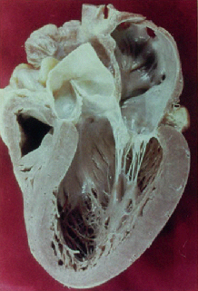
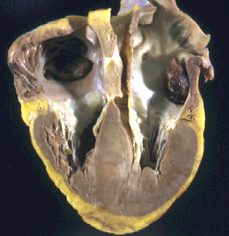
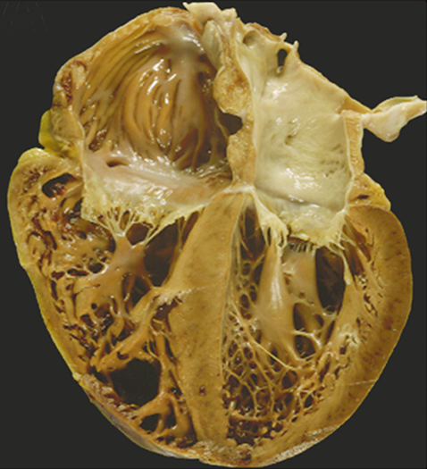
The 8th Annual New England Rare Disease Statistics (NERDS) Workshop 2025 NERDS 2025 JON & KRICKET Seidman Harvard Medical School Department of Genetics Harvard Medical School Boston, MA
The Molecular Basis of Inherited Cardiomyopathies:
From genes to therapies
Normal
Disclosure:
Jon and Christine Seidman
With Jim Spudich and Leslie Leinwand
Myokardia (Now BMS subsidiary) Co-founders, retired
Hypertrophic
Dilated

Slide 2
Heart Failure
Expending $43.9 billion annually (2023)
500000 New Cases Annually/ 4.7 million Americans Affected
75% Mortality in 8 Years
HCM
DCM
Notes:
Affects 4.7 million American
500,000 New Cases Annually
Costs: $17.8 Billion Annual
Prognosis: 75% Die within 8 Years

Slide 3
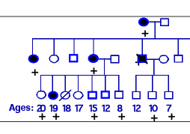
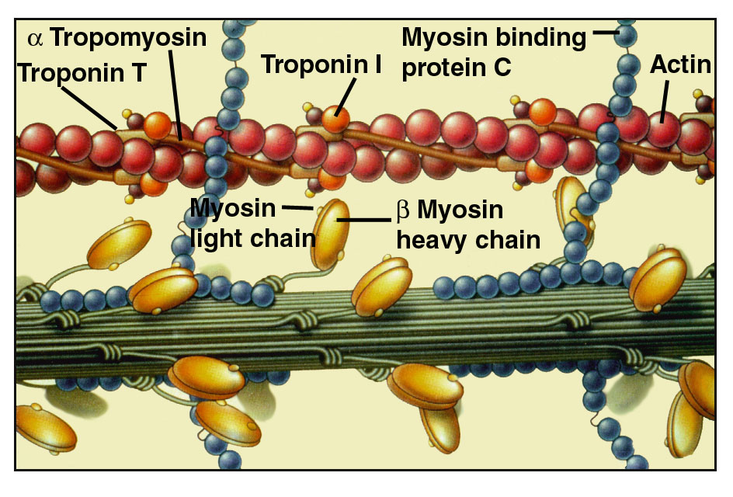

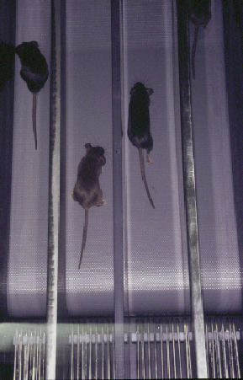
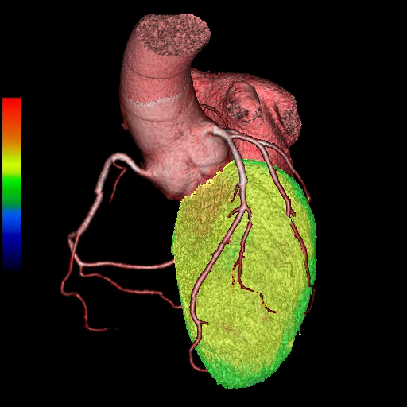

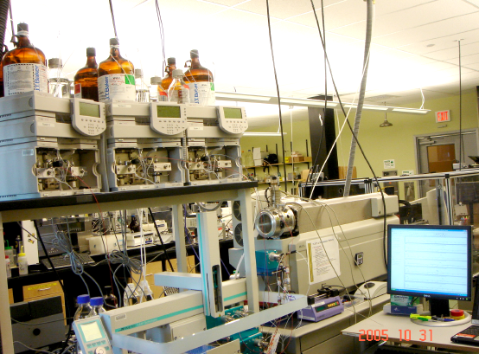

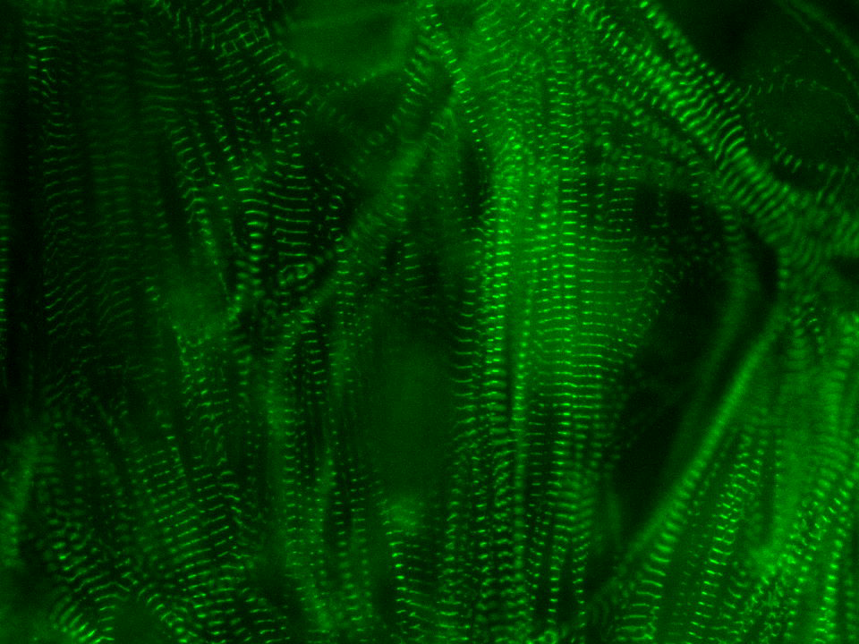
Genetic strategies for attacking rare inherited
heart diseases and other Mendelian traits
Genetics
Penetrance (age & sex factors)
Asymmetric (septal) & apical hypertrophy
HCM mechanisms for thin filament variants & polygenic risk loci
Heart failure & SCD predictors
Strategies to prevent and cure HCM
Bed
Bench
Notes:
3

Slide 4
Common Final Pathway?
Cellular differences between
HCM & DCM hearts?
Does genotype matter?
Heart Failure
HCM
DCM
TTN
LMNA
RBM20
DES
PLN
FLNC
BAG3
MYH7
TNNT2
PVneg
MYBPC3
MYH7
TNNI3
TNNT2
TPM1
MYL2
MYL3
ALPK3
PVneg
Notes:
Affects 4.7 million American
500,000 New Cases Annually
Costs: $17.8 Billion Annual
Prognosis: 75% Die within 8 Years

Slide 5
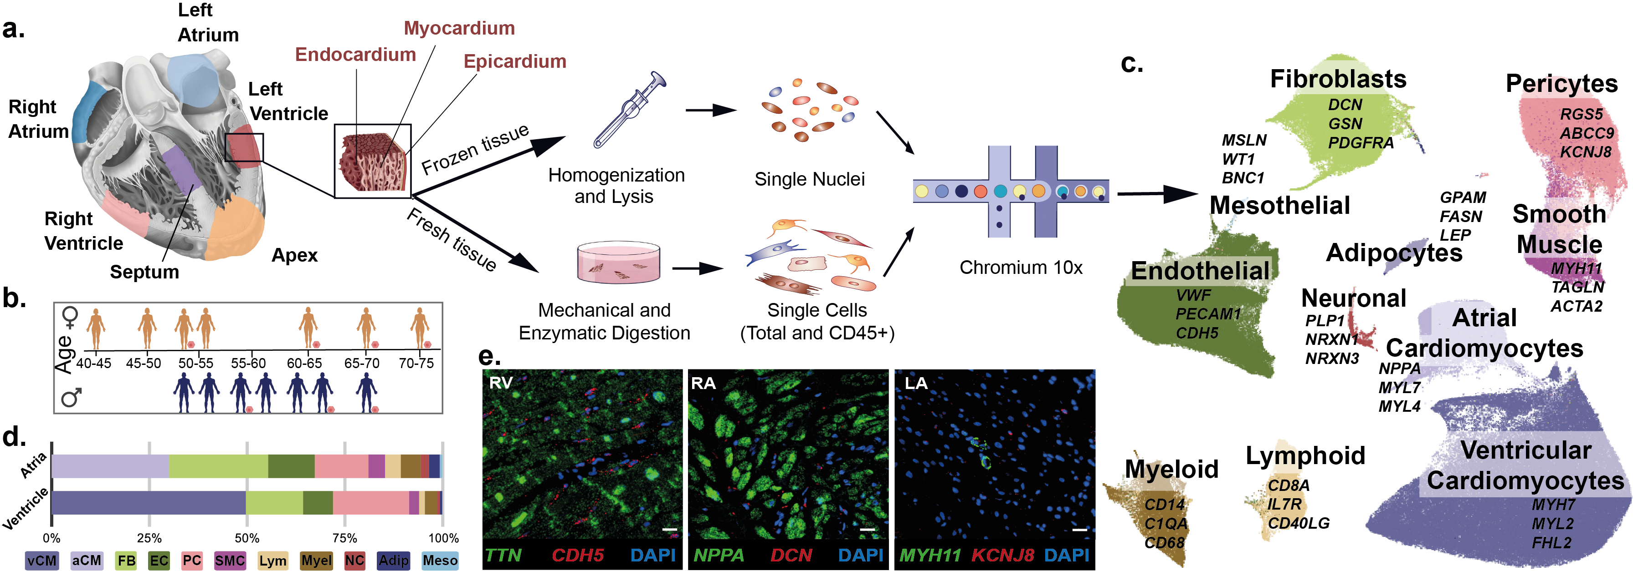
A Cell Atlas of the Normal Adult Human Heart
Nature, 2020, Science 2022
13 Male / 15 Female Donors
(50-70yrs); Normal LVEF
50-55%
55-60%
Cell: 100x25µm
Nucleus: 8-12µm
60%
Nuclei: 363,213
Cells: 45,870

Slide 6
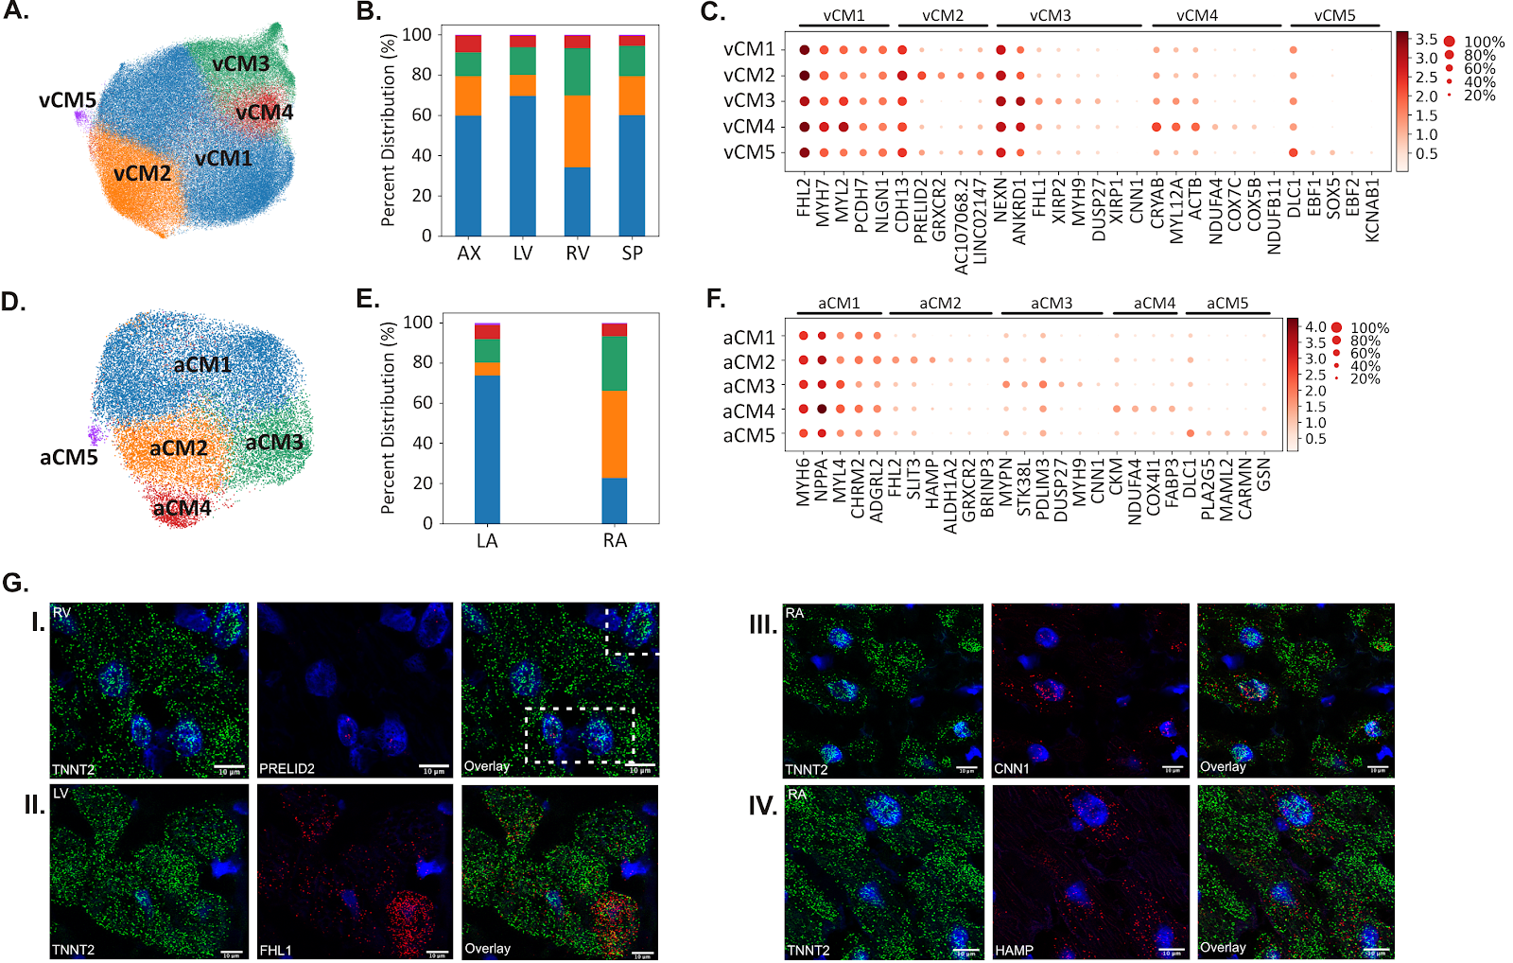
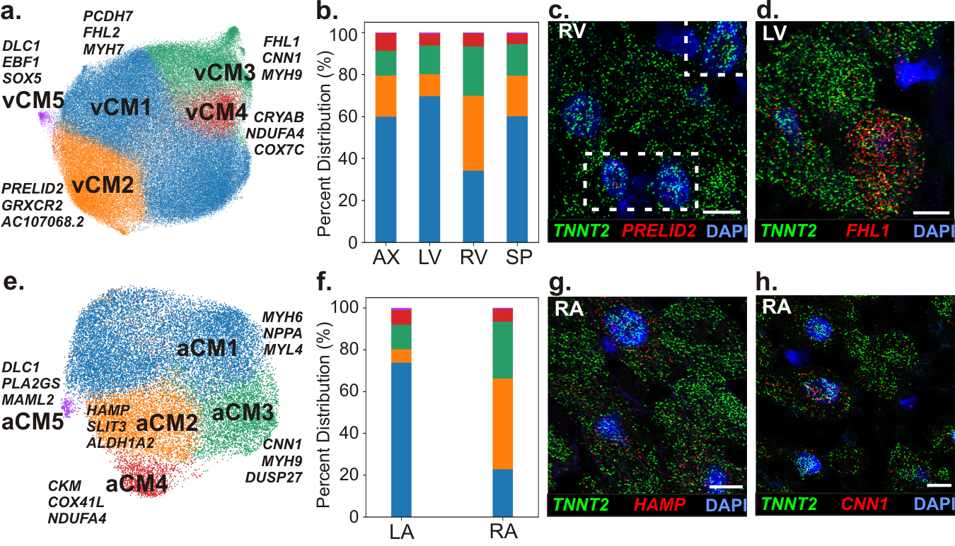
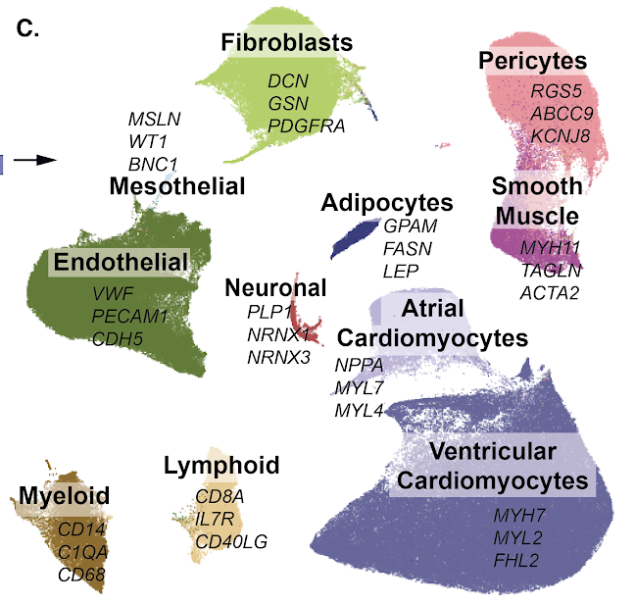
11 Major Cell Populations, 65 Cell States
Atrial Cardiomyocytes (aCM)
Regional distribution
Female vs Male Donor Hearts:
Similar Cell Distributions
More CMs in Female Hearts (56% vs 47%)
Functional Organization:
CMs & Fibroblasts: Neg Correlation
Pericytes & SM Cells: Pos Correlation
Ventricular Cardiomyocytes (vCM)
Regional distribution

Slide 7
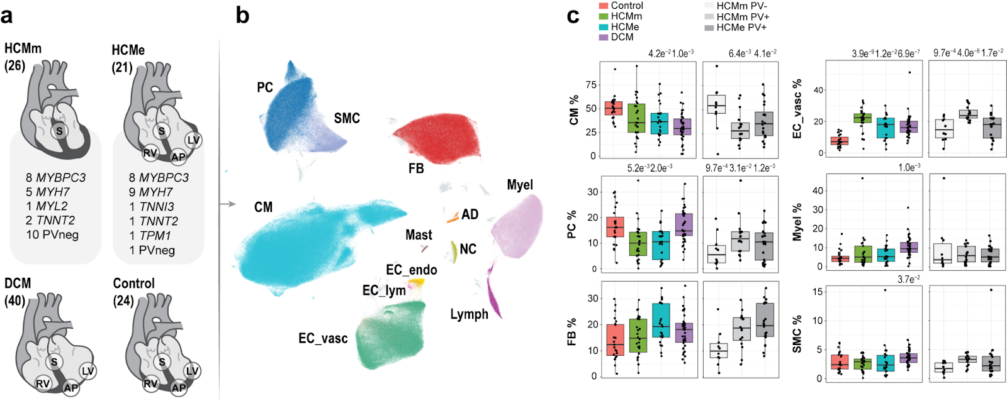
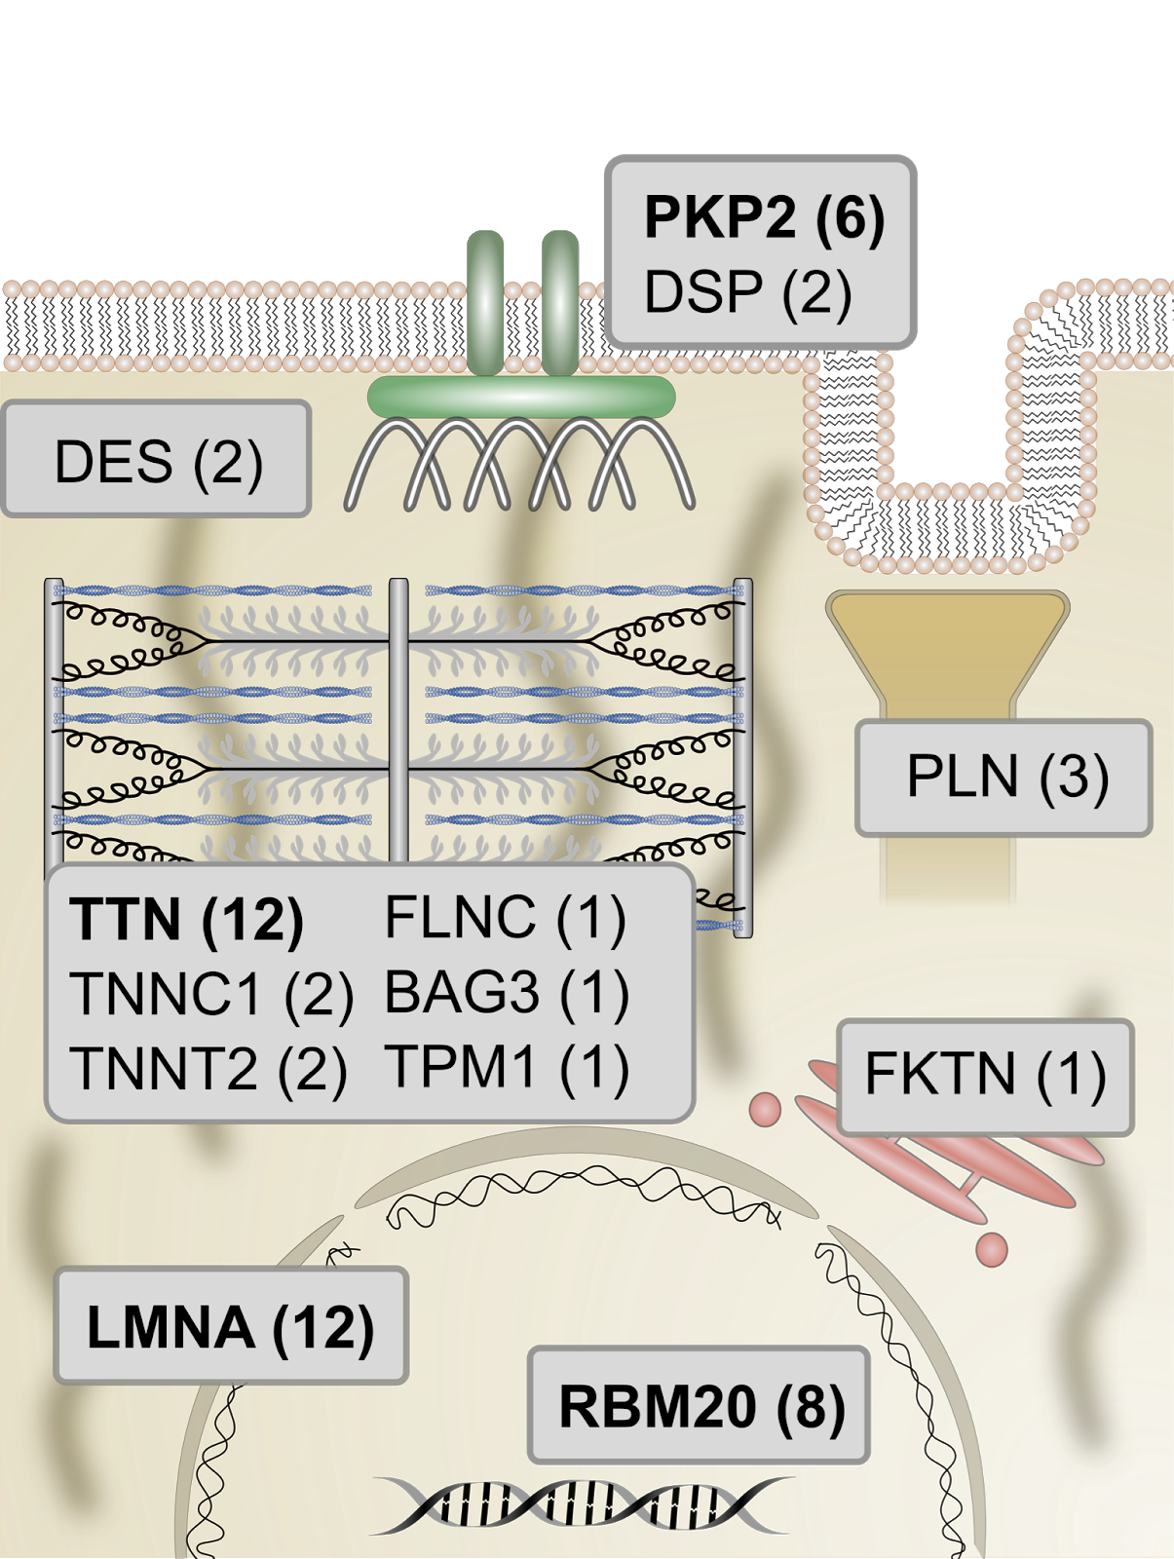
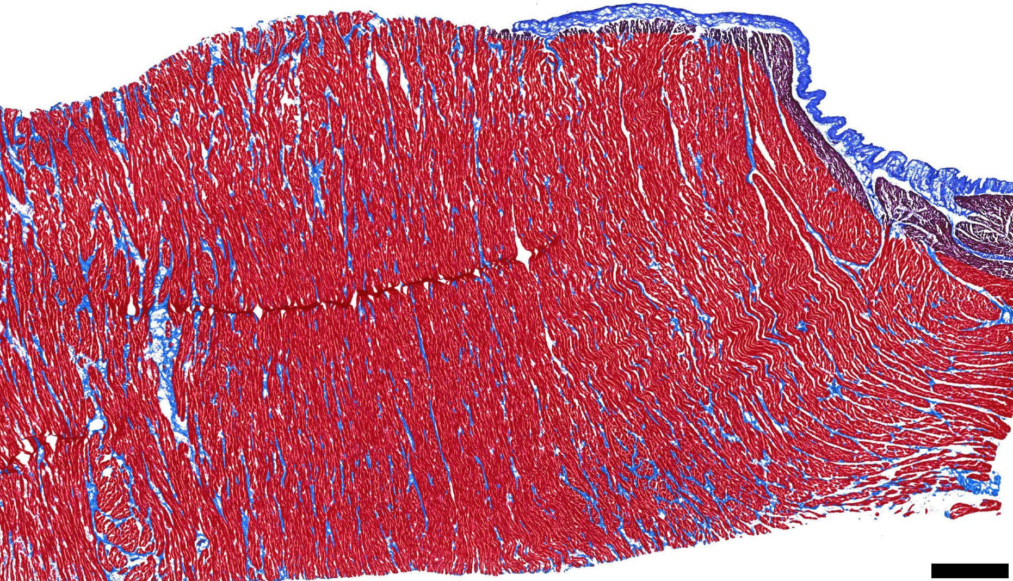
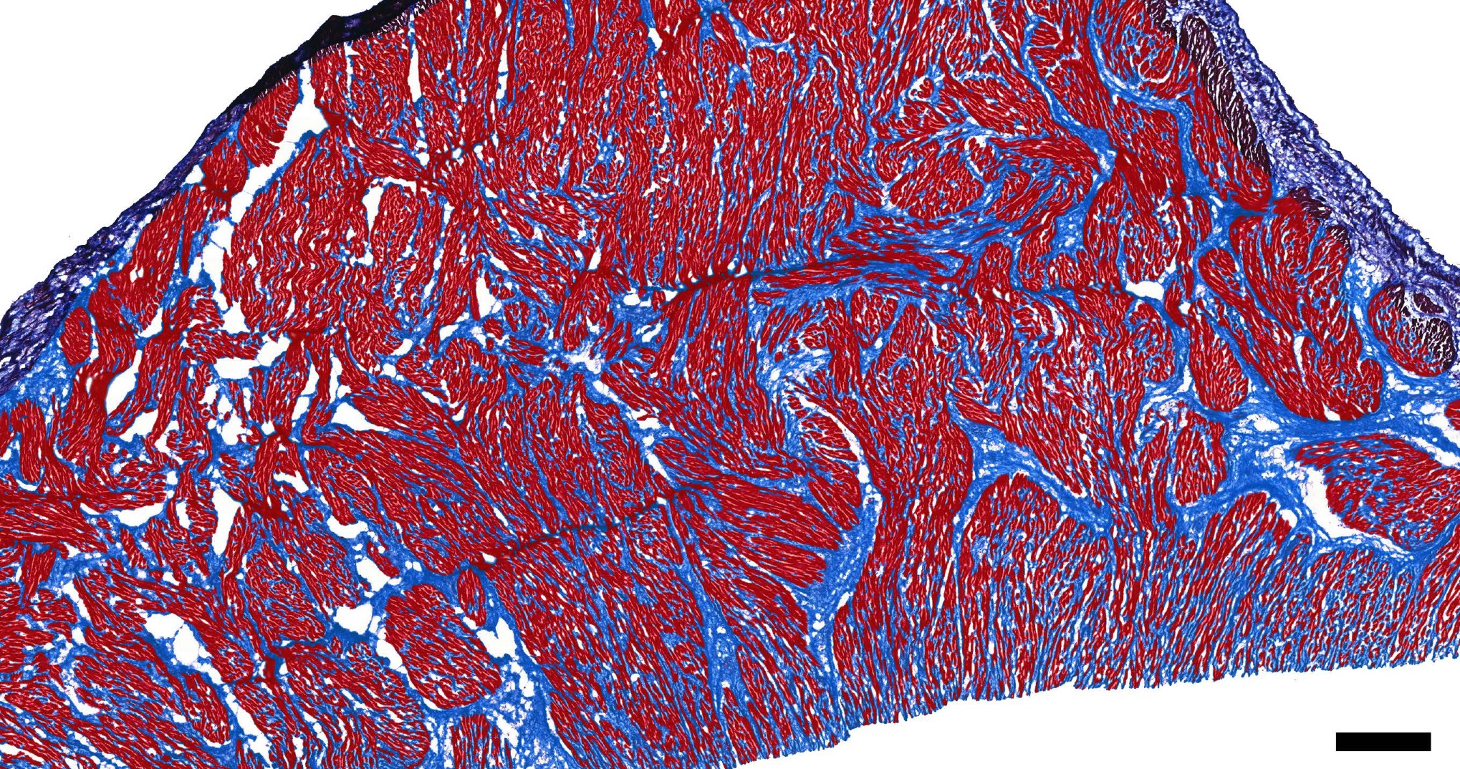
snRNAseq analyses of cardiomyopathy
Normal
HCM
TTN (12)
LMNA (12)
RBM20 (8)
PVneg (8)

Slide 8
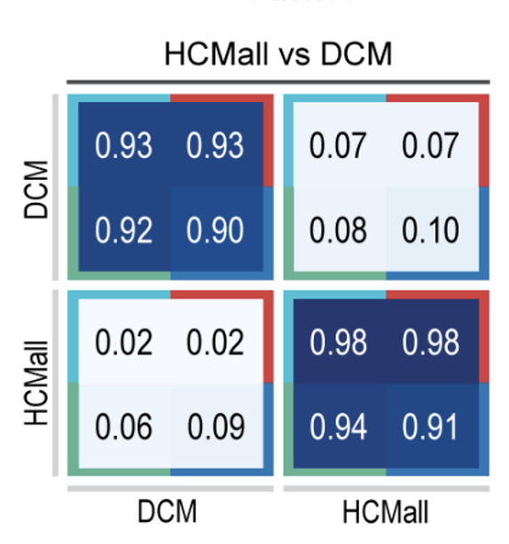
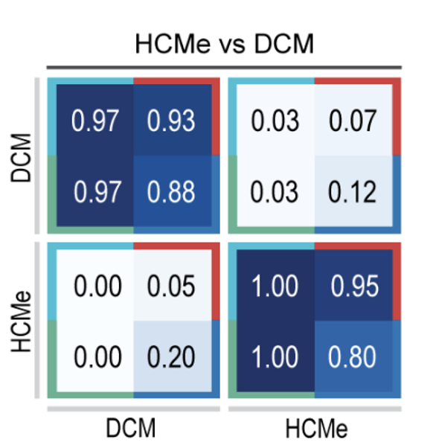
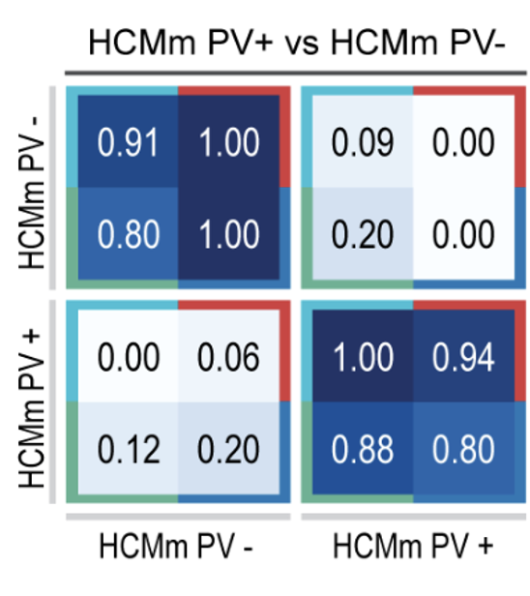
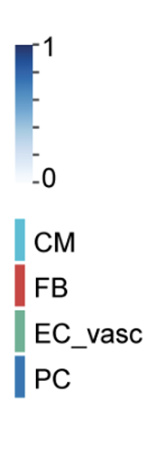
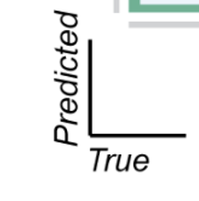
Disease-specific cell composition and gene expression patterns in myectomy and end-stage hearts distinguishes
HCM from DCM
PV+ from PV- HCM
Yuri Kim, Eleonora Adami, Meraj Neyazi, Viktoria Strohmenger

Slide 9
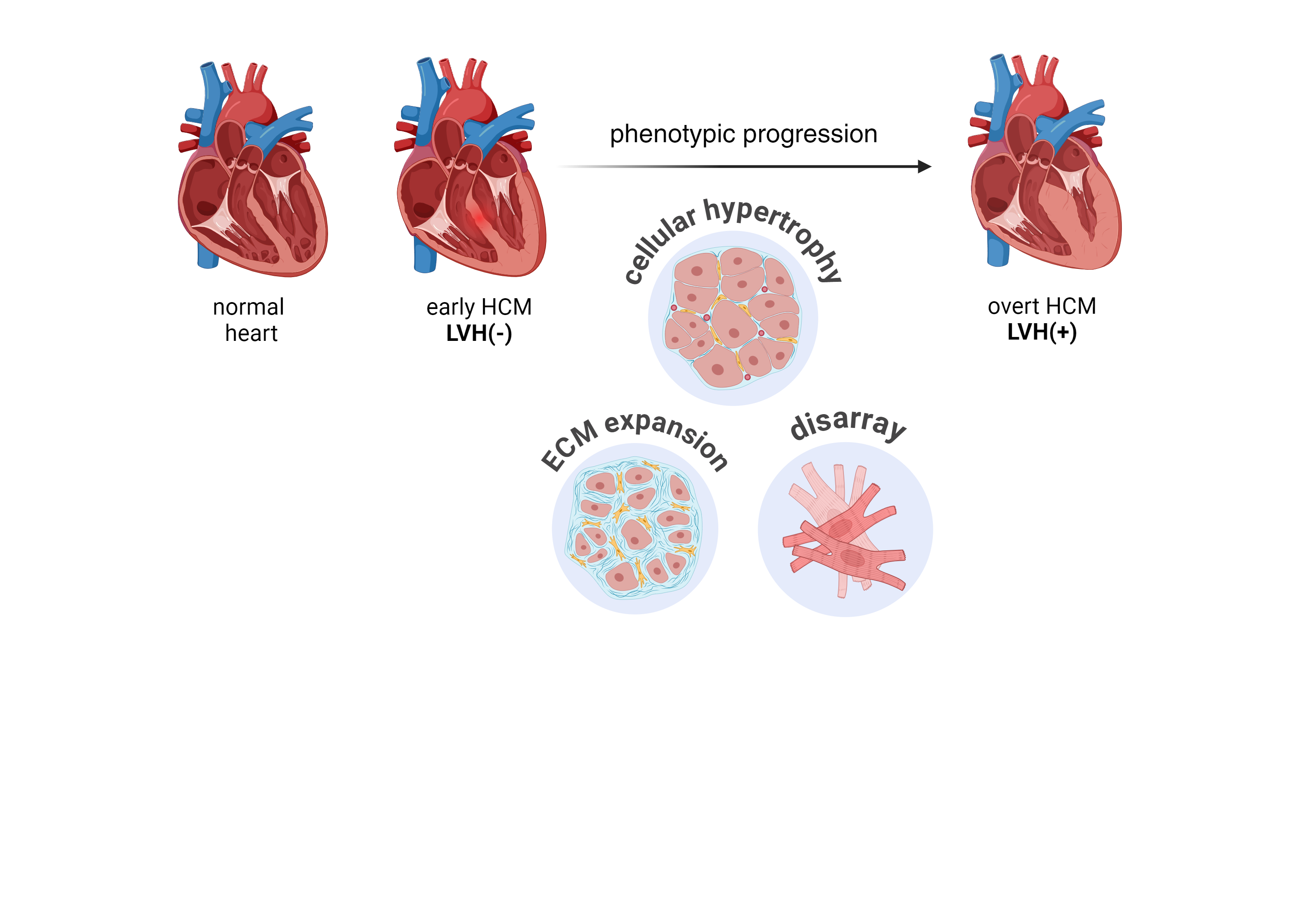
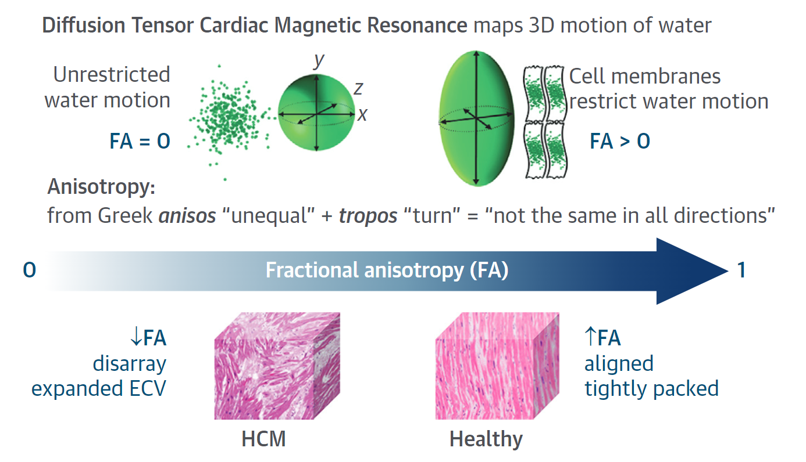
What cellular/extra cellular changes mediate hypertrophy in HCM?
phenotypic
progression
What are the relative contributions of cellular hypertrophy, interstitial fibrosis, and cellular disarray in early vs late HCM?
Adapted from Ariga R, et al.
JACC. 2019;73:2493–2502.

Slide 10
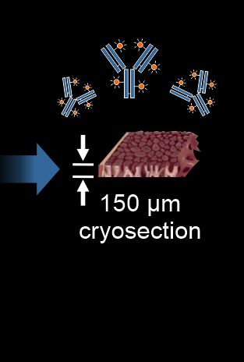
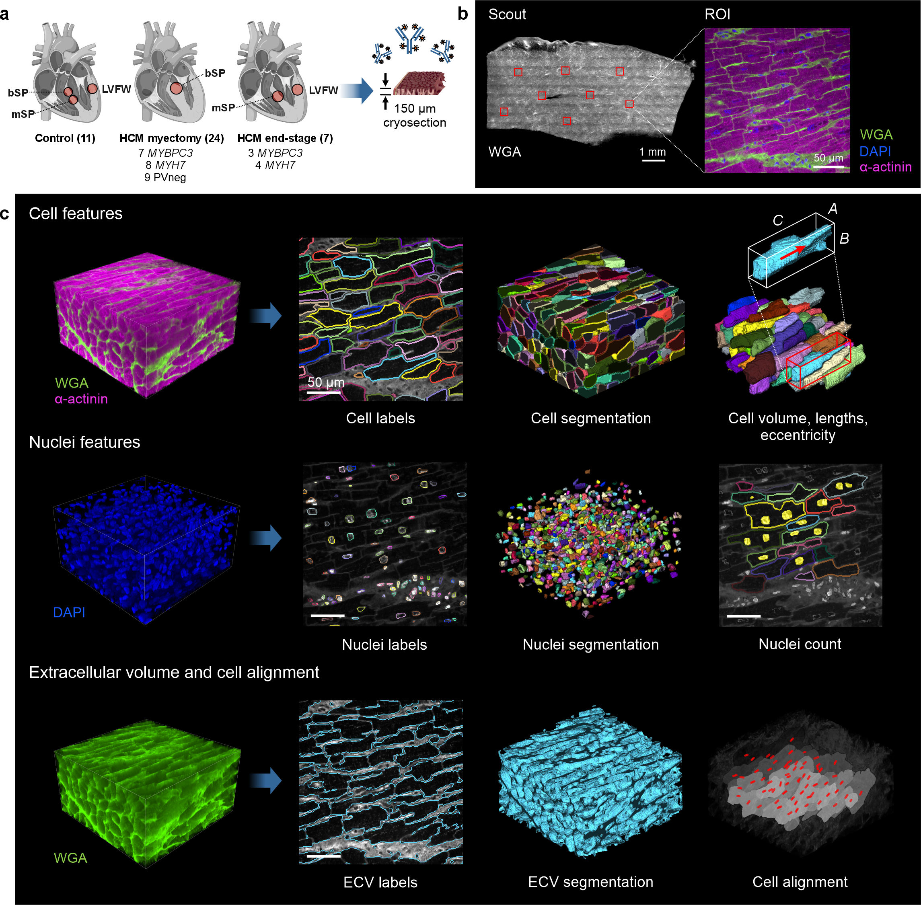
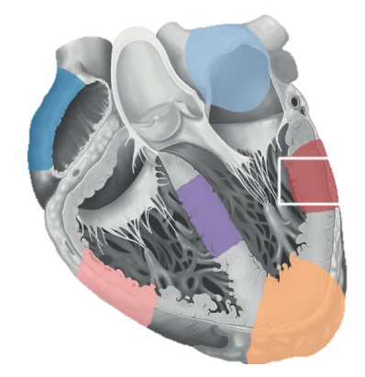
CaMVIA-3D – Cardiac Microarchitectural Volumetric Imaging and Analyis Pipeline
Eric Wei Kemar Brown
Wei et al, Science in Press
Martin Beyer, Alex Barnsbach, Eric Wei

Slide 11
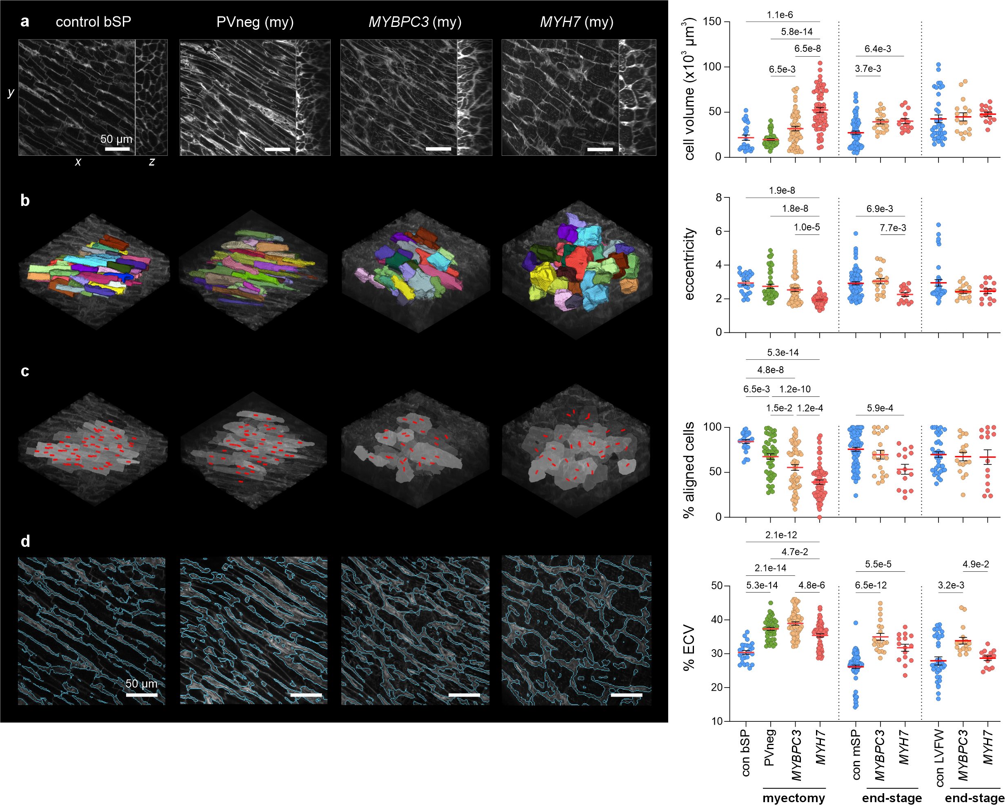
PV+ and PV- HCM exhibit Different Cell Sizes and Morphology
PVneg
MYH7
Control
MYBPC3

Slide 12
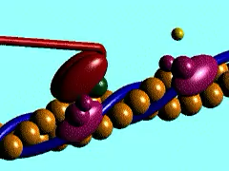
8 HCM genes encode sarcomere proteins

Slide 13
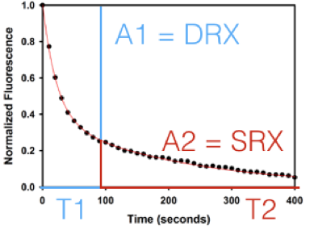
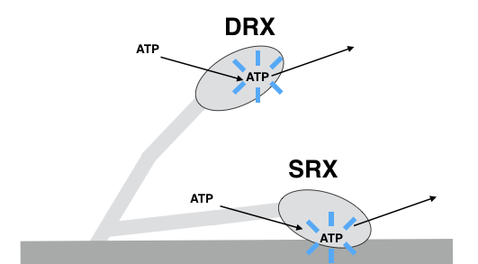
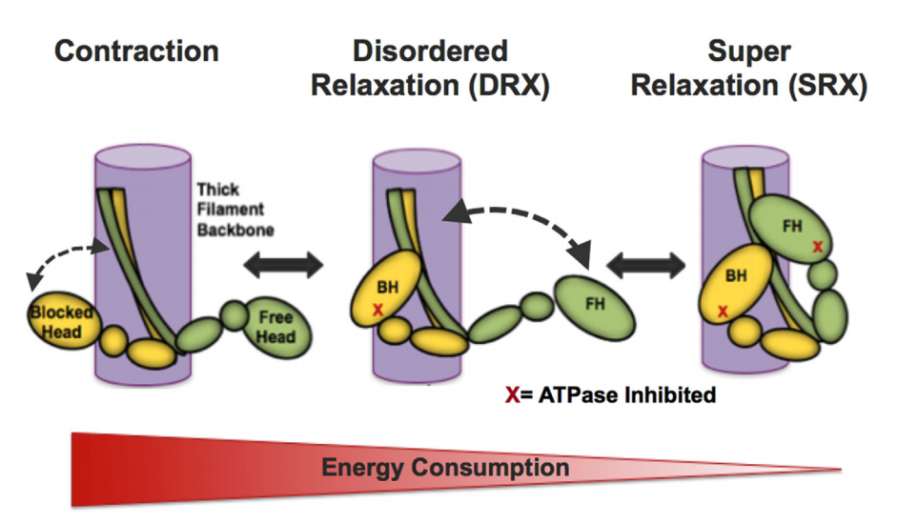
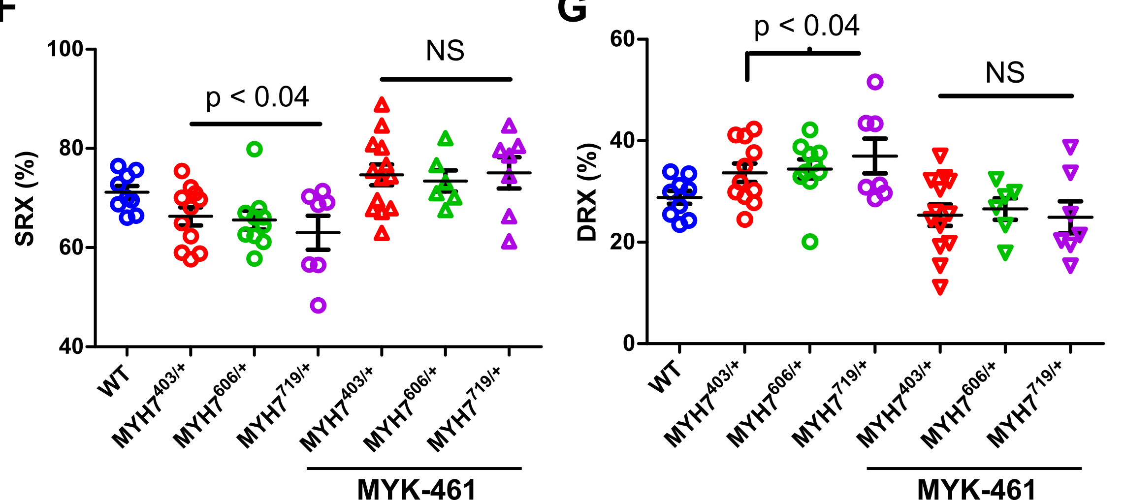

Destabilizing the interacting heads motif:
Myosin mutants shift balance of heads to active state
Roger Cooke
Fast
Slow
Toepfer et al. 2019 Circ Res
HCM Mutations :~15% Shift in SRX:DRX Ratios with Cellular Consequences

Slide 14
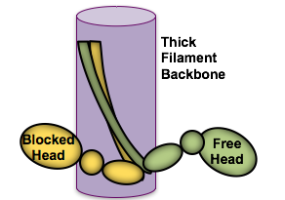
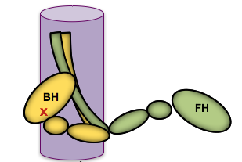
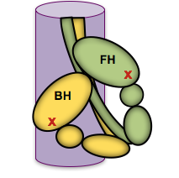
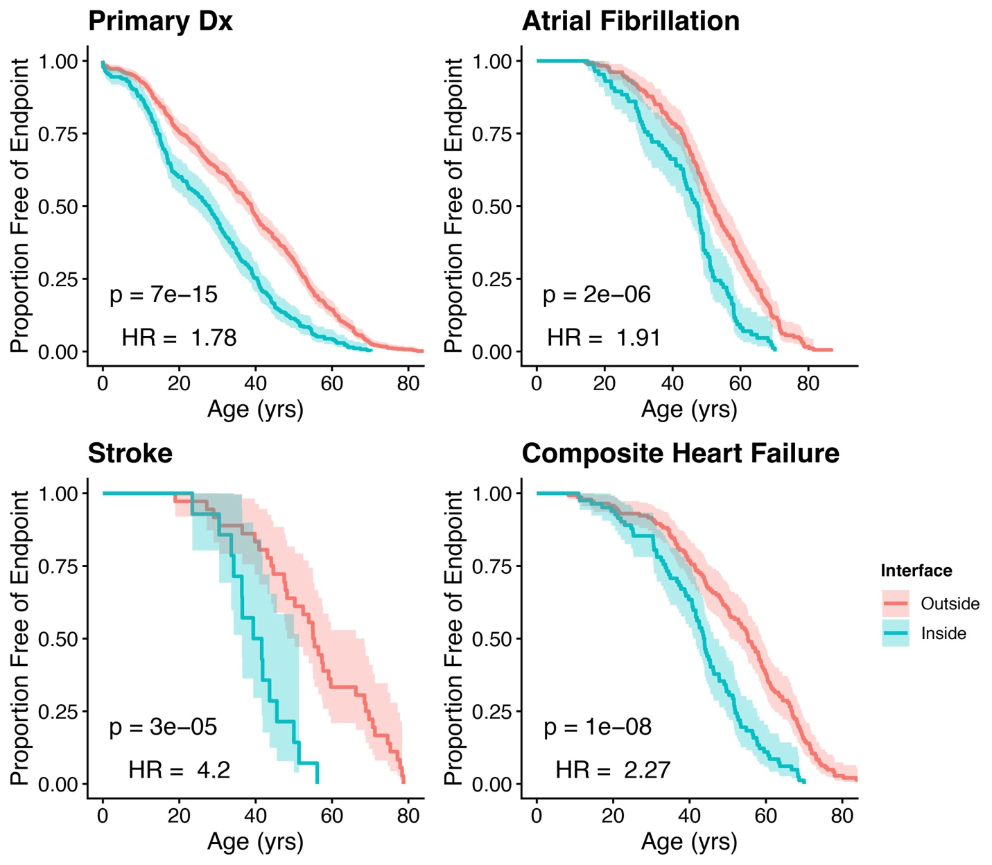
Mutations disrupting myosin interfaces cause more severe
disease than other myosin mutations
Sarcomeric Human cArdiomyopathy Registry (SHaRe)
(>6000 subjects with longitudinal clinical and genetic data collected over the past 20 years)
Contraction
Disordered Relaxed (DRX)
Super
Relaxed (SRX)
5X
ATPase
One ATPase
Inhibited
Two ATPases
Inhibited
Energy Consumption
eLIfe 2017
Circulation 2020
HCM-causing mutations cluster in BH-FH, BH-S2 and BH-proximal interfaces (p<1e-6)
Vibert & Craig, J Cell Biol; 1985, Woodhead et al, Nature 2005
Dutta et al., Nat Comm submitted 2025
Raul Padron, Roger Craig, Carolyn Ho
Notes:
This shows us that for a sarcomere to get to its most relaxed state, it passes through this middle phase of relaxation

Slide 15
Development of Molecules to Modulate Sarcomere Function
ATP hydrolysis
Mavacamten
(MYK-461)
ATP binding ADP release
Actin binding
Power Stroke
Inhibit
ATPase
Pi release
MYK-461-treated iPSC-CMs
With HCM Mutations
Myofibrils
Normalized SRX:DRX Ratios
Decreased Hyper-contractility
Normalized 0₂ Consumption
Reduced Hypertrophy
Science 2016; Circulation 2020

Slide 16
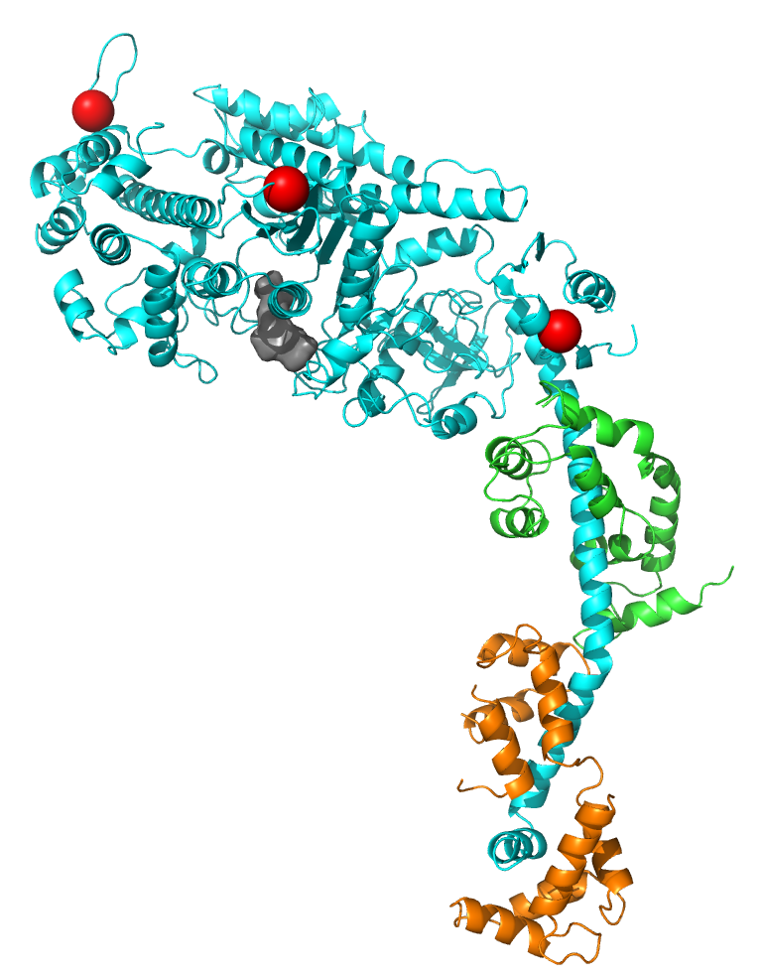
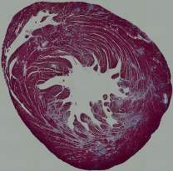
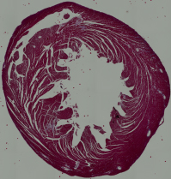
HCM Mice + Early in vivo MYK-461: Reduce LVH & Fibrosis
R403Q
1.4
p=0.002
p=0.001
R453C
p=0.0006
p=0.0001
Naïve
R403Q
1.2
R719W
LVWT (mm)
1.0
0.8
R403Q + MYK-461
0.6
0
2
4
6
10
14
18
22
26
Weeks of treatment
p=1x10⁻¹⁷
untreated
treated
p=5x10⁻¹⁶
Science 2016

Slide 17

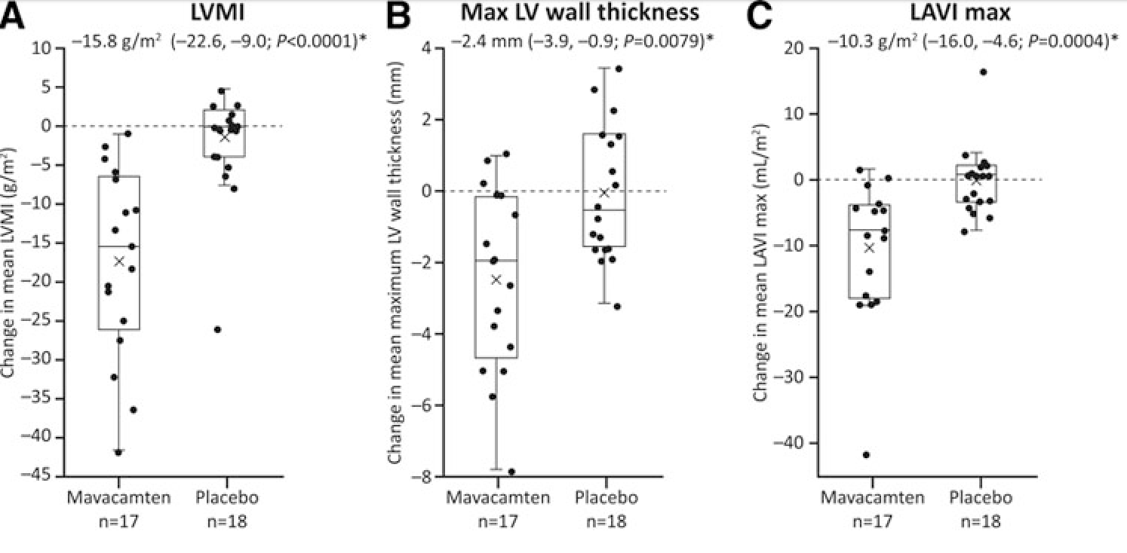
Mavacamten Improved Biomarkers and Remodeling
LV Wall thickness 12.4mm
(p=0.008)
LA Volume (indexed) 10.3/m²
(p= 0.0004)
LVMI -15.8g/m²
(p <0.0001)
Marketed as:
Camzyos
(nee Mavacamten)
Saberi et al
Circ, 2021
Mavacamten Placebo
Mavacamten Placebo
Mavacamten Placebo
Notes:
Do Thin Filament Mutations and Polygenic Risk Loci Act via Similar Mechanisms?
Will Myosin Modulators Reduce Risk for AF and Heart Failure?
Can Myosin Modulators Reverse Established HCM?

Slide 18
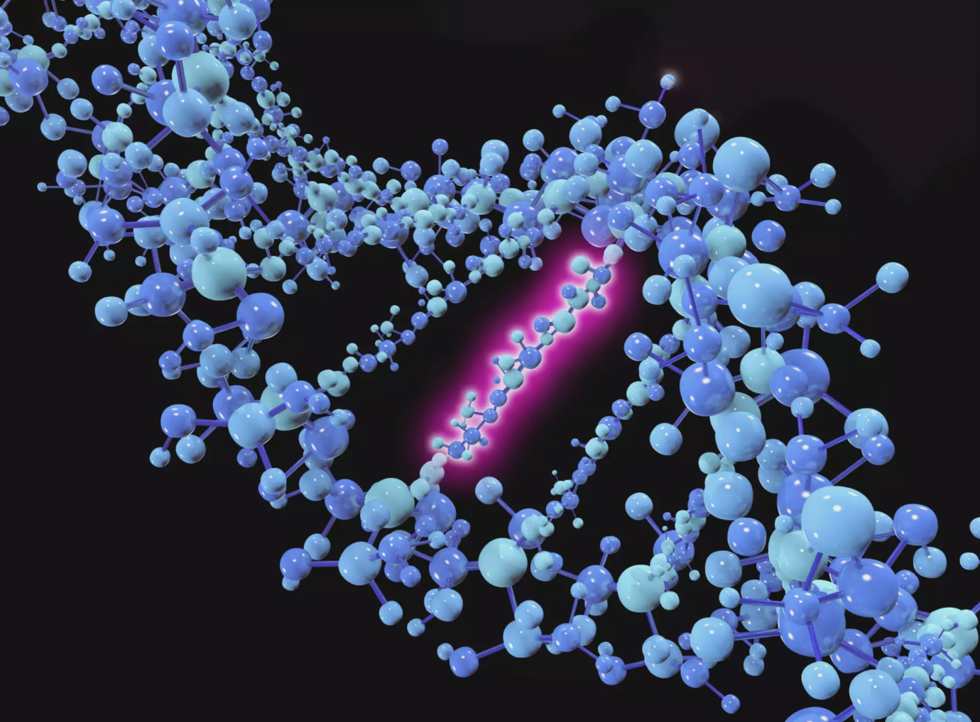
The Ultimate Opportunity Presented by Discovering the Genetic Basis of Human Disease: Disease Prevention
Can We Cure Rather than Treat Mutations?
Dominant Negative
MYH7 Missense
Normal Protein Level
Abnormal Function
Haploinsufficiency:
MYBPC3 Truncation
50% Normal Levels of Protein
Rx: Correct / Silence
Mutation
Rx: Supplement Normal
Gene

Slide 19
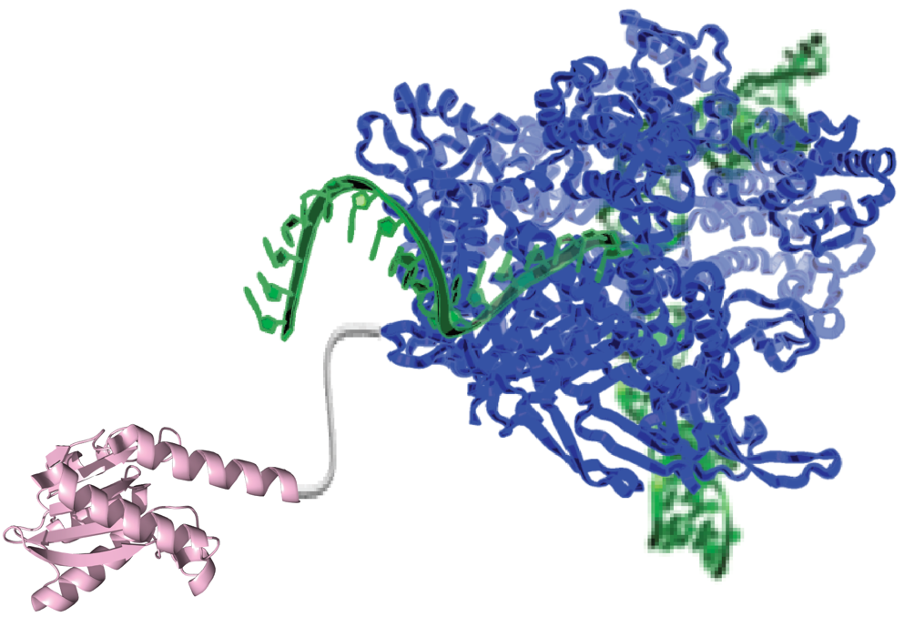
Base Editor Strategies: Convert Single Nucleotide without Introducing Double-Strand DNA breaks
Adenine base editor (ABE)
A → G and T → C
dCas9 nickase
sgRNA
24%
30%
C→T, G→A
A→G, T→C
Lab-evolved ssDNA deoxyadenosine deaminase
20%
A→C or T
C→A or G
G→C or T
T→A or G
Cytosine base editor (CBE)
C → T and G → A
Transition point mutation
Transversion point mutation
Deletion
Other
dCas9 nickase
ssDNA cytidine
deaminase
Notes:
For our editing strategies, either to target a common variant or to correct a mutation
need to correct point mutations - esp transitions
so we’re looking towards second generation – ie more precise, editing tools rather than CRISPR – cut/scissors
[as we don’t have efficient HDR (post mitotic cells) and don’t in any case want double stranded breaks]
So instead Base Editors (Liu lab)

Slide 20
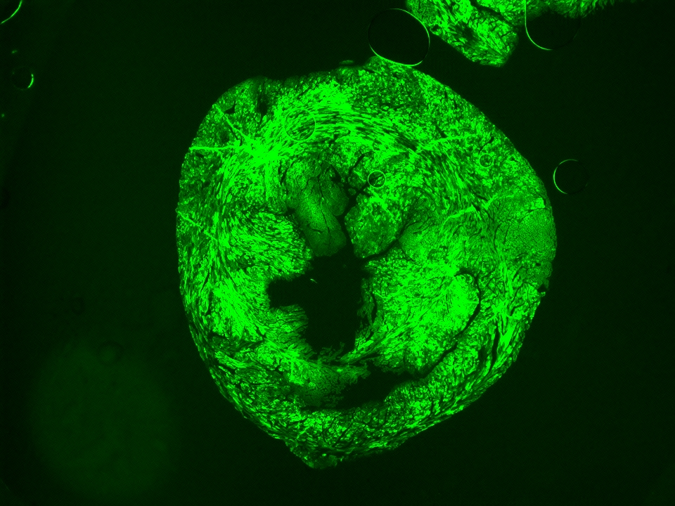
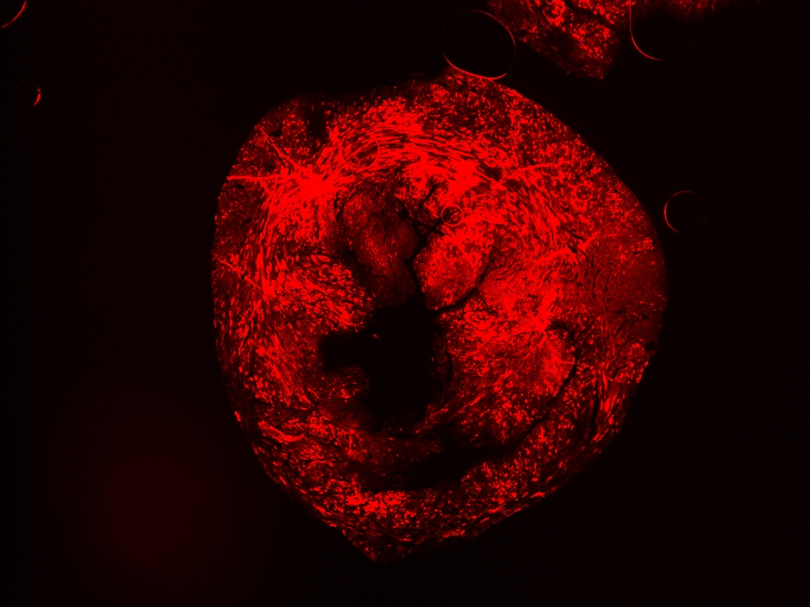
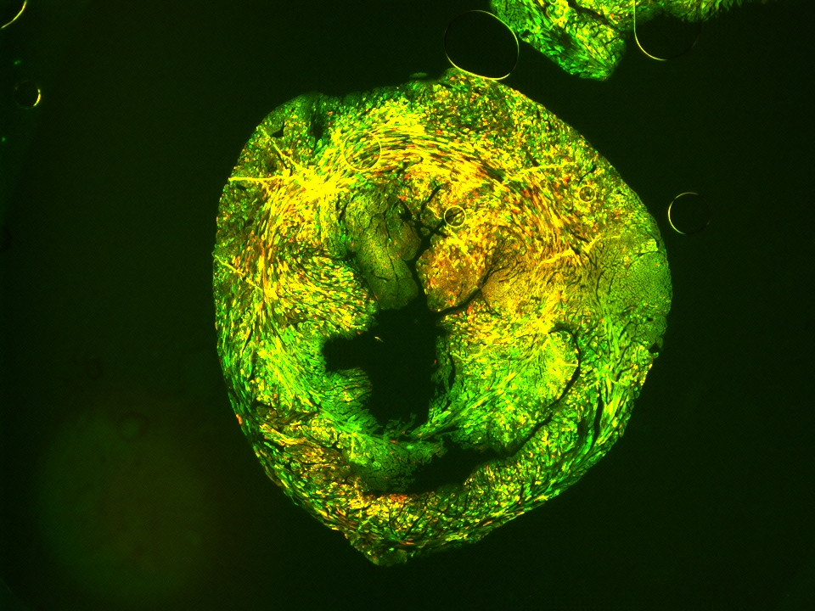
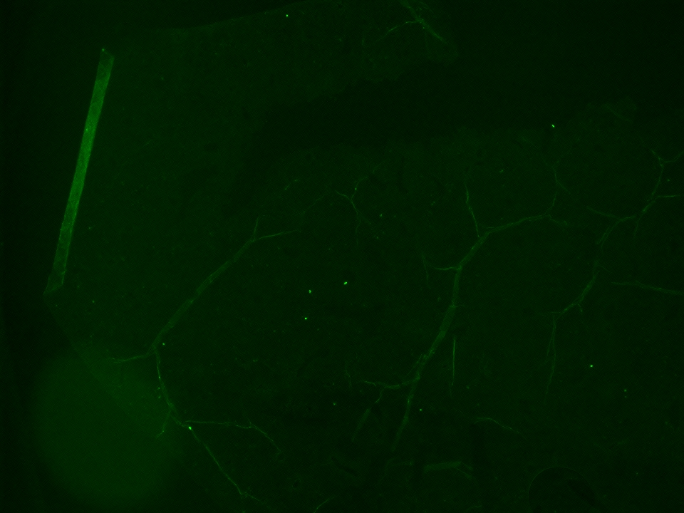
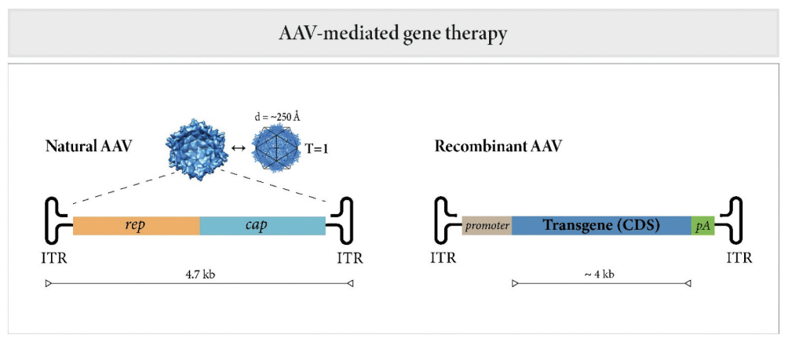
Systemic Delivery: Requires Dual AAV9 Vectors with Target Organ Selectivity
Heart Liver
Notes:
70 genes
Of these, 30-50% are of a genetic cause
Autosomal dominant inheritance (85-90%)
X-linked (5-10%)
Mitochondrial inheritance

Slide 21
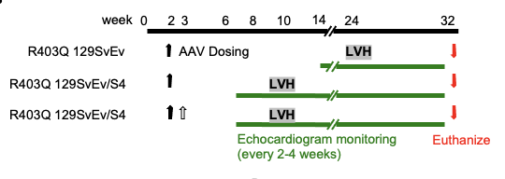
In vivo Targeting of Mouse Models with Insidious and Fulminant onset of HCM
Hiroko Wakimoto, Daniel Reichart, Greg Newby
Notes:
70 genes
Of these, 30-50% are of a genetic cause
Autosomal dominant inheritance (85-90%)
X-linked (5-10%)
Mitochondrial inheritance

Slide 22
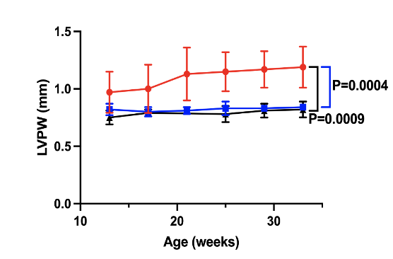



Editing Myosin Mutations in HCM Mice
SvEV/S4: Fulminant LVH
Single, Systemic Injection
Dual AAV9-ABE + Myosin Guide
SvEV: Insidious LVH
80-
60-
40-
20-
0-
Gln403
Bystander
Bystander
% LV CMs 403 Arg
% Cardiomyocytes Edited
Mouse 1 Mouse 2
WT
HCM
Normalized Levels of
Adverse Remodeling mRNAs
No Extra-Cardiac Effects
Nat Med 2023

Slide 23


CVGC
Carolyn Ho
Neal Lakdawala
Calum MacRae
Lab Members
Yuri Kim Eric Wei
Meraj Nayazi Martin Beyer
Gabriela Venturini Kemar Brown
Seong Kim Youjung Choi
Hidenori Kojima Vi Tang Hiroko Wakimoto Adam Wong Meeghan Sleeper Steve DePalma
Joshua Gorham Olivia Layton Arjun Verma David Conner
Susanne Bartlett Barbara McDonough
Collaborators
Ele Adami & Norbert Hubner
(MDC, Berlin)
Sean Zheng & Michela Nosedea
(Imperial College, UK)
Gavin Oudit (Univ Alberta, CA)
Funders
CZI
BHF
NIH

