Slide 1


Modifier-directed therapeutics in Cystic Fibrosis: targeting SLC26A9
Lisa J. Strug
The 8th Annual New England Rare Disease Statistics (NERDS) Workshop
Thursday October 9

Slide 2
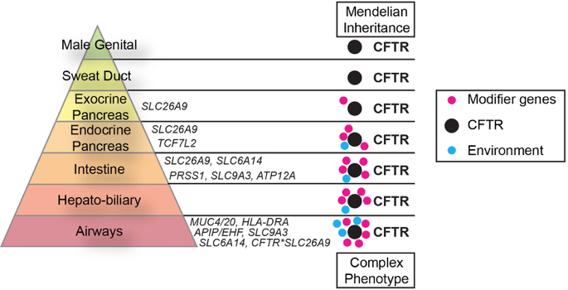
Genetics of Cystic Fibrosis (CF)
2
Hypothesized complex model across CF-Affected organs (Peter Durie)
2
2
2
Notes:
This is really the model that was proposed to me by Peter Durie and Lap-Chee when I joined SickKids the the GMS in 2008, and we have been working with our international partners to fill in the blue and pink dts
If one is to correct CFTR, one needs to think about the cross-tissue interaction with the modifiers, which I will show can differ

Slide 3
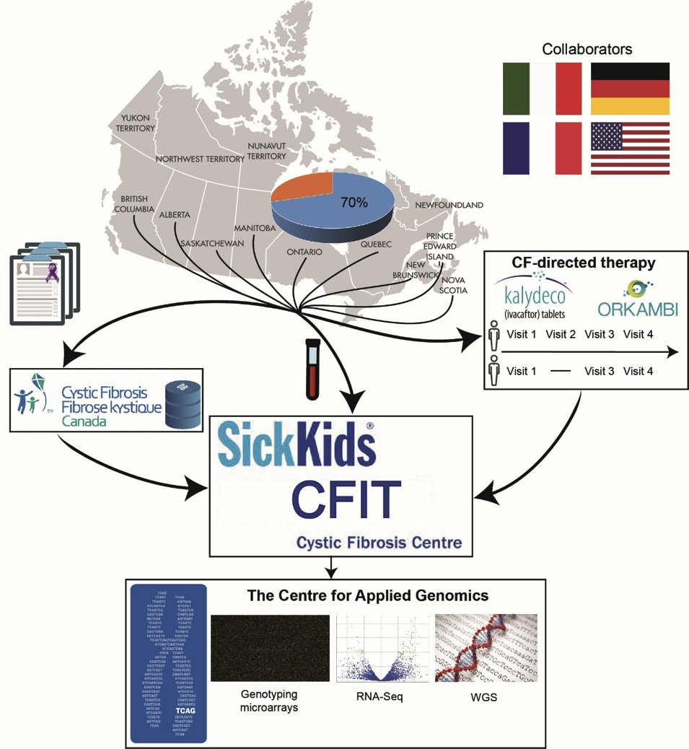


The Canadian CF Gene Modifier Study
3316 participants from 9 provinces across Canada
Build predictive models of disease severity and therapeutic response (eg. Lin et al. 2022)
Identify alternative therapeutic targets (eg. Gong et al 2022)
Understanding impact in non-CF (eg. Strug et al 2018; Matromatteo et al 2023)
(HNE, HBE)
Linked & Long-read
DNA-methyl
Notes:
Why identify these modifiers?

Slide 4
GWAS of Meconium Ileus (n=6,770) has informed us about lung infection, alternative targets, disease mechanisms in CF and other diseases. Gong et al. 2019 PLOS Genetics
1
Many associated loci:
Are shared with other CF GWAS phenotypes
Are shared with non-CF phenotypes
May interact with CFTR (apical)
3
1
2
2
3
Notes:
- carried out a GWAS with ICFGMS, identified several loci.
- GWAS identifies loci not responsible variation, mechanism of action, responsible gene or tissue. That requires more work.
But what we learned was that .. Like

Slide 5
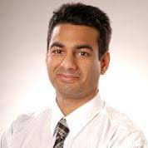

GWAS identifies associated loci – What gene, what tissue, what mechanism? LocusFocus.
Naim Panjwani
Fan Wang
Notes:
To understand the mechanism by which a locus contributes to disease requires functional investigation, and this needs to be hypothesis-driven, in a relevant cellular model of the contributing gene. To bridge this gap and guide the design of functional studies we developed data integration methods for multi-omic technologies.

Slide 6
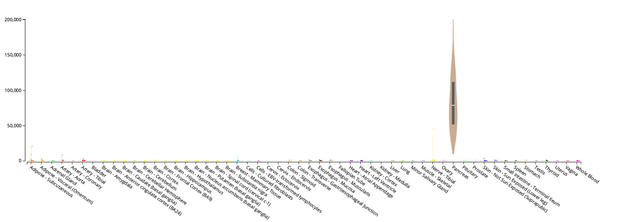

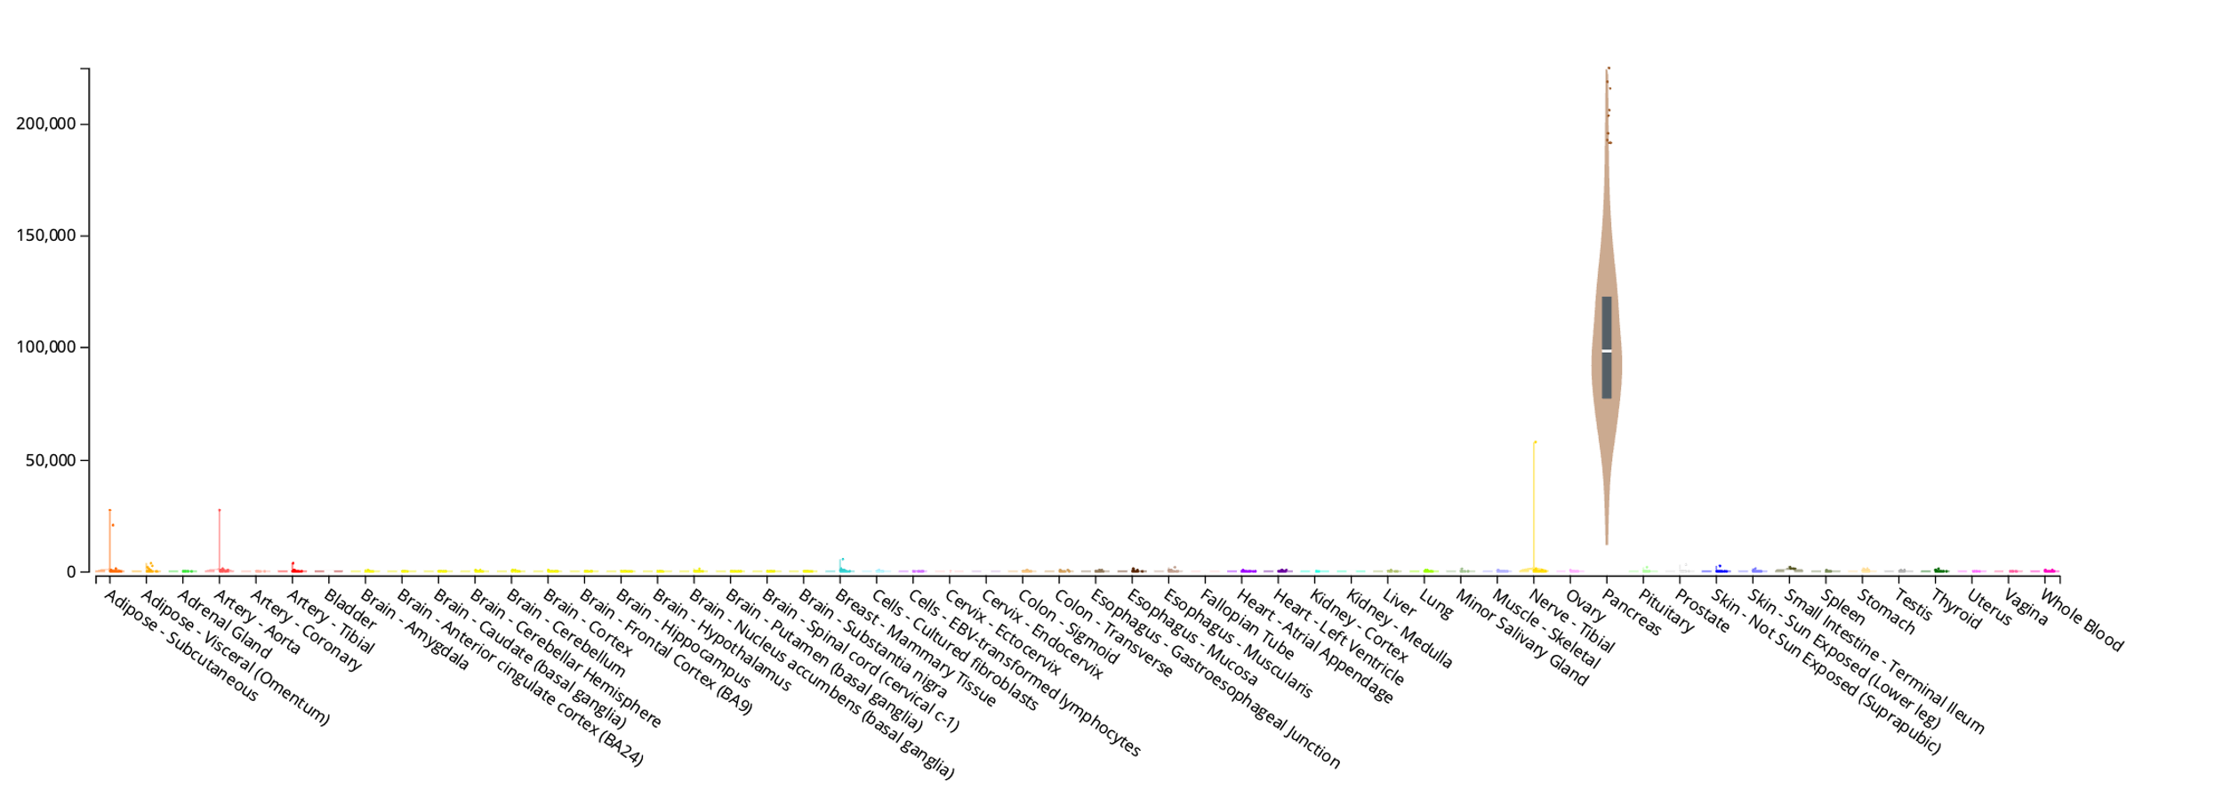
Trypsinogen
Gene Expression
A protease produced in the pancreas, aiding digestion
Variation tied to pancreatitis
Two major forms:
PRSS1 (cationic)
PRSS2 (anionic)
PRSS1
2
pancreas
PRSS2
pancreas
Tissues
[1] The Genotype-Tissue Expression (GTEx) Project The data used for the analyses in dbGaP accession number phs000424.vN.pN
RNA-seq expression data across 54 tissues
Tissue-specific expression
Notes:
To understand what we are missing consider the third locus
Zoom in can see it harbours trypsinogen family of genes, allelic heterogeneity, gamps
Trypsiongen is…
But exclusively expressed in pancreas
Needed to tie the associated variants to a function, for example to they impact PRSS1 or PRSS2 gene expression in the pancreas?

Slide 7
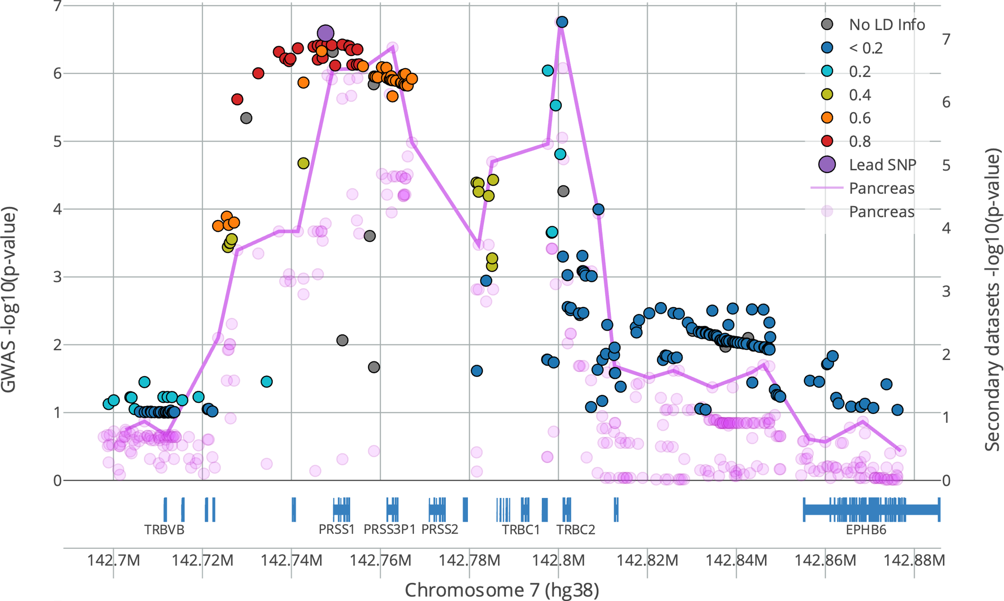

Aside: Expression quantitative trait locus (eQTL)
/
T
A
SNP is an eQTL
T
T
High GENE X expression
GENE X
A
Low GENE X expression
A
GENE X
GTEx^{[1]} Data
CF HNE
Notes:
We can do this by calculating eQTLs.
That is…

Slide 8
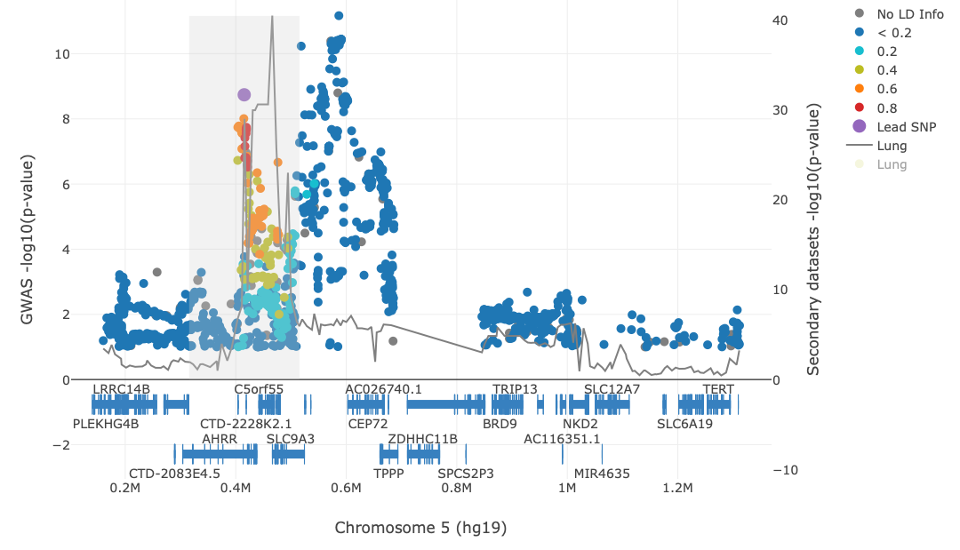
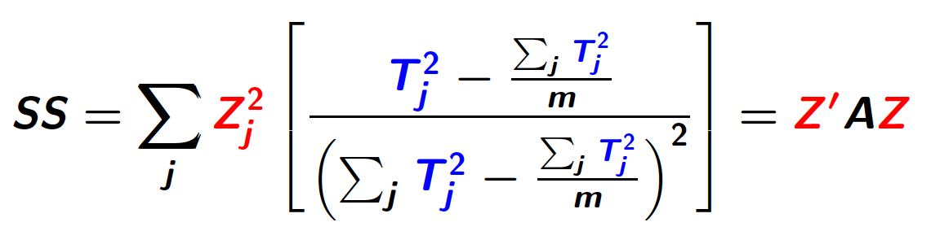
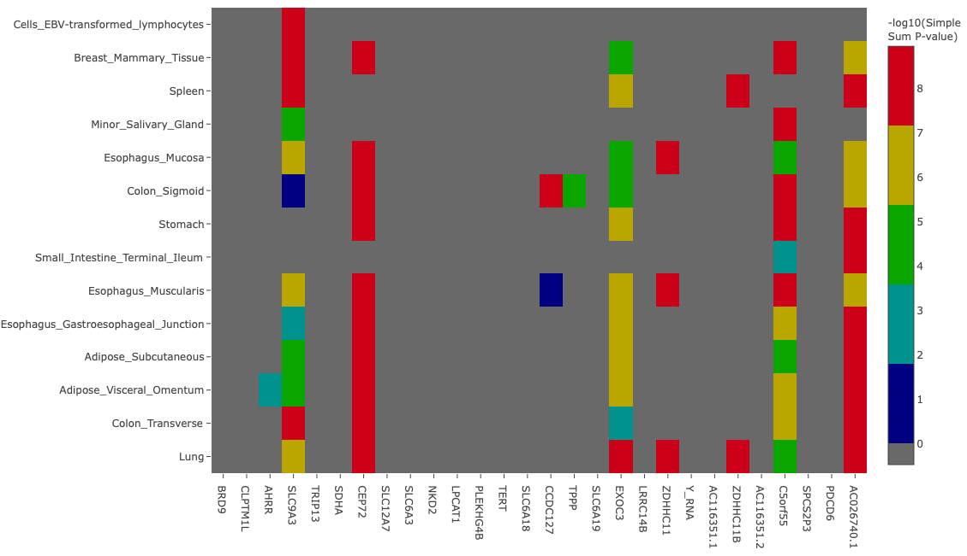
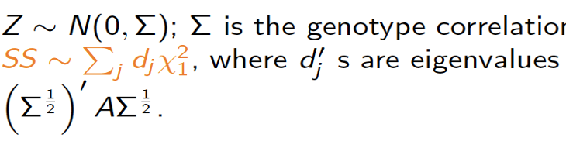
LocusFocus: data visualization and testing
https://locusfocus.research.sickkids.ca
Conduct colocalization analysis using SS2.
Input:
GWAS p-values
P-values from any secondary SNP-level dataset
LD matrix
Output:
Colocalization and heatmap visualization of GWAS and optional secondary datasets uploaded by the user.
Sample interactive plot output from the LocusFocus web application.
Panjwani N et al. (2020). PLOS Computational Biology 16(10): e1008336. https://doi.org/10.1371/journal.pcbi.1008336
Wang et al, AJHG 2023
TISSUES
GENES

Slide 9
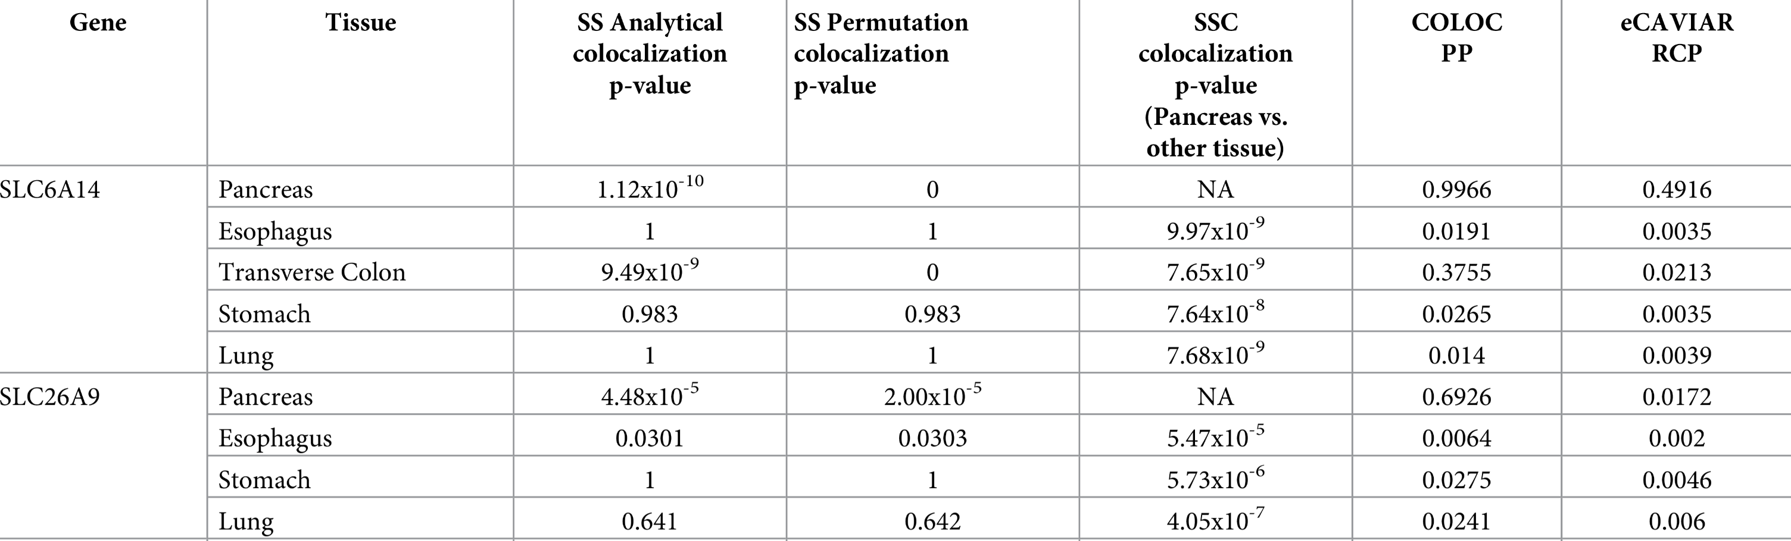
GWAS of Meconium Ileus (n=6,770): Genome-wide associated variants impact SLC6A14 and SLC26A9 gene expression in the pancreas Gong et al. 2019 PLOS Genetics
1
3
1
3
Notes:
Add SLC26A9 and SLC6A14 function

Slide 10
SLC26A9 is a CFTR-agnostic alternative Therapeutic Target

Slide 11
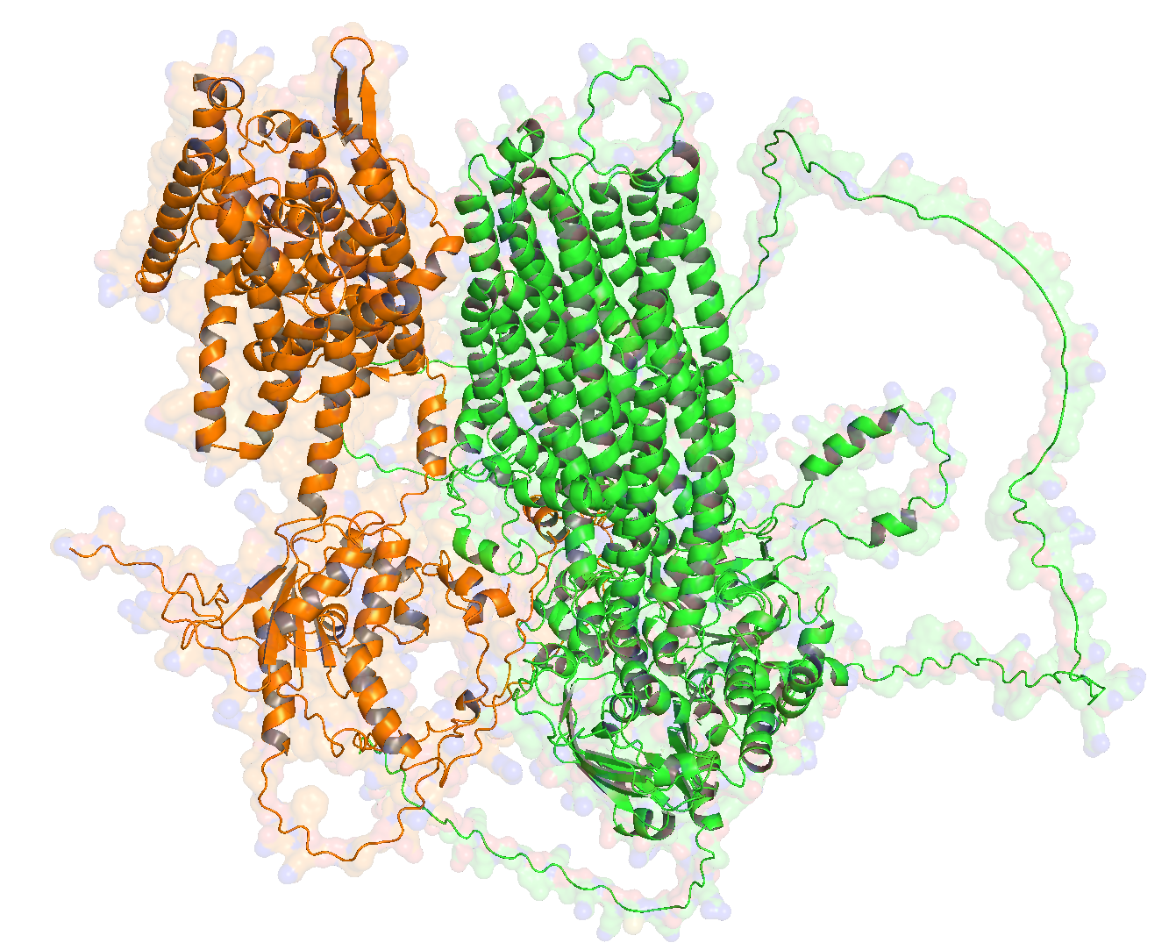
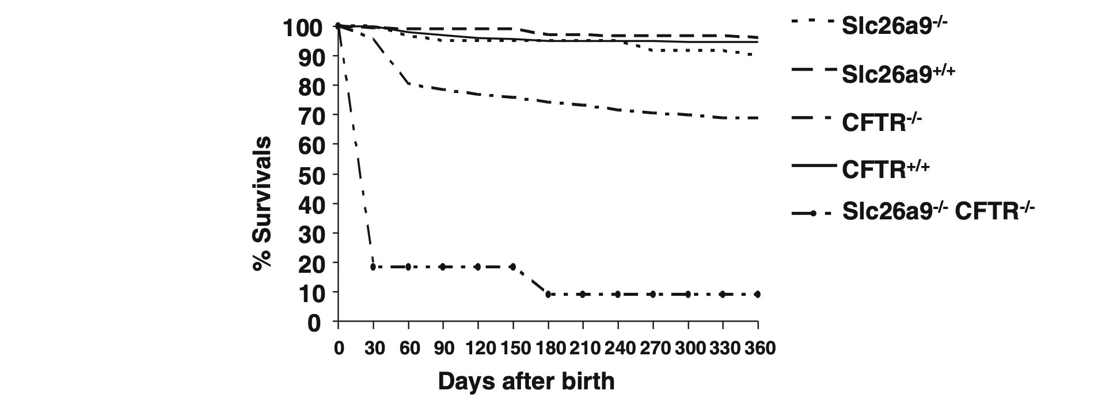
SLC26A9 is an uncoupled chloride transporter, expressed in CF-affected tissue (Walter et al. 2019; Tippett et al. 2023)
In epithelial cells contributes to constitutive apical chloride conductance and enhances cAMP-regulated CFTR currents (Bertrand et al 2009, Avella et al 2011)
Slc26a9^{-/-}/Cftr^{-/-} rodent models show poor
post weaning survival (over Cftr^{-/-})
AlphaFold-Multimer predicts SLC26A9-CFTR complexing
SLC26A9
CFTR
CFTR and SLC26A9 interact (Bertrand et al; 2009, 2017)
interaction enhances functional expression of CFTR
(but not when co-expressed in HBEs from p.Phe508del homozygotes)
From Liu et al, 2015
11
Notes:
SLC26A9 is an epithelial chloride transporter that contributes to epithelial surface hydration¹⁻³
Human population genetic evidence identified SLC26A9 as a modifier of CF pancreatic disease and lung function⁴⁻⁹
SLC26A9 expression contributes to enhanced CFTR expression and function^{10,11}
SLC26A9-mediated chloride secretion prevents mucus obstruction in airway inflammation¹²

Slide 12
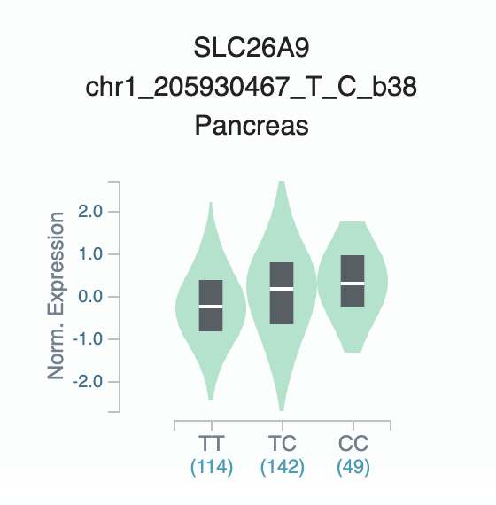
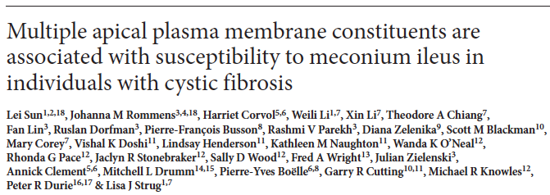
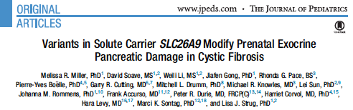
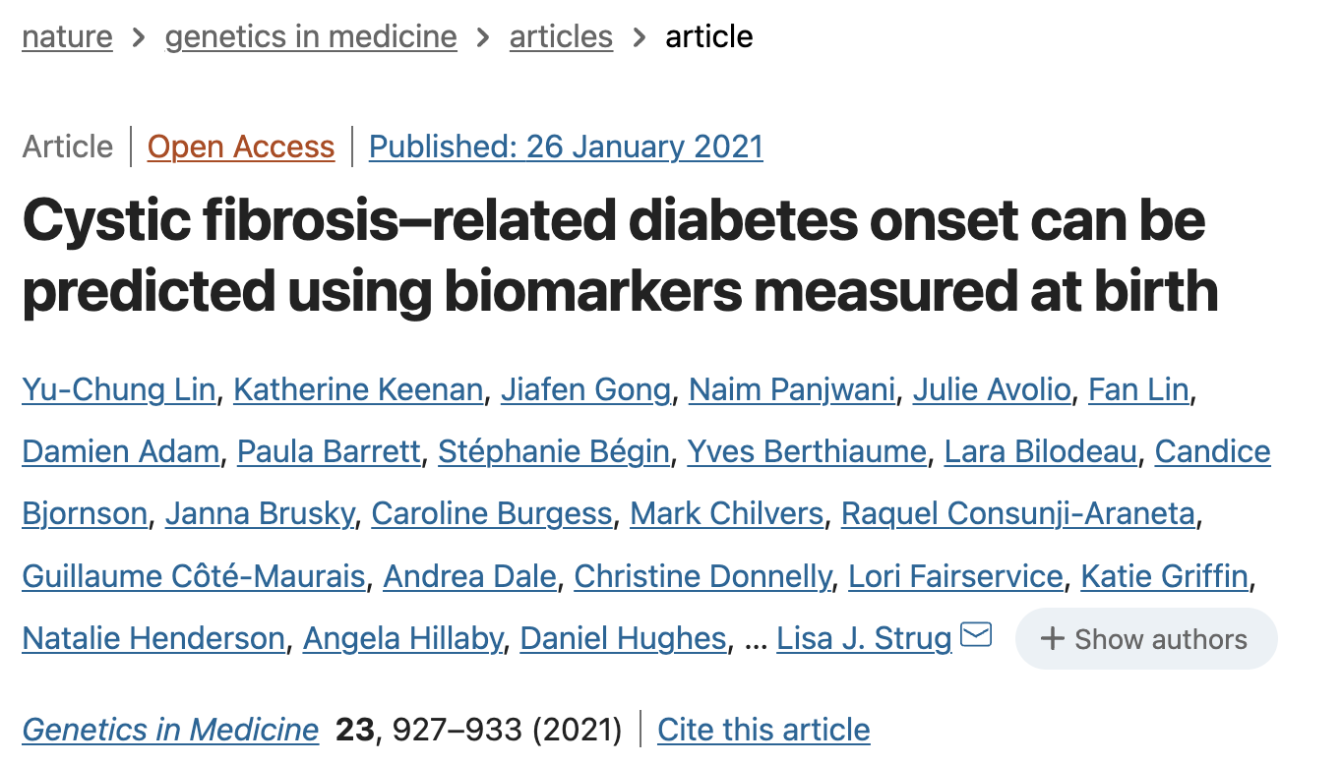
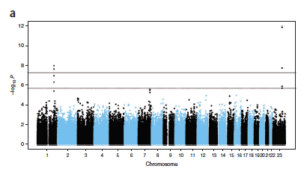
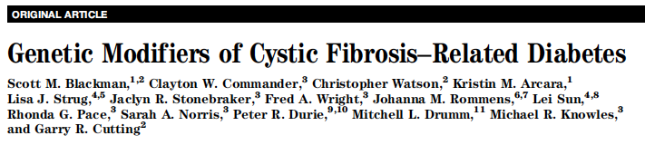
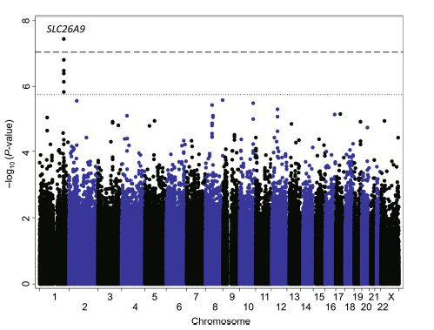
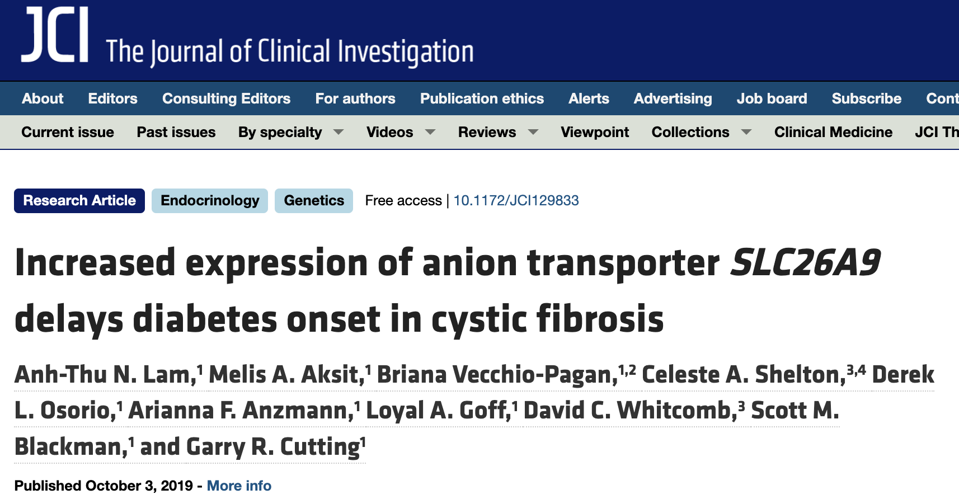
More SLC26A9 improves CF intestinal and pancreatic disease
rs7512462 GTEx
Pancreas eQTL
SLC26A9
Gong et al. 2019 PLoS Genetics
Notes:
We identified SLC26A9 expression in the pancrease associated with MI using locus focus, eQTL on the right shows greater expression associated with improved outcomes.
Same variants associated with exocrine…. CFRD.
Start recently to demonstrate its translational value: my group can be used in a model to predict CFRD; Garry’s group showing impact on delaying CFRD.

Slide 13
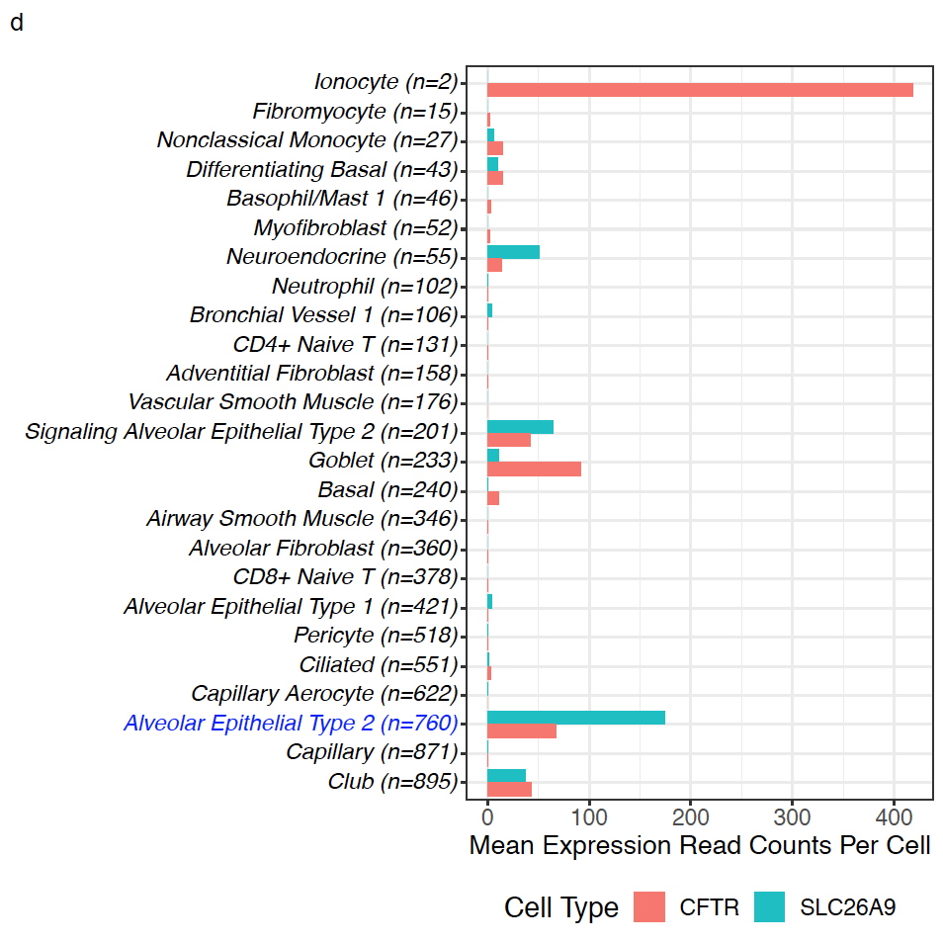
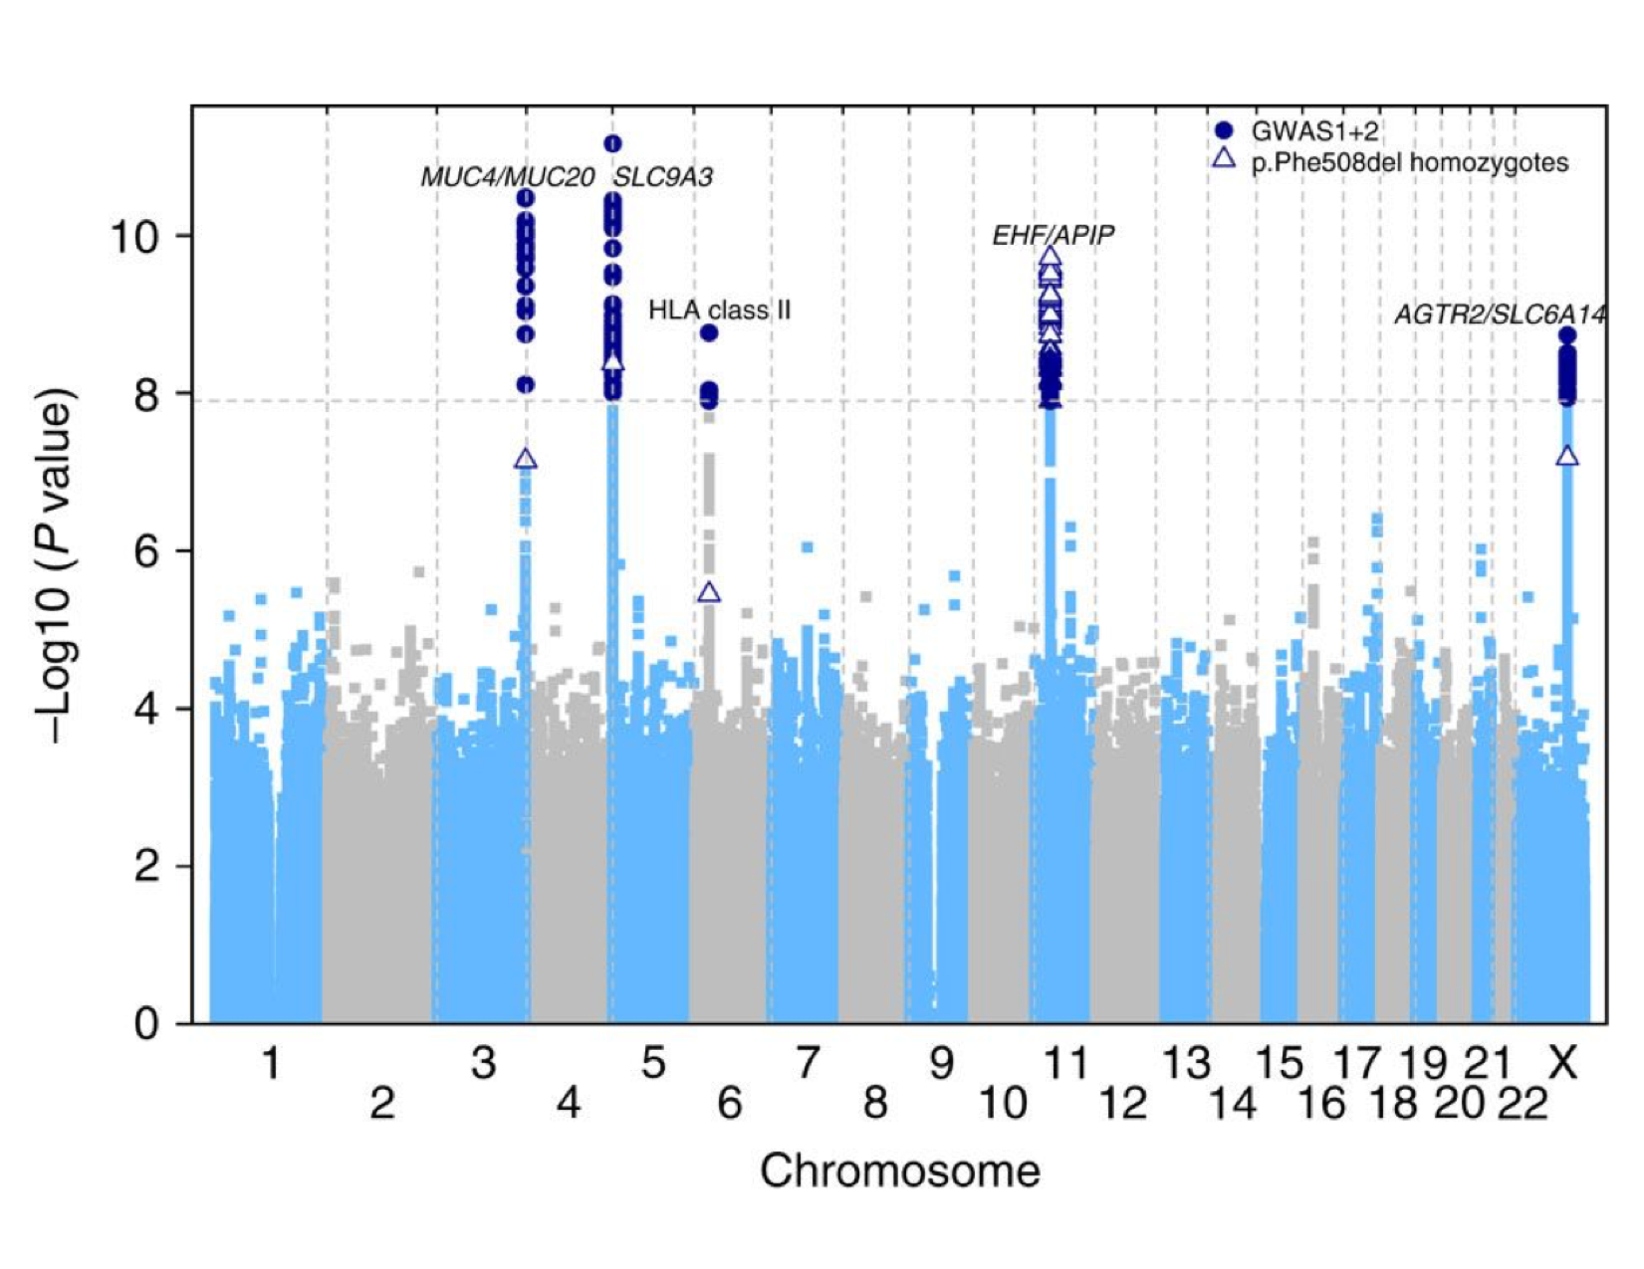


Does SLC26A9 contribute to CF lung disease?
Largest CF Lung GWAS in international GMS (n=6365); predominantly Phe508del/Phe508del
Two genes positively co-expressed in Alveolar Type 2 (log ratio = 0.0003 5, p=0.00974)
Corvol et al. 2015, Nat Comm.
Mirdita et al 2022; Travaglini, K. J. et al, Nature, 2020
Wang et al. BioRXiv 2023
13
13
13

Slide 14
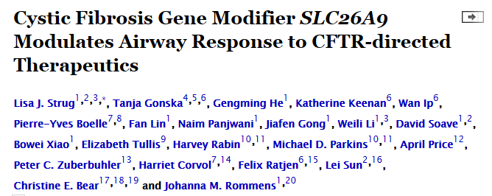
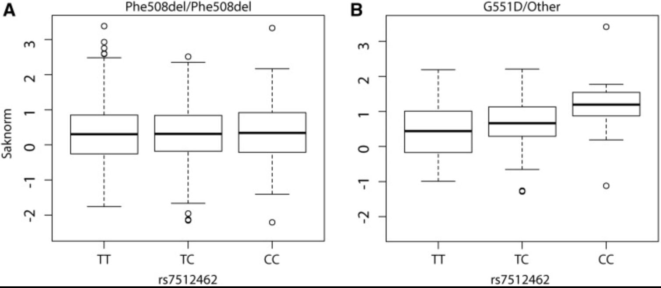
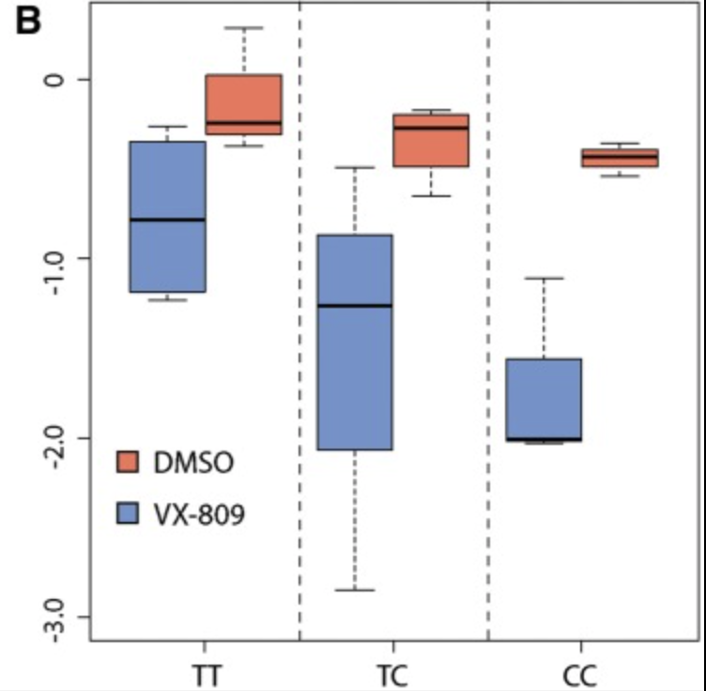
HIGHLIGHTS
A. rs7512462 C allele associated with improved lung function with a gating mutation (cell-surface protein)
B. Rs7512462 C allele associated with improved lung function response to Ivacaftor (not shown)
C. CFTR-mediated current in Phe508del CF-monolayers with VX-809 treatment is dependent on rs7512462 genotype
A
C
Lower is greater function
Boxplots of lung function (Saknorm) measures grouped by rs7512462 genotype;
(Left) individuals homozygous for Phe508del (n = 1,759) and (right) individuals with a G551D allele (n = 70).
Notes:
Forskolin-stimulated currents were assessed in cultured primary human bronchial cells from n = 11 individuals with homozygous Phe508del CF alleles treated with VX-809 or vehicle only (DMSO, n = 10). CFTR function (ΔIeq-forskolin) was measured as the current difference obtained with and without forskolin stimulation. More negative ΔIeq-forskolin values are associated with greater CFTR activity. (A) Individual trajectories of ΔIeq-forskolin measures with vehicle followed by VX-809 treatments are shown color-coded by rs7512462 genotype; one sample treated with VX-809 had a missing vehicle measurement. (B) Boxplots of the ΔIeq-forskolin with VX-809 treatment (blue) and DMSO vehicle measurements (red) stratified by rs7512462 genotype.

Slide 15
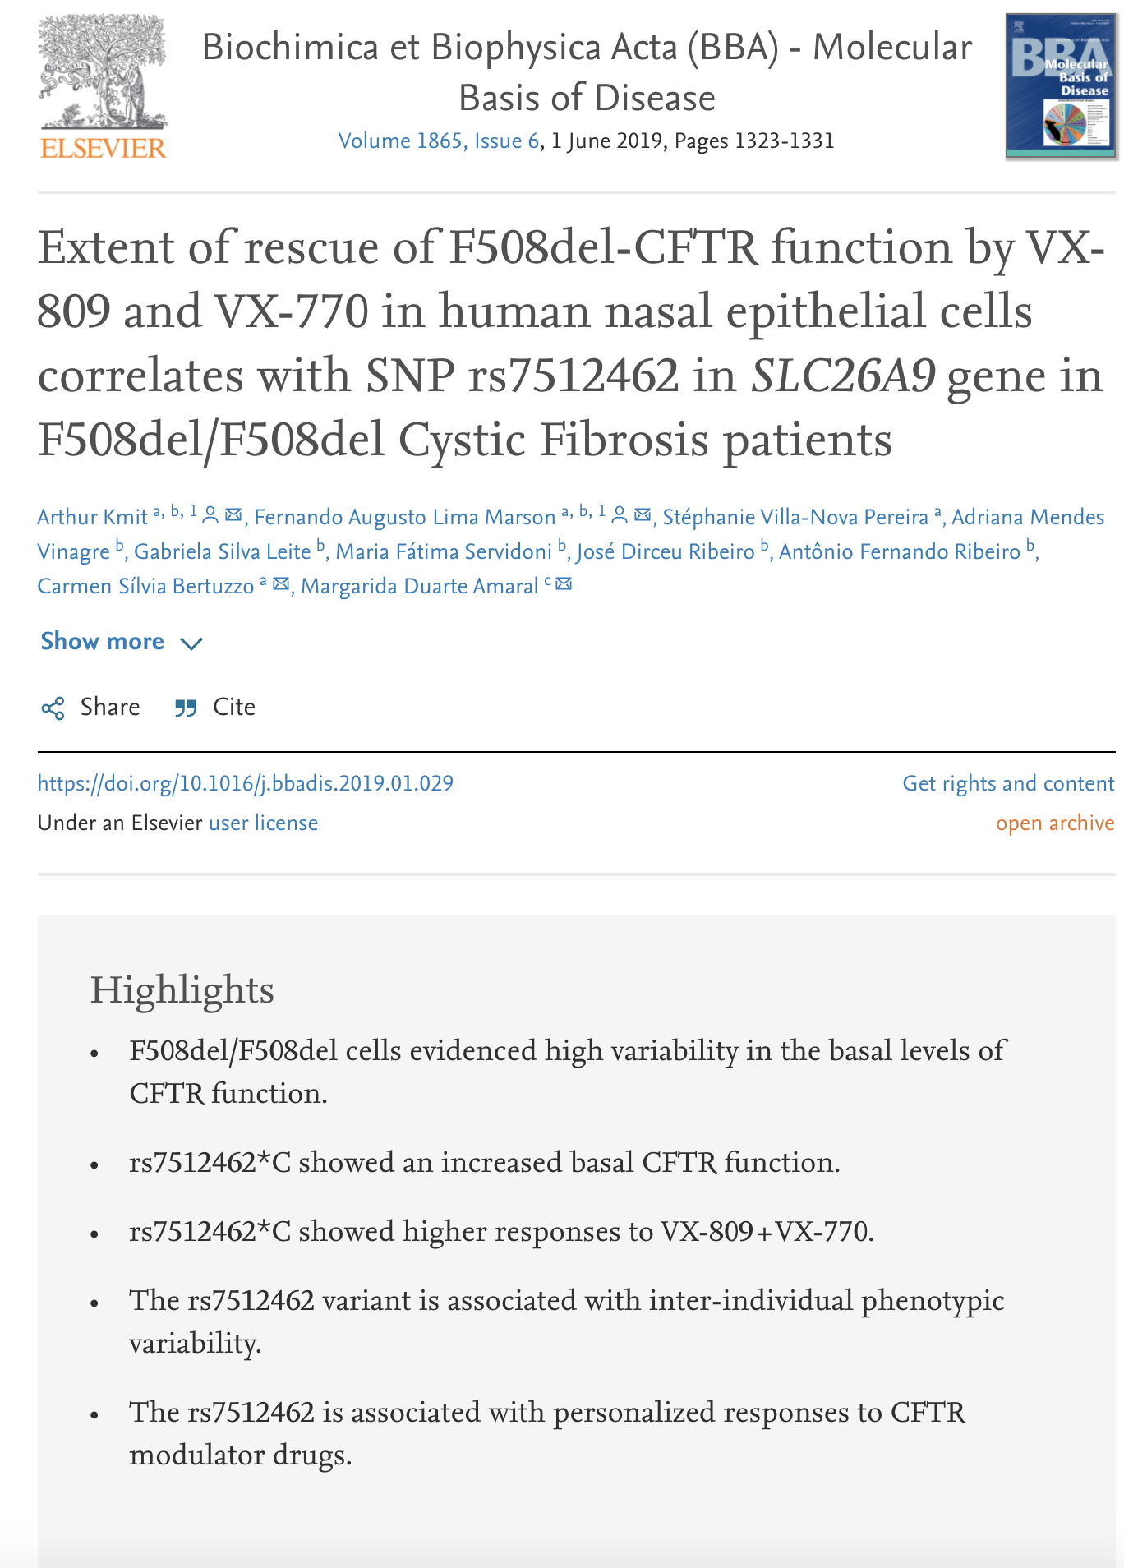
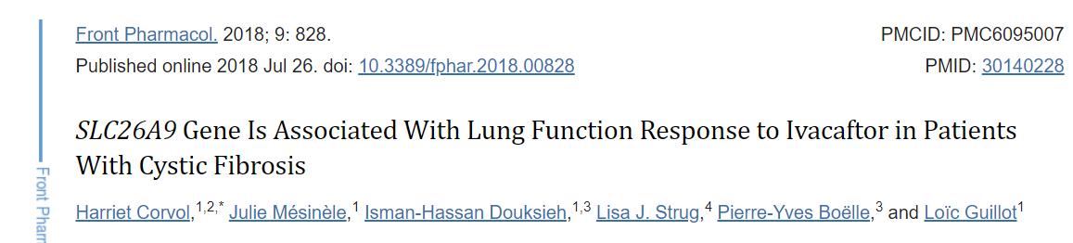
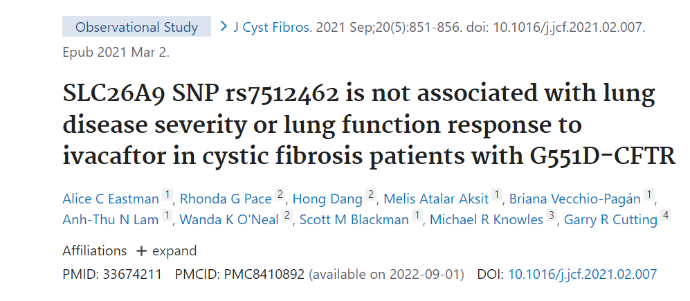
Independent Follow-up Studies
Opposite opinions
Notes:
- Including support but

Slide 16
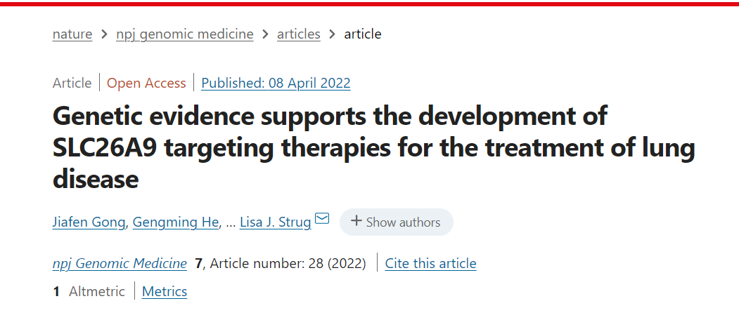
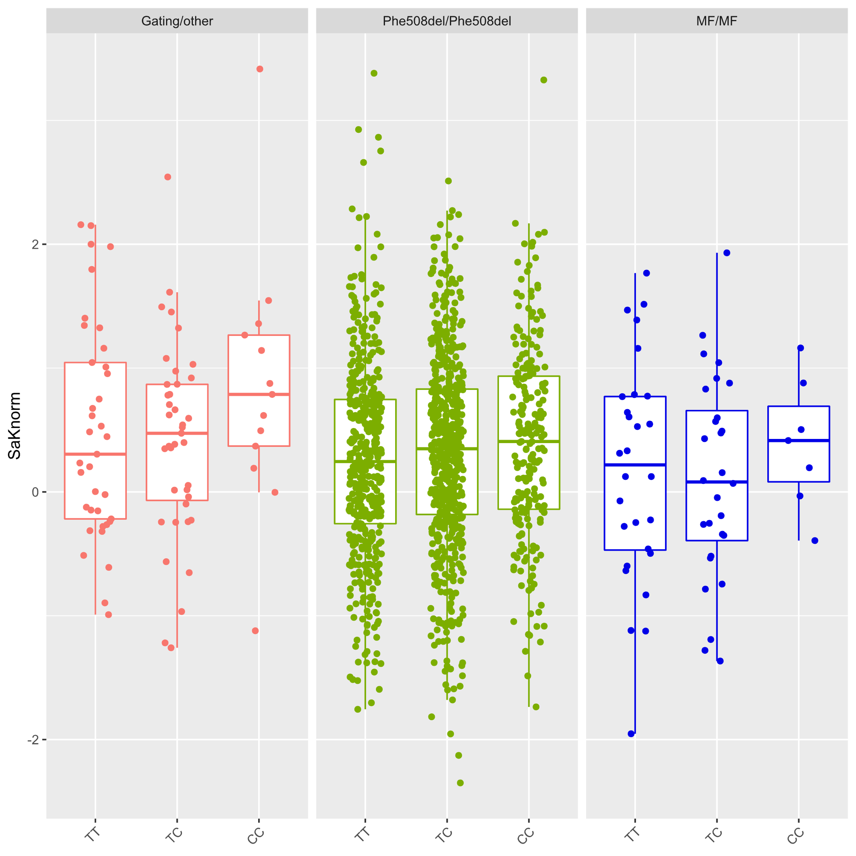
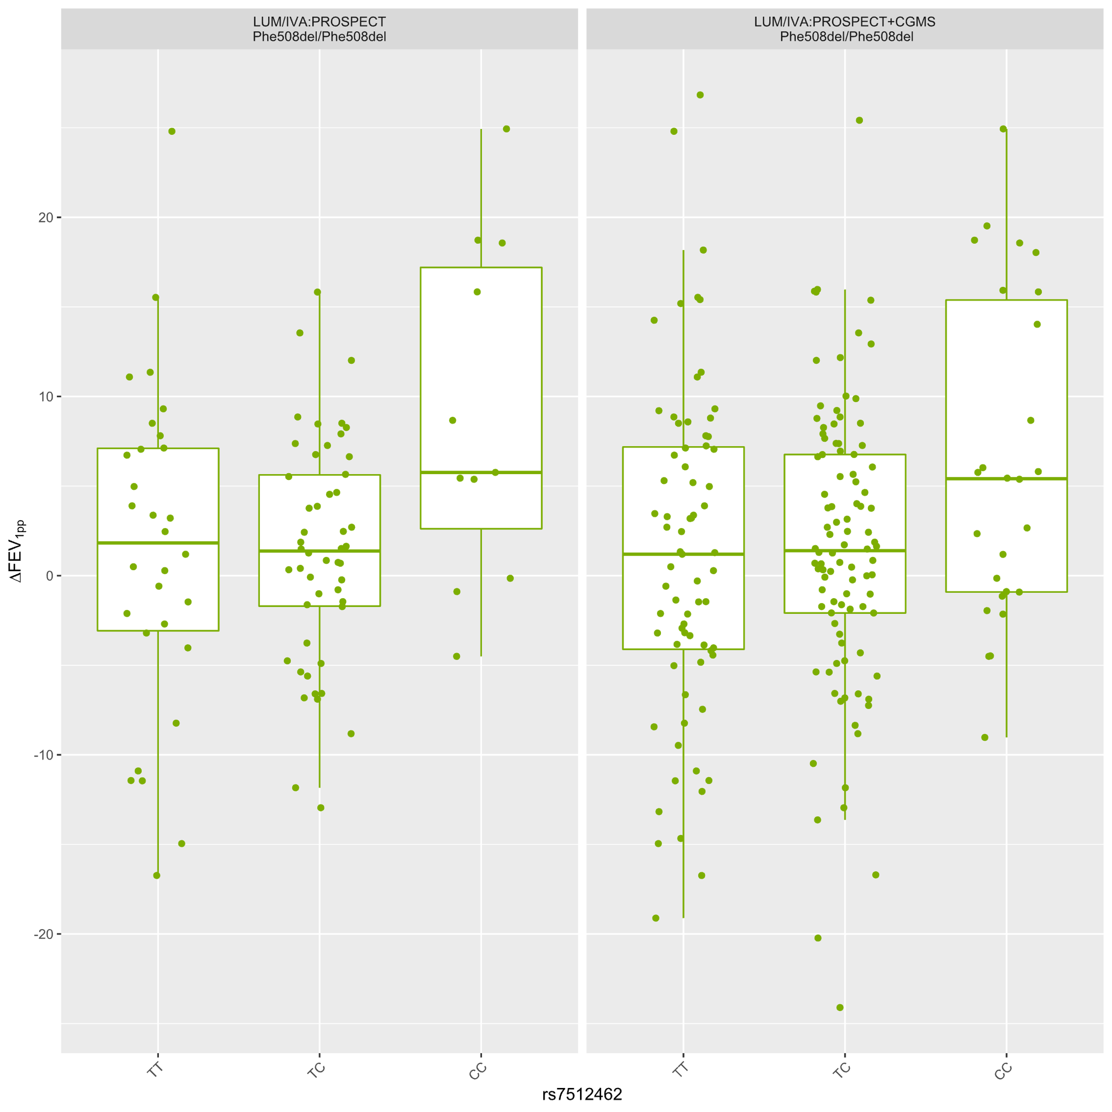
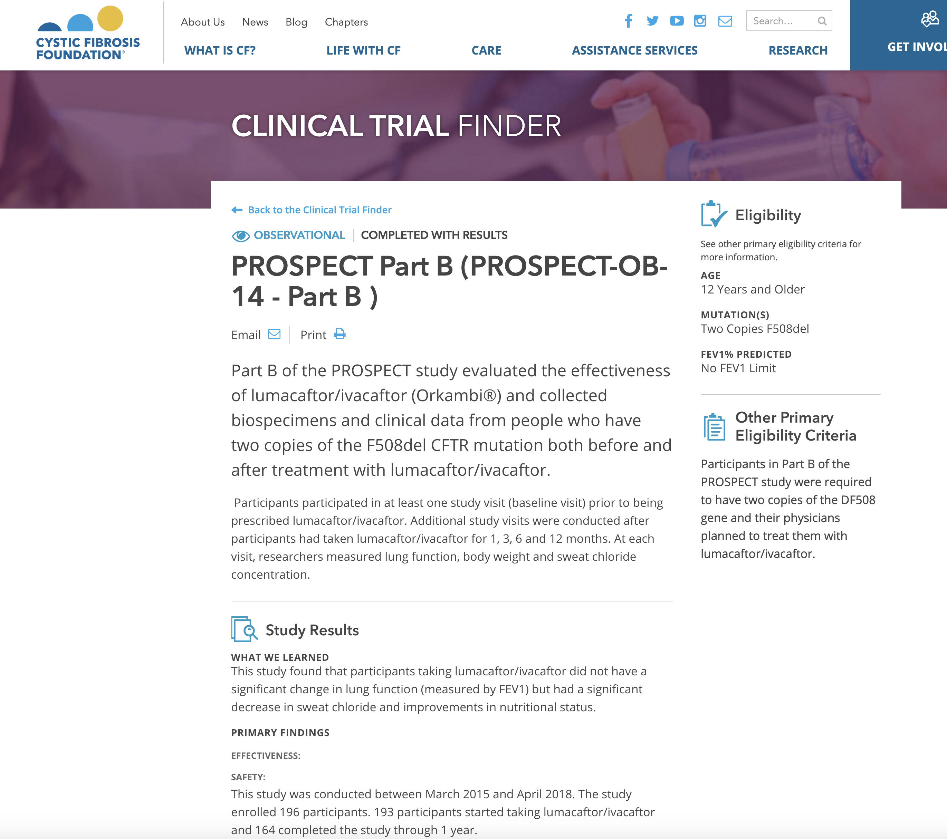
Rs7512462 is associated with lung function across mutations (no treatment)
p=0.05
p=0.021
p=0.008
Treatment response to ORKAMBI
rs7512462: different populations, different modulators,
different phenotypes
Canadians with CFTR mutations that produce no protein product
Canadians on Ivacaftor (larger data set)
Canadians and Americans on ORKAMBI
Some new functional data in HNEs
Beyond CF: GWAS results of other phenotypes by other groups
*Collaboration with the PROSPECT
US ORKAMBI Observational trial
Notes:
Brought together population genetic evidence to investigate the benefits of A9 for GI and
Although A9 variants do not reach genome-wide significance for lung disease in CF, does

Slide 17
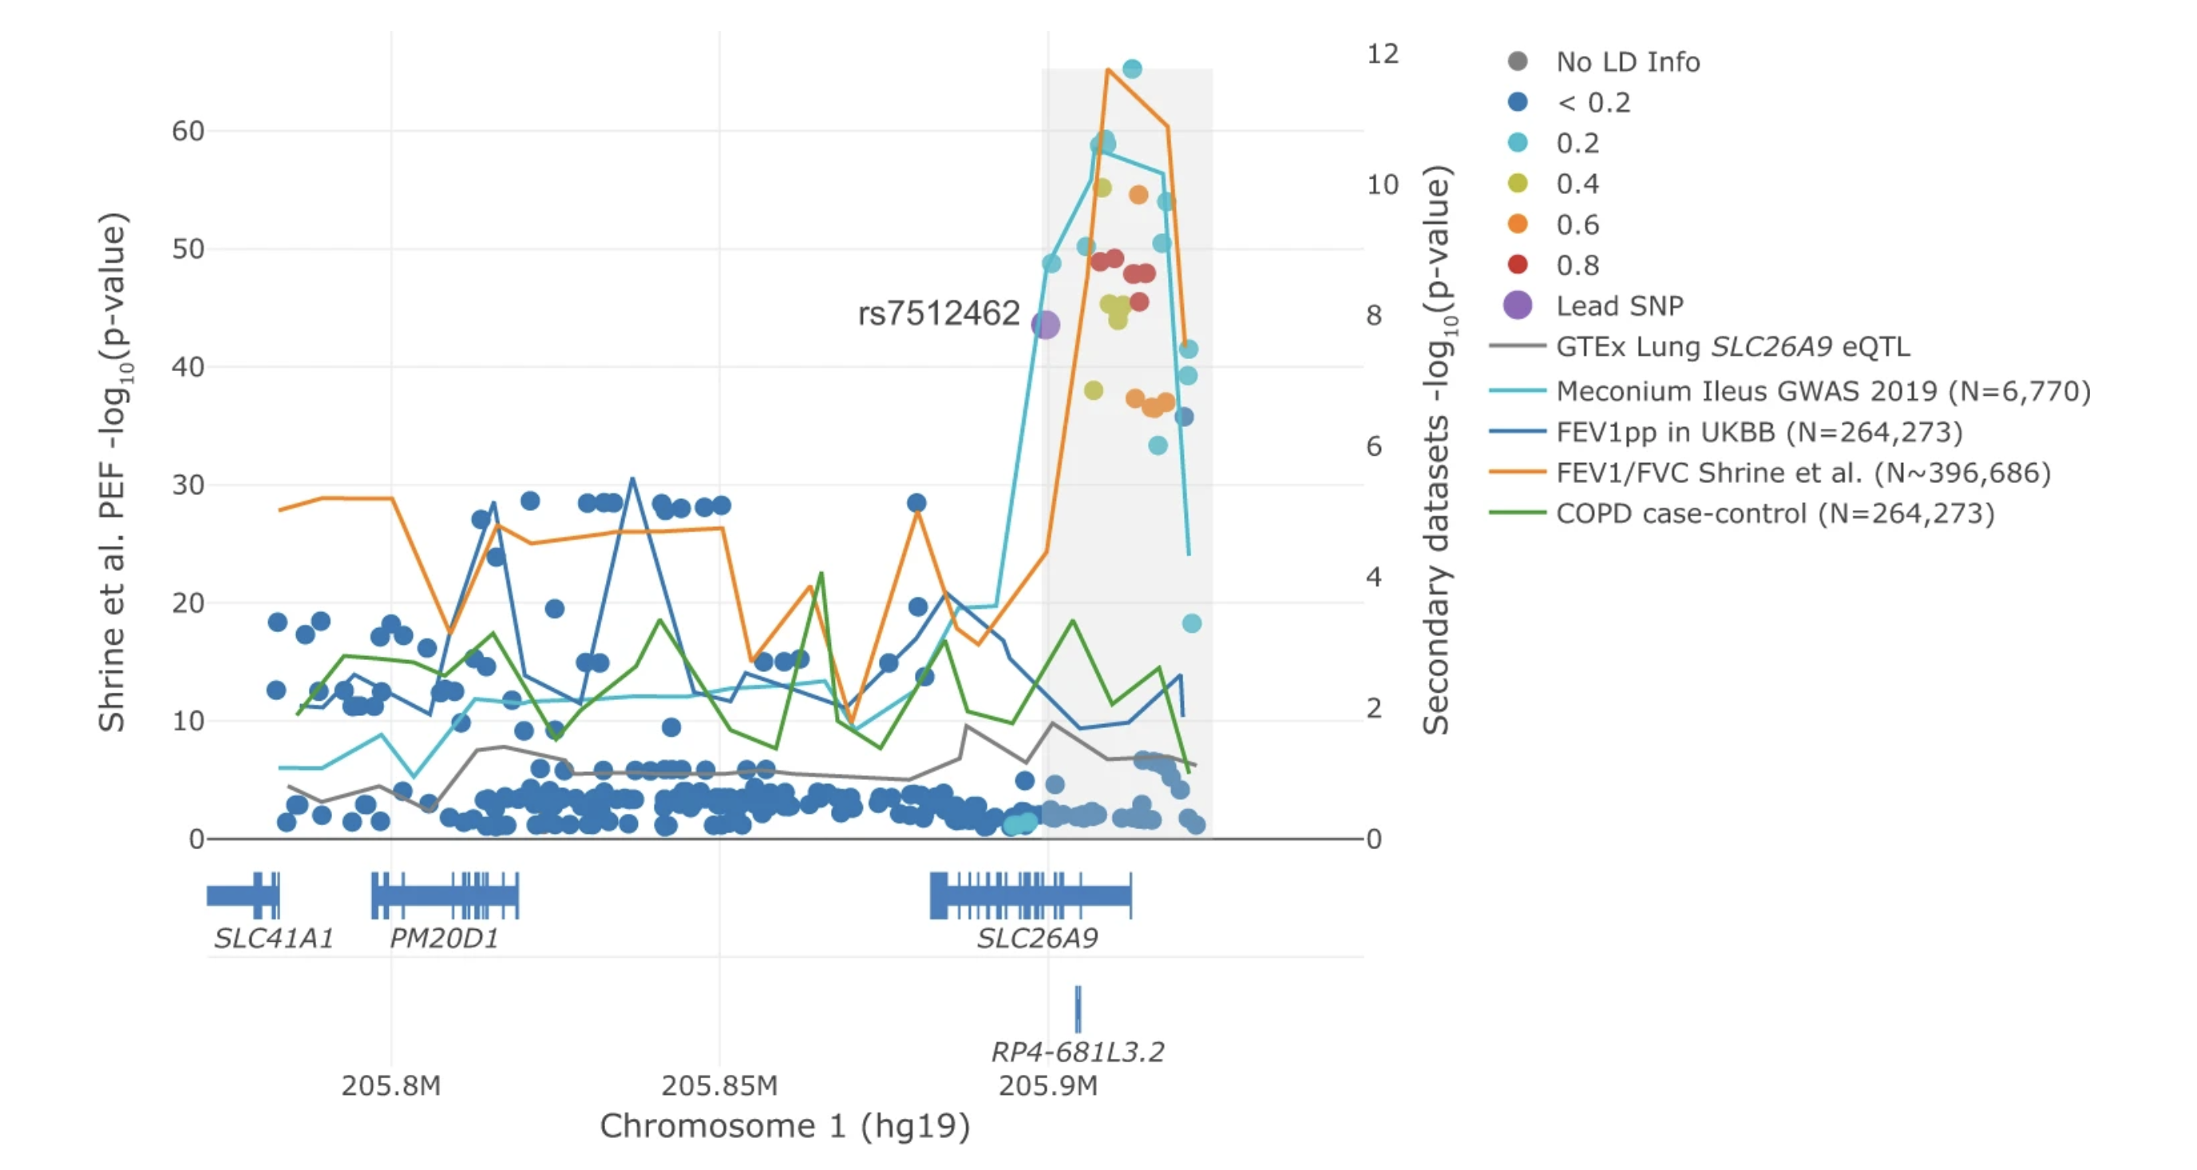
Non- CF results analogous to CFTR DF/DF correction
Rs7512462 is associated with lung function in the general population (UKBiobank)
Shrine et al. 2019 Nat Gen
Notes:
Suggesting there is some interaction with CFTR

Slide 18
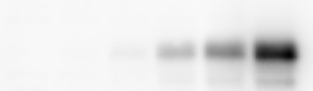
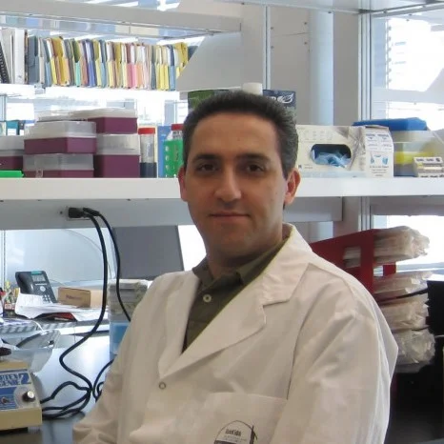
Aim: Identify small molecules that activate SLC26A9
Assay development: SLC26A9 activity is measured by FLIPR assay
GripTite-SLC26A9
Dox (ng/ml) (24 h)
0 5 10 20 30 50
SLC26A9
Johanna Rommens
Mohsen Esmaeili
95 kDa
95 kDa
Calnexin

Slide 19


Drug screening identified 15 candidate agonists
Primary screen: 104,280 compounds
Auto-fluorescent compounds
Frequent hitters
Counter-screen
Dose response
Hit profiling
MedChem
analysis
Visual inspection for clusters
Structural alert filters
Druglikeness
15 candidate agonists
Relevant dose-response curves
Low EC₅₀ values
Good or moderate QED scores (Quantitative Estimate of Druglikeness)

Slide 20
Representative agonist increases SLC26A9 response
GripTite-SLC26A9
Lung cell line
(H2122)

Slide 21
SLC26A9 knockdown decreased agonist effect
SLC26A9 knockdown effect for candidate agonists tested by FLIPR assay in GripTite-SLC26A9 cells
Compound | Reduced response (%)# | p value
DMSO | 49.3 | 0.0010
013 | 39.4 | 2.8E-05
026 | 33.9 | 0.0006
037 | 33.2 | 0.0014
038 | 36.8 | 0.0041
70%
# Reduced response denotes decreased membrane potential response for SLC26A9 siRNA-treated cells compared to non-target siRNA

Slide 22
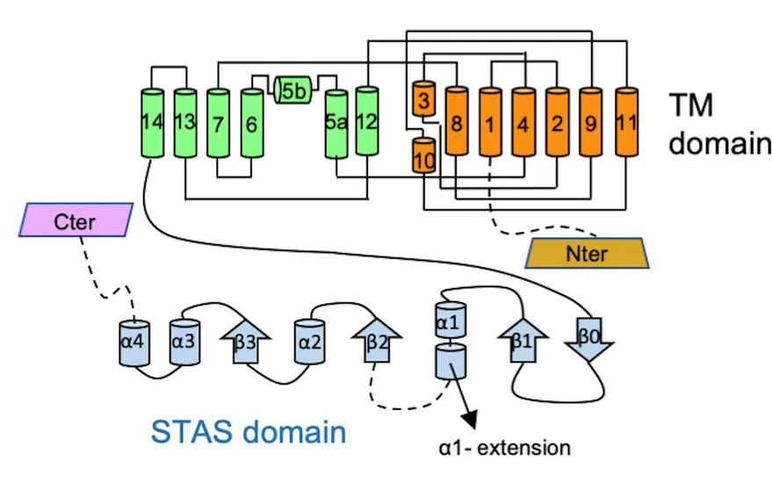

Computational Hit-to-Lead provided derivatives
SiteMap tool: To identify potential drug-binding pockets on SLC26A9
Homology-based deep learning method (DiffDock): To validate the proposed binding sites
Molecular docking and similarity-based scoring techniques:
To navigate the vast realm of molecular possibilities in the
Enamine REAL Space to select top derivatives
Proposed model structure of SLC26A9 from Chi et al, 2020
High potency derivatives
Computational design of derivatives
SLC26A9 agonists
FLIPR assay
9
Alan Aspuru-Guzik, UofT
Notes:
Structure activity relationship analysis, including quantitative approaches that use regression, NN (AI) and PCA to analyze the derivatives. Will also carry out AI-assisted binding analysis eg. Boltz-2.
Computational hit-to-lead campaign ongoing with similarity to our 15 priority compounds to increase poten

Slide 23
Concluding thoughts
Modifier-directed therapies could complement current therapeutic strategies and GWAS helps us find candidates: data integration guides functional study
Strong population genetic evidence supporting SLC26A9 as an alternative target: GI and lung, CF and non-CF applications
Differences in CF and non-CF lung tissue aligns with functional studies
May complex with - and improve - CFTR function in lung tissue so could aid gene therapies
We now have compounds, cells, models and protocols to investigate/advance the compounds, the role of SLC26A9 in ion transport and its relationship with CFTR
Notes:
Consistent with earlier studies showing SLC26A9 can enhance CFTR channel function

Slide 24









Acknowledgements
Strug Lab
Danny Del Rosso
Katherine Keenan Julie Avolio
Gengming He
Fan Lin
Mohsen Esmaeili
Scott Mastromatteo
Cheng Wang
Jerry Lin
Lehang Zhang
Delnaz Roshandel
Eric Sanders
Shalvi Chirmade
CFIT/CF Center
Canadian CF Gene Modifier Study
Christine Bear​
Felix Ratjen​
Tanja Gonska​
Theo Moraes​
Paul Eckford
Amy Wong
Toronto
Johanna Rommens Lei Sun Felix Ratjen Melinda Solomon
Elizabeth Tullis
Anne Stephenson Julie Avolio
Katherine Griffin
Jennifer Pike
Kamalprit Chokar
Ontario April Price
Michael Derynck
Joe Reisman
Mary Jackson
Linda Pineau
Erin Fleischer Natalie Henderson Joanne Hammel
Daniel Veniott
Newfoundland Mary Jane Smith
Saskatchewan Janna Brusky Lorna Kosteniuk
British Columbia
Andy Sanford
Bradley Quon
Pearce Wilcox
Mark Chilvers
Vanessa McMahon
Caroline Burgess
Tony Guo
Ekjot Sangha
Alberta Michael Parkins
Candice Bjornson
Winnie Leung
Lori Fairservice
Claire Smith
Valerie Levesque
Angela Hillaby
Amy Haarsma
Manitoba Shaikh Iqbal
Québec
CHUM
Emmanuelle Brochiero
Yves Berthiaume
Damien Adam
Sandra Morissette
Guillaume Cote-Maurais
Laval
Lara Bilodeau
Nathalie Vadeboncoeur
Élise Boucher
Sherbrooke
Christelle Bergeron
Josee Lessard
Montreal Children's
Larry Lands
Joanie Gonthier
Shakiba Rahimeyanjo
Nova Scotia Dimas Mateos-Corral Daniel Hughes
Nancy Morrison Paula Barrett Christine Donnelly Andrea Dale
Frances Gosse
AI Matter Lab
Alán Aspuru-Guzik
Aksgat Nigam
Ella Rajaonson​
International GMC
Ann Harris
Hariet Corvol
Loïc Guillot
Chris Fladd
TCAG
Bhooma Thiruv
Liz Li
Zhouzhi Wang
Sana Allana
Canadian CF Patients
and Families​

